Slide 1
A quick overview of Basic Statistical Analysis

Slide 2
Disclaimer!!!
These slides are based off the slide deck used for the multilevel course presented by Paul Bliese at CARMA

Slide 3
Agenda
Levels Introduction
Estimating Multilevel Models in R
Aggregation: Agreement and Reliability
OLS Contextual Analysis and Fixed-Effects approaches
Mixed Effects Models (e.g., Random Effects, HLM)
Growth Modeling
Optional
Discontinuous Growth Modeling
Emergence Models

Slide 4
Multilevel Analysis
Primary Assumption in Statistical Analysis
Observations are not related to each other (non-interdependence)
In other words…
One observation is not “more correlated” with another observation than with any other observation
The error terms are not correlated
There is no “nesting” of data (i.e., observations from multiple individuals within the same group; repeated observations of multiple organizations)
But is this assumption always true?

Slide 5
Multilevel Analysis
Organizational data is inherently hierarchical
Individuals in groups/teams
Groups/teams in departments
Departments in organizations
Repeated measures data are also very common (Panel Data)
Entities such as individuals, teams, firms measured over time
Repeated measures nested in higher-level entities have additional complexities
Autocorrelation
Heteroscedasticity (may be of substantive interest: Emergence Models)

Slide 6
Multilevel Analysis
Introduction

Slide 7
Multilevel Analysis
Outline
Describe the common problems in organizational data
Hierarchical nesting structure of data
Describe the purpose/usefulness of multilevel modeling
Alignment of theory and analyses (avoid inferential errors)
Modeling contextual effects
Statistical model specification

Slide 8
Multilevel Analysis
Why is it important to think about data nesting?
Helps align theory with analyses and avoid inferential errors
Provides a way to expand theory by modeling contextual effects
Helps avoid incorrectly specifying statistical models in data structures common in applied research

Slide 9
Multilevel Analysis
Alignment of Theory and Analysis

Slide 10
Multilevel Analysis – Alignment
Alignment of level of analysis and level of inference is important!
Misalignment can lead to incorrect inferences (Diez-Roux, 1998)
Ecological Fallacy – using aggregate-level results to make inferences about individuals
Atomistic Fallacy – using individual-level results to make inferences about groups

Slide 11
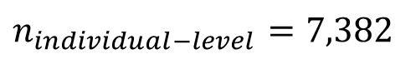
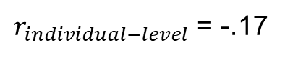
Multilevel Analysis – Alignment
Individual-level correlation between work hours and well-being is low (Bliese & Halverson, 1996)
$$n_{individual−level}=7,382$$
5
4
Individuals
3
Well-Being
$r_{individual−level}$ = -.17
2
1
0
8
10
12
14
Daily Hours Worked

Slide 12

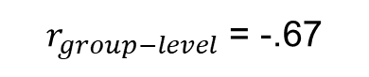
Multilevel Analysis – Alignment
Group-level correlation between work hours and well-being is much stronger (Bliese & Halverson, 1996)
$$n_{group−level}=99$$
5
4
3
Well-Being
2
$r_{group−level}$ = -.67
Groups
1
0
8
10
12
14
Daily Hours Worked

Slide 13
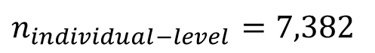
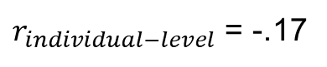
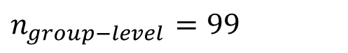
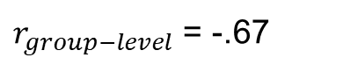
Multilevel Analysis – Alignment
Which correlation is right?
$$n_{individual−level}=7,382$$
5
$$n_{group−level}=99$$
Individuals
4
3
Well-Being
$r_{individual−level}$ = -.17
2
$r_{group−level}$ = -.67
Groups
1
0
8
10
12
14
Daily Hours Worked

Slide 14
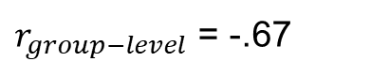
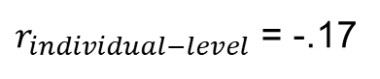
Multilevel Analysis – Alignment
Which correlation is right?
$r_{individual−level}$ = -.17
Group-level correlation is right if we want to make inferences about groups.
Individual-level correlation is right if we want to make inferences about individuals.
Mismatch results in a fallacy – either ecological or the atomistic
$r_{group−level}$ = -.67
5
4
Individuals
3
Well-Being
2
Groups
1
0
8
10
12
14
Daily Hours Worked

Slide 15
Multilevel Analysis - Alignment
Different results at different levels of analysis raise conceptual questions about the link between lower-level and aggregate variable.
When results differ across levels, lower-level and aggregate variables may be non-isomorphic
Individual work hour preferences versus externally mandated work requirements for the group
Individual well-being versus share strain
When results are the same across levels, it suggest isomorphism of variables

Slide 16
Multilevel Analysis - Alignment
Econometric Example (“Real Econometrics” by Bailey)
Do Police Reduce Crime?
Panel Data – Numerous years of data from 5 large Californian cities
Model –
Robberies (across numerous years for each city)
Police per 1,000 people (across numerous years for each city)

Slide 17
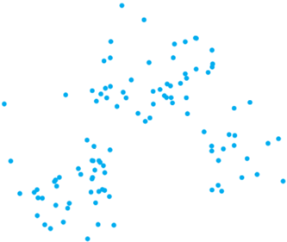
Multilevel Analysis - Alignment
Here is a scatterplot of the data. (Figure 8.1 from “Real Econometrics”)
How should we analyze it?
12
10
Robberies per 1,000 people
8
6
4
2
2
3
Police per 1,000 people

Slide 18
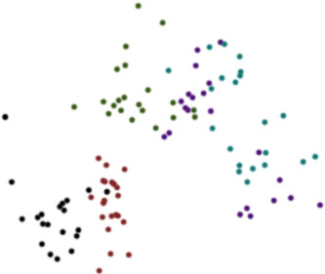
Multilevel Analysis - Alignment
Data comes from different geographic regions…
Does this change how we should analyze it?
12
Oakland
10
San Francisco
Robberies per 1,000 people
8
6
4
Los Angeles
Fresno
Sacramento
2
2
3
Police per 1,000 people

Slide 19
Multilevel Analysis - Alignment
We could group-mean center the variables and run a regression.
Does this test our research question?
12
Oakland
10
San Francisco
Robberies per 1,000 people
8
6
4
Los Angeles
Fresno
Sacramento
2
2
3
Police per 1,000 people

Slide 20
Multilevel Analysis - Alignment
Ideally, we would want to allow for different regression lines for each geographic area
12
Oakland
10
San Francisco
Robberies per 1,000 people
8
6
4
Los Angeles
Fresno
Sacramento
2
2
3
Police per 1,000 people

Slide 21
Multilevel Analysis - Alignment
In econometrics, the idea of isomorphism (or lack thereof) indicates a form of endogeneity
“A common source of endogeneity in the use of a pooled model to analyze panel data is that the specific units have different baseline levels of Y, and these levels are correlated with X… creating a correlation between the error term and the independent variable” (p 253, Bailey)

Slide 22
Multilevel Analysis - Alignment
In econometrics, the idea of isomorphism (or lack thereof) indicates a form of endogeneity
In the pooled data, many city-level factors go into the error term for robberies (drug use, gang membership) and correlate with the average number of police officers
City-level factors associated with the error term produce increases in the number of police officers
We can eliminate city-level endogeneity (but not all endogeneity) using fixed effects or demeaned variables

Slide 23
Multilevel Analysis - Alignment
Aggregation Models describe the theoretical link between lower-level and aggregate variables
See James (1982), Chan (1998), Klein & Kozlowski (2000), Bliese (2000)
Agreement and reliability indices are used to validate the aggregation model
Intraclass correlation coefficients (ICCs): Non-isomorphism
Within-group agreement: Evolved out of isomorphism assumption

Slide 24
Multilevel Analysis - Alignment
Summary of Key Points
Why is it important to consider clustering of nested data from groups?
To ensure analyses and theory are aligned
To avoid inferential fallacies
Key analytic points raised
Need to clearly understand what models are testing
Need to specify aggregation model to consider how lower and aggregate variables are related

Slide 25
Multilevel Analysis
Modeling Context

Slide 26
Multilevel Analysis – Modeling Context
The second reason why it is important to consider clustering of nested data from groups is to explicitly account for contextual effects
Contextual effects may have a direct effect on group averages of outcome
Contextual effects may moderate (cross-level interaction) strength of lower-level relationships

Slide 27
Multilevel Analysis – Modeling Context
Example: Social context is often absent in work-stress research
Individual Moderators
•Hardiness
•Job Involvement
•Self Efficacy
Stressors
•Work Hours
•Lack of Purpose
•Role Conflict
Strains
•Morale
•Well being

Slide 28
Multilevel Analysis – Modeling Context
Individual Moderators
•Hardiness
•Job Involvement
•Self Efficacy
Stressors
•Work Hours
•Lack of Purpose
•Role Conflict
Strains
•Morale
•Well being
Contextual Variables
•Cohesion
•Collective Efficacy

Slide 29
Multilevel Analysis – Modeling Context
Data from bh1996
Each cell represents one Army Company
Note the differences in slopes and intercepts (mean well-being values)
Are these reliable differences?
If so, what group-level variables explain these differences?
Notes:
xyplot(WBEING~HRS|as.factor(GRP),data=bh1996[1:1582,],
subset=HRS>5&HRS<19,
type=c("p","g","r"),col="dark blue",col.line="black",
xlab="Work Hours",
ylab="Well-Being")

Slide 30
Multilevel Analysis – Modeling Context
Here is another data set.
What do you notice about the intercepts?
What do you notice about the slopes?
Do you think there are potential group-level factors causing these differences?

Slide 31
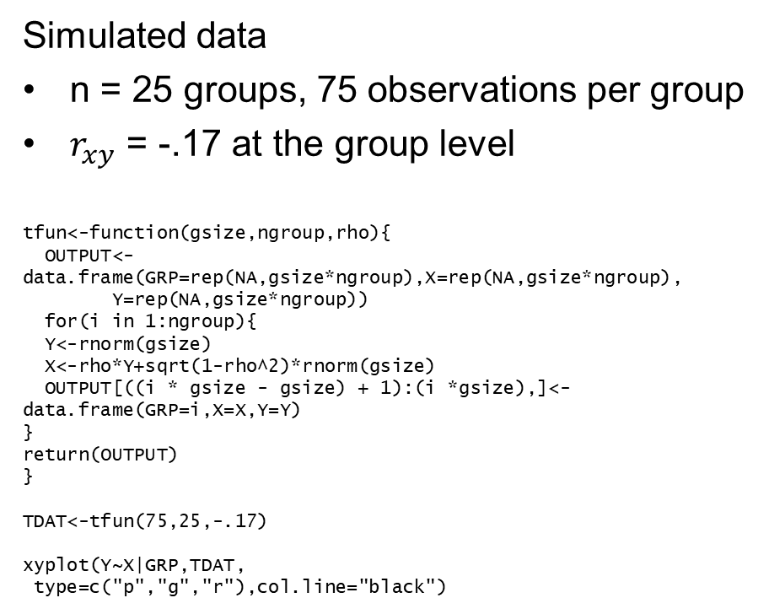
Multilevel Analysis – Modeling Context
Simulated data
n = 25 groups, 75 observations per group
$r_{xy}$ = -.17 at the group level
tfun<-function(gsize,ngroup,rho){
OUTPUT<-data.frame(GRP=rep(NA,gsize*ngroup),X=rep(NA,gsize*ngroup),
Y=rep(NA,gsize*ngroup))
for(i in 1:ngroup){
Y<-rnorm(gsize)
X<-rho*Y+sqrt(1-rho^2)*rnorm(gsize)
OUTPUT[((i * gsize - gsize) + 1):(i *gsize),]<-data.frame(GRP=i,X=X,Y=Y)
}
return(OUTPUT)
}
TDAT<-tfun(75,25,-.17)
xyplot(Y~X|GRP,TDAT,
type=c("p","g","r"),col.line="black")

Slide 32
Multilevel Analysis – Modeling Context
Platoon-Level Variation in the Relationship Between Combat Exposures and Acute Stress
It becomes difficult to tell when there are actual, important contextual factors at play

Slide 33
Multilevel Analysis – Modeling Context
We can extend the idea of modeling group-level factors to consider changes over time
In panel data, time is often controlled (fixed effects for time), but not modeled substantively
Goal is to model how attributes of the higher-level entity relates to:
Overall mean differences
Patterns of change over time

Slide 34
Multilevel Analysis – Modeling Context
Example of “Changes over time” analysis
Some slopes increase
Some slopes decrease

Slide 35
Multilevel Analysis – Modeling Context
You can model complex changes over time
Bliese, McGurk, Thomas, Balkin & Wesensten (2007)

Slide 36
Multilevel Analysis – Modeling Context
You can model complex changes over time
Lang & Bliese (2009)

Slide 37
Multilevel Analysis – Modeling Context
You can model complex changes over time
Rupp, Wesensten, Bliese & Balkin (2009)

Slide 38
Multilevel Analysis – Modeling Context
You can model complex changes over time
Bliese & Lang (2016)

Slide 39
Multilevel Analysis – Modeling Context
Summary of Key Points
Why is it important to consider clustering of nested data from groups?
To understand the role of context
To enrich organizational models
Model context using:
OLS contextual analysis and Fixed-Effects approaches
Mixed-Effects models (e.g., Random Effects, HLM)
Growth Modeling

Slide 40
Multilevel Analysis
Accounting for Variance

Slide 41
Multilevel Analysis - Variance
Third reason why it is important to consider clustering of nested data from groups is to correctly account for the sources of variance
Variance across levels can affect validity of statistical tests:
Pooled results (slopes/parameter estimates) may be confusing and inaccurate
Standard errors may be biased resulting in biased t-values
Incorrect conclusions about what is and is not significant

Slide 42
Multilevel Analysis - Variance
GRP | PERS.COHES | GRP.COHES | WBEING
1 | 3.25 | 2.93 | 3.33
1 | 3.38 | 2.93 | 2.11
1 | 3.75 | 2.93 | 4.39
1 | 4.00 | 2.93 | 1.72
17 | 2.13 | 3.43 | 2.83
17 | 3.00 | 3.43 | 3.22
17 | 3.00 | 3.43 | 3.28
17 | 3.25 | 3.43 | 3.17
80 | 1.50 | 2.57 | 3.00
80 | 1.75 | 2.57 | 1.83
80 | 2.88 | 2.57 | 0.94

Slide 43
Multilevel Analysis - Variance
Group-Level Variable
 | Value | Std.Error | t-value
Group Cohesion: OLS | 0.281 | 0.051 | 5.505
Group Cohesion: lme | 0.314 | 0.097 | 3.233
Individual-Level Variable
 | Value | Std.Error | t-value
Personal Cohesion: OLS | 0.254 | 0.014 | 18.121
Personal Cohesion: lme | 0.249 | 0.012 | 20.78
Bliese (2002)

Slide 44
Multilevel Analysis - Variance
Bliese & Hanges (2004) - Simulation

Slide 45
Multilevel Analysis – Variance
Summary of Key Points
Why is it important to consider clustering of nested data from groups?
It is important to model the hierarchical nature of data to account for known sources of variance
Reduces bias in statistical models
Key theoretical and analysis points raised:
How do we account for sources of variation?
Fixed-Effect models (econometrics)
Mixed-Effect models (e.g., random effects, HLM)

Slide 46
Multilevel Analysis – Case Study for Variance
A National Guard Army group assigned embedded behavioral health providers to Companies
5 Companies with embeds (n = 453)
7 Companies without embeds (n = 679)
Large sample of individuals in each condition
Research Question: Does having an embedded provider result in any positive outcomes?
Estimate regression models for depression sum and collective efficacy
Regress depression sum on embed (0/1)
Regress collective efficacy sum on embed (0/1)

Slide 47
Multilevel Analysis – Case Study for Variance
Depression results (NS)
Collective efficacy results (very encouraging!)
> round(summary(lm(MDDsum~embedprov,data=embed,
na.action=na.omit))$coef,dig=4)
Estimate Std. Error t value Pr(>|t|)
(Intercept) 11.7835 0.1801 65.4371 0.0000
embedprov 0.5032 0.2850 1.7656 0.0777
> round(summary(lm(rdnssum~embedprov,data=embed,
na.action=na.omit))$coef,dig=4)
Estimate Std. Error t value Pr(>|t|)
(Intercept) 13.5682 0.1395 97.2891 0.0000
embedprov 0.6942 0.2209 3.1426 0.0017

Slide 48
Multilevel Analysis – Case Study for Variance
Results suggested that having an embedded provider:
Was not directly related to mental health
Was related to unit performance indices (a good news story!)
Paper was submitted and one reviewer noted:
“The correct unit of analysis is the NG units, not the individuals who compose those units. The multivariate analyses do not appear to control for clustering of individuals within units, and it is not clear whether there are a sufficient number of units in terms of power.”

Slide 49
Multilevel Analysis – Case Study for Variance
Reviewer was right!
Because the regression models had level-2 predictors (predictors constant among members of the same group) our results were likely to be highly biased and overly liberal
The only way our regression results would have been okay in this design is if the level of non-independence in the outcome was zero; however…

Slide 50
Multilevel Analysis – Case Study for Variance
Depression results (sample sizes equal)
> tmod<-aov(MDDsum~as.factor(bn.co),embed,na.action=na.omit)
> ICC1(tmod)
[1] 0.03868019
> round(summary(lm(MDDsum~embedprov,data=embed,na.action=na.omit))$coef,dig=4)
Estimate Std. Error t value Pr(>|t|)
(Intercept) 11.7835 0.1801 65.4371 0.0000
embedprov 0.5032 0.2850 1.7656 0.0777
> round(summary(lme(MDDsum~embedprov,random=~1|bn.co,
data=embed,na.action=na.omit))$tTable,dig=4)
Value Std.Error DF t-value p-value
(Intercept) 11.9314 0.4251 1080 28.0660 0.0000
embedprov 0.7510 0.6645 10 1.1302 0.2848

Slide 51
Multilevel Analysis – Case Study for Variance
Collective efficacy results (sample sizes equal)
> tmod<-aov(rdnssum~as.factor(bn.co),data=embed,na.action=na.omit)
> ICC1(tmod)
[1] 0.08008846
> round(summary(lm(rdnssum~embedprov,data=embed,na.action=na.omit))$coef,dig=4)
Estimate Std. Error t value Pr(>|t|)
(Intercept) 13.5682 0.1395 97.2891 0.0000
embedprov 0.6942 0.2209 3.1426 0.0017
> round(summary(lme(rdnssum~embedprov,random=~1|bn.co,
data=embed,na.action=na.omit))$tTable,dig=4)
Value Std.Error DF t-value p-value
(Intercept) 13.5797 0.4841 1097 28.0521 0.0000
embedprov 0.3317 0.7538 10 0.4400 0.6693

Slide 52
Multilevel Analysis – Case Study for Variance
Key Take Aways
It is easy to use OLS regression and receive misleading results
It is likely that applied organizational data rarely meets the independence criteria underlying the use of regression
Important to have analytic tools that properly account for pre-existing non-independence due to groups

Slide 53

Multilevel Analysis - Additional Reading
Please refer to Bliese, Maltarich, & Hendricks (2019)

Slide 54
Multilevel Analysis
Aggregation, Agreement, and Reliability

Slide 55
Aggregation Models – Purpose
In multilevel research, summary statistics (e.g., group means) of individual responses are often used to represent group-level phenomenon
Goal of this section: Explore the relationship between summary statistics (e.g., group means) and the individual-level response.
Agreement and reliability indices serve as tools to support one’s aggregation model

Slide 56
Aggregation Models
Outline
Discuss Aggregation Models
Define and contrast
Reliability
ICC(1), ICC(2), and eta-squared
Test of significance
Within-group agreement
rwg/rwg(j) and tests of significance

Slide 57
Aggregation Models
Aggregation models address relationships between lower-level and higher-level constructs
All types of variables can be aggregated:
Items with the group as the referent
Cohesion
Collective Efficacy
Items with the self as the referent
Job Satisfaction
Well-Being
Demographic variables (e.g., group diversity)

Slide 58
Aggregation Models
What is the relationship between higher and lower-level variables?
Aggregation model frameworks:
Composition Theory of Climate (James, 1982)
Aggregation Model Typology (Chan, 1998)
Compilation and Composition Models (Kozlowski & Klein, 2000)
Fuzzy Composition Models (Bliese, 2000)
Structure and Function (Morgeson & Hofamnn, 1999)
Each framework focuses on the link between lower and upper level constructs

Slide 59
Aggregation Models - Examples
Composition Theory of Climate (James, 1982)
Organizational Climate (a mean score) is isomorphic with individual climate (an individual-level score), given perceptual agreement
Isomorphism: similarity or one-to-one correspondence between two or more elements
Analysis of group means justified only when within-group agreement is high
Dominant framework for a looooooong time, but limited because group means are often influenced by:
Non-random clustering
A wide range of shared experiences

Slide 60
Aggregation Models- Examples
Bliese, Chan, & Ployhart (2007)

Slide 61
Aggregation Models - Examples
Aggregation Model Typology (Chan, 1998)
Additive (no concern about agreement)
Direct Consensus
Referent of item typically individual-level
Need to establish within-group agreement
Assume functional isomorphism
Referent-shift Consensus Models
Referent of item shifted to group
Within-group agreement still important
Isomorphism not assumed
Dispersion Models
Model within-group variance
Process Models

Slide 62
Aggregation Models - Examples
Compilation / Composition Emergence (Kozlowski & Klein, 2000)
Compilation Process Model
Lower-level data within a group expected to vary
Meaning of aggregate and lower-level variables expected to differ (e.g. demographic diversity)
Agreement not needed
Composition Process Model
Data among group members expected to be same
Meaning of aggregate and lower-level variables expected to be isomorphic
Agreement needed

Slide 63
Aggregation Models – Criticizing Theory
A key element of composition models is the idea that lower-level and higher-level constructs are functionally and structurally isomorphic
Individual work hours = group work hours
Individual psychological climate = group climate
Yet consider Firebaugh (1978):
“an aggregate variable often measures a different construct than its namesake at the individual level”
Can these views be integrated?

Slide 64
Aggregation Models – Criticizing Theory
Bliese (2000) notes that:
True isomorphism exists only when ICC(1) = 1 or ICC(1) = 0 (both rare)
ICC(1) values >) and <1 (common circumstance) creates a situation where an aggregate variable is potentially non-isomorphic with its lower-level counterpart
Theoretically, variables still share meaning even if not isomorphic
This is what Bliese labeled as the “fuzzy composition process” model

Slide 65
Aggregation Models – Criticizing Theory
The “fuzziness” of the composition process is a function of group size and the shared group properties of the data (Bliese, 2000)
In large groups, one can reliably detect subtle group differences. In these cases, the aggregate variable is a “fuzzy representation” of the raw variable
The interpretation of the aggregate variable is still related to the raw variable
e.g., work hours vs. externally mandated work requirements

Slide 66
Aggregation Models - Examples
Construct Validation (Morgeson & Hofmann, 1999)
“measures of an individual-level construct cannot always simply be aggregated and assumed to be a veridical representation of its collective counterpart” (p 260)
Structure and Function
Group construct of “memory” may have same function as individual memory
Structure of group memory may be entirely different than structure of individual memory
Proper construct validity should define group constructs in terms of function and measure based on knowledge of structure

Slide 67
Aggregation Models - Examples
Construct validation in sociology (Sampson, 2003)
“[a]s interest in the behavioral sciences turns increasingly to an integrated scientific approach that emphasizes individual factors in social contexts, a mismatch has arisen in the quality of measures… [t]he basic idea is to take the measurement of ecological properties and social processes as seriously as we have always taken individual-level differences.” (p S57)
Integrated frameworks for multilevel construct validation
Chen, Mathieu, & Bliese (2005)
Bliese, Maltarich, Hendricks, Hofmann, & Adler (2019)

Slide 68
Aggregation Models - Tests
Validating aggregate-level constructs is done using a combination of theory and empirical evidence
Empirical measures used to support aggregation models:
Reliability-based measures (useful to justify fuzzy composition models and Chan’s additive models)
Agreement-based measures (useful in isomorphic models such as Chan’s consensus models
rwg and rwg(i)
Average deviation around mean or median (AD)

Slide 69
Aggregation Models - Tests
Reliability-based Measures
ICC
Measure of the proportional consistency of variance among raters
Intra-class correlation coefficients
ICC(1) (Bartko, 1976) a.k.a. ICC(1,1) (Shrout & Fleiss, 1979) a.k.a ICC (Bryk & Raudenbush, 1992)
ICC(2) (Bartko, 1976) a.k.a. ICC(2,k) (Shrout & Fleiss, 1979) a.k.a Group-mean Reliability (Bryk & Raudenbush, 1992; Snijders & Bosker, 1999)
Eta-Squared

Slide 70
Aggregation Models - Tests
Reliability-based Measures
ICC
ICC(1) test how much of the variability in individual responses can be predicted by group membership
ICC(2) tests the reliability of the group means: is a function of group size and ICC(1) via the Spearman-Brown formula
Both ICC(1) and ICC(2) can be estimated from:
One-way random effects ANOVA models
Random coefficient models

Slide 71
Aggregation Models - Tests
Reliability-based Measures
Eta-Squared
Calculated from the one-way random effects ANOVA
Represents the ratio of between group SS to total SS
Influenced by groups size:
As group sizes increase, eta-squared values asymptotically approach ICC(1) values
When group sizes are small, eta-squared gives a very inflated estimate of ICC(1) (see Bliese, 2000; Bliese & Halverson, 1998)

Slide 72
Aggregation Models - Tests
Influence of Group Size on Eta-Squared

Slide 73
Aggregation Models - Tests
ANOVA Model Calculations
ANOVA models
DV: variable of interest (e.g., individuals’ reports of job satisfaction
IV: group membership
ANOVA based formulas
ICC(1) = (MSB-MSW)/[MSB+((N_{g}-1)*MSW)]
ICC(2) = (MSB-MSW)/MSB
Eta-Squared = SS_{between}/SS_{total}

Slide 74
Aggregation Models - Tests
Reliability measures example with Job Satisfaction using Klein et al. (2000) data set (group size = 15)
ANOVA based formulas
ICC(1) = (15.7-5.5)/[15.7+((15-1)*5.5)] = .11
ICC(2) = (15.7-5.5)/15.7 = .65
Eta-Squared = 770.6/(770.6+3831.9) = .17
> tmod<-aov(JOBSAT~as.factor(GRPID),data=klein2000)
> summary(tmod)
Df Sum Sq Mean Sq F value Pr(>F)
as.factor(GRPID) 49 770.6 15.7 2.873 1.296e-09
Residuals 700 3831.9 5.5

Slide 75
Aggregation Models - Tests
What does an ICC(1) look like?
Use graph.ran.mean() to visualize ICC(1) values
> tmod<-aov(HRS~as.factor(GRP),data=bh1996)
> ICC1(tmod)
[1] 0.1331067
> with(bh1996,graph.ran.mean(HRS,GRP,nreps=1000,bootci=TRUE))

Slide 76
Aggregation Models - Test
ICC(1) for Work Hours = .13

Slide 77
Aggregation Models - Tests
What does an ICC(1) look like?
Does the graph look the same for a different variable? Say, Well-being?
> tmod<-aov(WBEING~as.factor(GRP),data=bh1996)
> ICC1(tmod)
[1] 0.04336905
> with(bh1996,graph.ran.mean(WBEING,GRP,nreps=1000, bootci=TRUE))

Slide 78
Aggregation Models - Test
ICC(1) for Well-being = .04

Slide 79
Aggregation Models - Tests
Significance Testing for ICC(1)
F-value from one-way ANOVA
Deviance test (-2 log likelihood from Mixed-Effect Models
Consideration in interpreting ICC values:
Values depend upon between-group variance
Range restriction in groups may produce low values
ICCs provide an omnibus test; i.e., cannot use ICC(1) if estimates are needed for each group

Slide 80
Aggregation Models – Composition Model Exercise
Estimating ICC values using:
Bliese, Halverson, & Schresheim (2002) “Leadership Quarterly” special issue data
Klein et al. (2000) simulated data for chapter on integrative methods

Slide 81
Aggregation Models – Composition Model Exercise
Estimating ICC values using:
Bliese, Halverson, & Schresheim (2002) “Leadership Quarterly” special issue data
Klein et al. (2000) simulated data for chapter on integrative methods
SKIP

Slide 82
Aggregation Models - Tests
Agreement-Based Measure
r_{wg}
Assess the degree to which raters provide essentially the same rating
Common indexes
r_{wg}(for single items) and r_{wg(j)} (for scales) (James et al., 1984)
Compares observed group variance to an expected random variance
Average deviation around mean or median (AD.M) (Burke, Finkelstein & Dusig, 1999)
Practically significant levels of agreement when AD values are smaller than (number of response options) / 6
SKIP

Slide 83
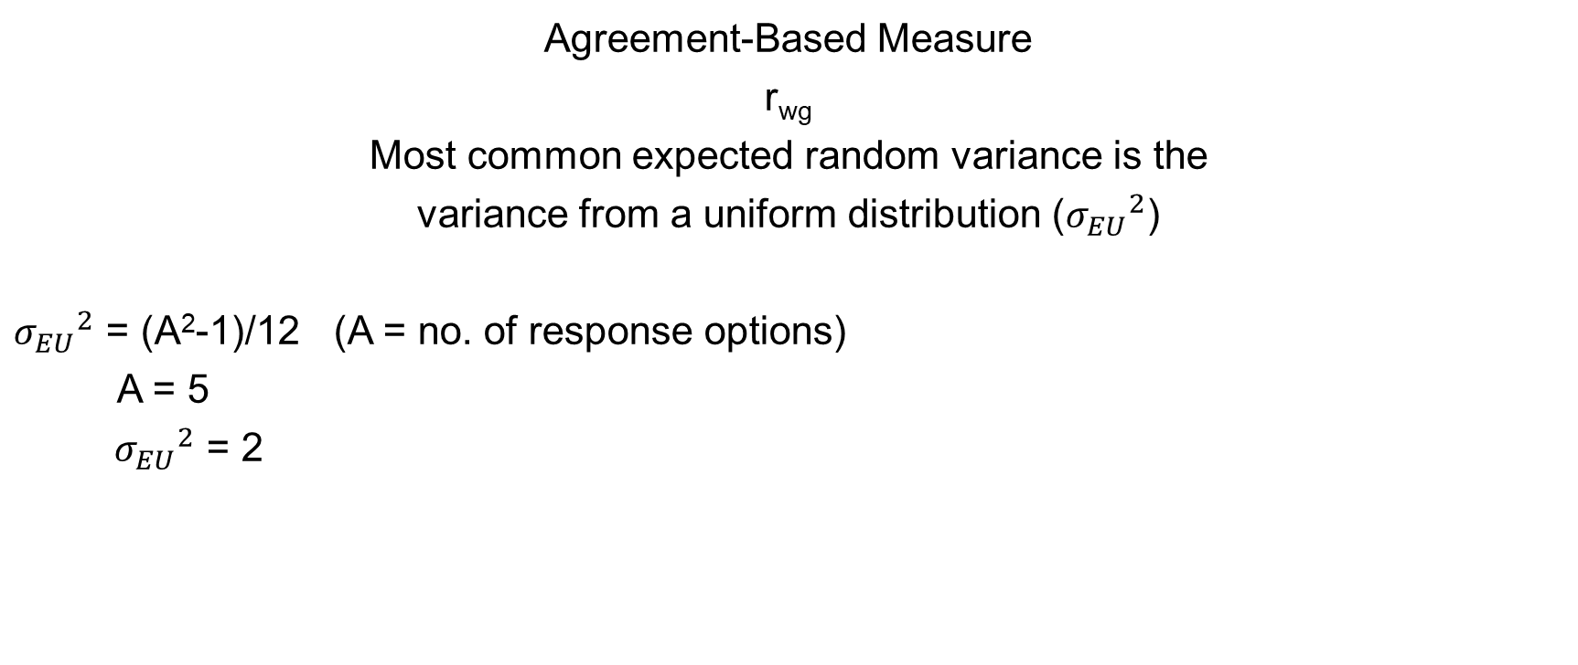
Aggregation Models - Tests
Agreement-Based Measure
r_{wg}
Most common expected random variance is the
variance from a uniform distribution (${σ_{EU}}^{2}$)
${σ_{EU}}^{2}$ = (A²-1)/12 (A = no. of response options)
A = 5
${σ_{EU}}^{2}$ = 2
SKIP

Slide 84
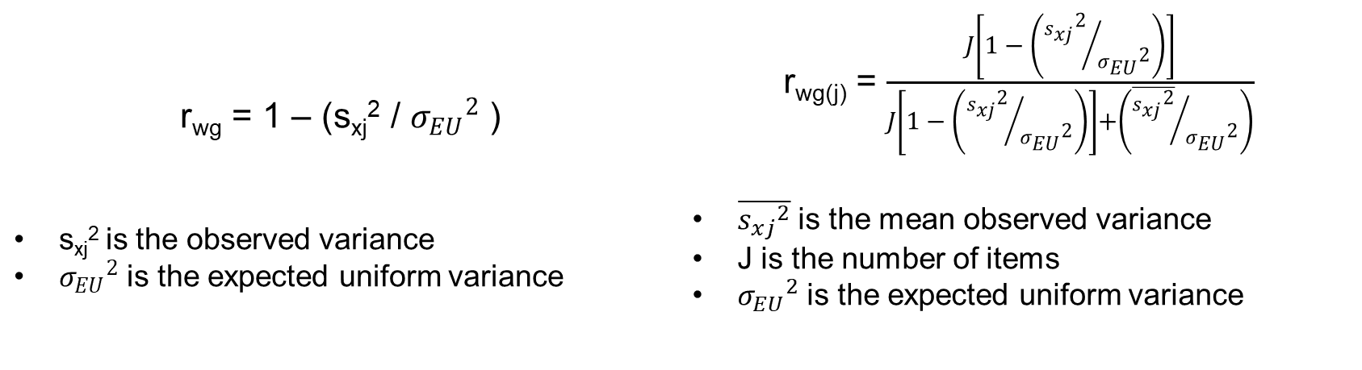
Aggregation Models - Tests
Agreement-Based Measure
r_{wg}
r_{wg} = 1 – (s_{xj}² / ${σ_{EU}}^{2}$ ) s_{xj}² is the observed variance ${σ_{EU}}^{2}$ is the expected uniform variance | r_{wg(j)} = $\frac{J\left[1 − \left({{s_{xj}}^{2}}/{{σ_{EU}}^{2}}\right)\right]}{J\left[1 − \left({{s_{xj}}^{2}}/{{σ_{EU}}^{2}}\right)\right]+\left({\overline{{s_{xj}}^{2}}}/{{σ_{EU}}^{2}}\right)}$ $\overline{{s_{xj}}^{2}}$ is the mean observed variance J is the number of items ${σ_{EU}}^{2}$ is the expected uniform variance
SKIP

Slide 85
Aggregation Models - Tests
Reliability measure examples using army data
r_{wg} of Work Hours (with 11 response options)
> data(bhr2000) #bring data to work environment
> (11^2-1)/12 #calculate uniform random variance
[1] 10
> RWG.HRS<-rwg(bhr2000$HRS,bhr2000$GRP,ranvar=10)
> summary(RWG.HRS)
grpid rwg gsize
1 : 1 Min. :0.4683 Min. : 8.00
10 : 1 1st Qu.:0.6668 1st Qu.: 29.50
11 : 1 Median :0.7551 Median : 45.00
12 : 1 Mean :0.7353 Mean : 54.55
13 : 1 3rd Qu.:0.8099 3rd Qu.: 72.50
14 : 1 Max. :0.9176 Max. :188.00
(Other):93
SKIP

Slide 86
Aggregation Models - Tests
Reliability measure examples using army data
r_{wg(j)} of Leadership (with 11 items and 5 response options)
> (5^2-1)/12
[1] 2
> RWG.J.OUT<-rwg.j(bhr2000[,2:12],bhr2000$GRP,ranvar=2)
> summary(RWG.J.OUT)
grpid rwg.j gsize
1 : 1 Min. :0.7859 Min. : 8.00
10 : 1 1st Qu.:0.8708 1st Qu.: 29.50
11 : 1 Median :0.8925 Median : 45.00
12 : 1 Mean :0.8876 Mean : 54.55
13 : 1 3rd Qu.:0.9088 3rd Qu.: 72.50
14 : 1 Max. :0.9440 Max. :188.00
(Other):93
SKIP

Slide 87
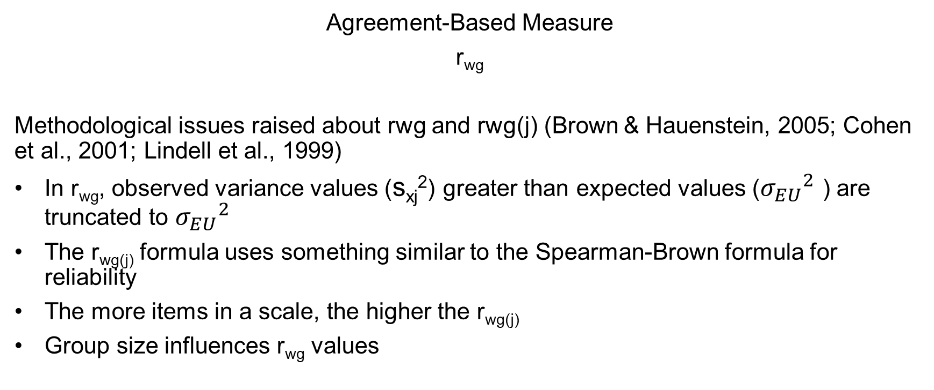
Aggregation Models - Tests
Agreement-Based Measure
r_{wg}
Methodological issues raised about rwg and rwg(j) (Brown & Hauenstein, 2005; Cohen et al., 2001; Lindell et al., 1999)
In r_{wg}, observed variance values (s_{xj}²) greater than expected values (${σ_{EU}}^{2}$ ) are truncated to ${σ_{EU}}^{2}$
The r_{wg(j)} formula uses something similar to the Spearman-Brown formula for reliability
The more items in a scale, the higher the r_{wg(j)}
Group size influences r_{wg} values
SKIP

Slide 88
Aggregation Models - Tests
Simulation approaches used to test significance of r_{wg} (Cohen et al., 2001; Dunlap et al., 2003)
Create sampling distribution of r_{wg} on uniform null distribution to determine significance (10,000 runs)
SKIP
Notes:
> RWG.OUT<-rwg.sim(gsize=5,nresp=5,nrep=10000)
> quantile(RWG.OUT, c(.95,.99))
quantile.values confint.estimate
1 0.95 0.85
2 0.99 1.00
> histogram(RWG.OUT$rwg,col="lightsteelblue",xlab=list("Group size =5 \n 95% Confidence Interval = 0.85",cex=1.5))
> RWG.OUT2<-rwg.sim(gsize=30,nresp=5,nrep=10000)
> quantile(RWG.OUT2, c(.95,.99))
quantile.values confint.estimate
1 0.95 0.2620690
2 0.99 0.3672414
> histogram(RWG.OUT2$rwg,col="lightsteelblue",xlab=list("Group size =30 \n 95% Confidence Interval = 0.26",cex=1.5))

Slide 89
Aggregation Models - Tests
Using the rwg.sim function in the multilevel library to determine statistical significance
Group size of 5
Group size of 30
SKIP
> RWG.OUT<-rwg.sim(gsize=5,nresp=5,nrep=10000)
> quantile(RWG.OUT, c(.95,.99))
quantile.values confint.estimate
1 0.95 0.85
2 0.99 1.00
> RWG.OUT2<-rwg.sim(gsize=30,nresp=5,nrep=10000)
> quantile(RWG.OUT2, c(.95,.99))
quantile.values confint.estimate
1 0.95 0.2620690
2 0.99 0.3672414
Notes:
> RWG.OUT<-rwg.sim(gsize=5,nresp=5,nrep=10000)
> quantile(RWG.OUT, c(.95,.99))
quantile.values confint.estimate
1 0.95 0.85
2 0.99 1.00
> histogram(RWG.OUT$rwg,col="lightsteelblue",xlab=list("Group size =5 \n 95% Confidence Interval = 0.85",cex=1.5))
> RWG.OUT2<-rwg.sim(gsize=30,nresp=5,nrep=10000)
> quantile(RWG.OUT2, c(.95,.99))
quantile.values confint.estimate
1 0.95 0.2620690
2 0.99 0.3672414
> histogram(RWG.OUT2$rwg,col="lightsteelblue",xlab=list("Group size =30 \n 95% Confidence Interval = 0.26",cex=1.5))

Slide 90
Aggregation Models - Tests
Simulation approaches used to test significance of r_{wg(j)} (Cohen et al., 2009)
Include options for number of scale items and correlation among scale items
SKIP
Notes:
> RWG.J.OUT<-rwg.j.sim(gsize=30,nitems=3,nresp=5,nrep=10000)
> quantile(RWG.J.OUT,c(.95,.99))
quantile.values confint.estimate
1 0.95 0.3522427
2 0.99 0.4506835
> RWG.J.OUT2<-rwg.j.sim(gsize=30,nitems=10,nresp=5,nrep=10000)
> quantile(RWG.J.OUT2,c(.95,.99))
quantile.values confint.estimate
1 0.95 0.475627
2 0.99 0.569925
> histogram(RWG.J.OUT$rwg,col="lightsteelblue",xlab=list("Group size = 30 with 3-item scale \n 95% Confidence Interval = 0.35",cex=1.5))
> histogram(RWG.J.OUT2$rwg,col="lightsteelblue",xlab=list("Group size = 30 with 10-item scale \n 95% Confidence Interval = 0.48",cex=1.5))

Slide 91
Aggregation Models - Tests
Using the rwg.j.sim function in the multilevel library to determine statistical significance
Group size of 30, 3-item scale (J = 3)
Group size of 30, 10-item scale (J = 10)
SKIP
> RWG.J.OUT<-rwg.j.sim(gsize=30,nitems=3,nresp=5,
nrep=10000)
> quantile(RWG.J.OUT,c(.95,.99))
quantile.values confint.estimate
1 0.95 0.3522427
2 0.99 0.4506835
> RWG.J.OUT2<-rwg.j.sim(gsize=30,nitems=10,nresp=5,
nrep=10000)
> quantile(RWG.J.OUT2,c(.95,.99))
quantile.values confint.estimate
1 0.95 0.475627
2 0.99 0.569925
Notes:
> RWG.OUT<-rwg.sim(gsize=5,nresp=5,nrep=10000)
> quantile(RWG.OUT, c(.95,.99))
quantile.values confint.estimate
1 0.95 0.85
2 0.99 1.00
> histogram(RWG.OUT$rwg,col="lightsteelblue",xlab=list("Group size =5 \n 95% Confidence Interval = 0.85",cex=1.5))
> RWG.OUT2<-rwg.sim(gsize=30,nresp=5,nrep=10000)
> quantile(RWG.OUT2, c(.95,.99))
quantile.values confint.estimate
1 0.95 0.2620690
2 0.99 0.3672414
> histogram(RWG.OUT2$rwg,col="lightsteelblue",xlab=list("Group size =30 \n 95% Confidence Interval = 0.26",cex=1.5))

Slide 92
Aggregation Models - Tests
Using the rwg.j.sim function to determine statistical significance of leadership scale
> RWG.J.OUT<-rwg.j.sim(gsize=55,nitems=11,nresp=5,
nrep=10000,itemcors=cor(bhr2000[,2:12]))
> summary(RWG.J.OUT)
$rwg
Min. 1st Qu. Median Mean 3rd Qu. Max.
0.000000 0.000000 0.009016 0.143800 0.285700 0.706200
$gsize
[1] 55
$nresp
[1] 5
$nitems
[1] 11
$rwg.95
[1] 0.4968278
SKIP
SKIP
Notes:
> RWG.OUT<-rwg.sim(gsize=5,nresp=5,nrep=10000)
> quantile(RWG.OUT, c(.95,.99))
quantile.values confint.estimate
1 0.95 0.85
2 0.99 1.00
> histogram(RWG.OUT$rwg,col="lightsteelblue",xlab=list("Group size =5 \n 95% Confidence Interval = 0.85",cex=1.5))
> RWG.OUT2<-rwg.sim(gsize=30,nresp=5,nrep=10000)
> quantile(RWG.OUT2, c(.95,.99))
quantile.values confint.estimate
1 0.95 0.2620690
2 0.99 0.3672414
> histogram(RWG.OUT2$rwg,col="lightsteelblue",xlab=list("Group size =30 \n 95% Confidence Interval = 0.26",cex=1.5))

Slide 93
Aggregation Models - Tests
Exercise:
Using the datasets:
Bliese, Halverson, & Schriesheim (2002) “Leadership Quarterly” special issue data
Klein et al., (2000) simulated data for chapter on integrative methods
Estimate r_{wg} and r_{wg(j)}
Calculate the statistical significance of r_{wg} and r_{wg(j)}
SKIP

Slide 94
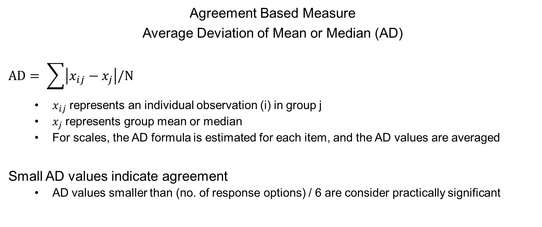
Aggregation Models - Tests
Agreement Based Measure
Average Deviation of Mean or Median (AD)
$$AD= \sum{\left|x_{ij}−x_{j}\right|/N}$$
$x_{ij}$ represents an individual observation (i) in group j
$x_{j}$ represents group mean or median
For scales, the AD formula is estimated for each item, and the AD values are averaged
Small AD values indicate agreement
AD values smaller than (no. of response options) / 6 are consider practically significant

Slide 95
Aggregation Models - Tests
Using the ad.m function from the multilevel package
Work Hours (11 response options)
> AD.HRS<-ad.m(bhr2000$HRS,bhr2000$GRP,type="median")
> summary(AD.HRS)
grpid AD.M gsize
1 : 1 Min. :0.6026 Min. : 8.00
10 : 1 1st Qu.:0.9932 1st Qu.: 29.50
11 : 1 Median :1.2045 Median : 45.00
12 : 1 Mean :1.2017 Mean : 54.55
13 : 1 3rd Qu.:1.4033 3rd Qu.: 72.50
14 : 1 Max. :1.7922 Max. :188.00
(Other):93
> 11/6 #Practical Significance
[1] 1.833333

Slide 96
Aggregation Models - Tests
Using the ad.m function from the multilevel package
Leadership (11 items, 5response options)
> AD.LEAD<-ad.m(bhr2000[,2:12],bhr2000$GRP,type="median")
> summary(AD.LEAD)
grpid AD.M gsize
1 : 1 Min. :0.5799 Min. : 8.00
10 : 1 1st Qu.:0.7824 1st Qu.: 29.50
11 : 1 Median :0.8375 Median : 45.00
12 : 1 Mean :0.8298 Mean : 54.55
13 : 1 3rd Qu.:0.8776 3rd Qu.: 72.50
14 : 1 Max. :0.9813 Max. :188.00
(Other):93
> 5/6 # Practical significance
[1] 0.8333333

Slide 97
Aggregation Models - Tests
Significance of AD values can be calculated via simulations using the ad.m.sim function
Example testing for statical significance on 11-item leadership scale
Values smaller than or equal to 1.14 are significant at p < .05
> SIMOUT<-ad.m.sim(gsize=55, nitems=11, nresp=5,
itemcors=cor(bhr2000[,2:11]), type="mean",
nrep=10000)
> quantile(SIMOUT,c(.05,.01))
quantile.values confint.estimate
1 0.05 1.143207
2 0.01 1.115174

Slide 98
Aggregation Models - Tests
Exercise:
Using the datasets:
Bliese, Halverson, & Schriesheim (2002) “Leadership Quarterly” special issue data
Klein et al., (2000) simulated data for chapter on integrative methods
Estimate AD.M
Calculate the statistical significance of AD.M
SKIP

Slide 99
Aggregation Models - Tests
Summary of the various aggregation indices for the leadership scale
Index | Value | Significance Value
r_{wg(j)} | 0.89 | >0.50
r*_{wg(j)} | 0.43 | NA
AD.M | 0.83 | <1.14
ICC(1)/ICC(2) | 0.14/0.90 | p<.001
RGR.AGREE | -6.28 | p<.001

Slide 100
Aggregation Models - Tests
Key Take Aways
Issues to consider in aggregation models
Is it logical to think that group members will agree?
Is the aggregate variable likely to be isomorphic with the lower-level variable?
Psychological Climate vs. Organizational Climate
Individual Work Hours vs. Externally mandated work requirement
Test aggregation model by matching the index (agreement vs. reliability) to the model

Slide 101
Multilevel Analysis
Analytic Methods

Slide 102
Multilevel Methods - Purpose
Multilevel models let one determine whether or not group membership matters; do contextual effects exist?
An aim of aggregate-level research is to “know whether an empirical relation between organizational properties stems from organizational or an individual process” (Lincoln & Zeitz, 1980)
Unfortunately this may not be as easy at it seems…

Slide 103
Multilevel Methods - Contextual Effects
Example
100 work groups each with 10 members
Measure individual role clarity and individual job satisfaction
Correlation between average role clarity and average job satisfaction equals .50 (p < .01)
What does this correlation mean?

Slide 104
Multilevel Methods - Contextual Effects
Example
100 work groups each with 10 members
Measure individual role clarity and individual job satisfaction
Correlation between average role clarity and average job satisfaction equals .50 (p < .01)
Option 1:
The significant correlation provides evidence of contextual effects
An organizational process is operating
Group membership matters
Option 2:
The correlation is significant simply because of individual-level process
Option 3:
Some combination of 1 and 2

Slide 105
Multilevel Methods - Contextual Effects
Example
Y = 1000 normally distributed random numbers
X = 1000 numbers generated to correlate .50 with Y
Arbitrarily assign group IDs (100 groups of size 10)
Create group means
Y<-rnorm(1000)
X<-.50*Y+sqrt(1-.50^2)*rnorm(1000)
GRP<-rep(1:100,10)
TDAT<-data.frame(GRP, Y, X)
TDAT.G<-aggregate(TDAT,list(TDAT$GRP),mean)

Slide 106
Multilevel Methods - Contextual Effects
Example
Sample clearly has no group-level properties
X and Y are 1000 correlated random numbers
Group IDs are assigned arbitrarily
ICC(1) values are near zero
Nonetheless, group-mean correlation is .50 (on average)
Relationships between group means mirror relationships at lower levels
Group-level correlation “explained” by individual process
cor(TDAT.G$Y, TDAT.G$X)

Slide 107
Multilevel Methods - Contextual Effects
Individual-Level Processes
b_{xy}
Role
Clarity
Job
Satisfaction
b_{XY}-b_{xy}
Organizational-Level Processes

Slide 108
Multilevel Methods - Contextual Effects
Explains the whole aggregate-level relationship in the simulation
Individual-Level Processes
b_{xy}
Role
Clarity
Job
Satisfaction
b_{XY}-b_{xy}
Organizational-Level Processes

Slide 109
Multilevel Methods - Contextual Effects
Key Take Aways
The significant group-level relationships do not necessarily mean that group membership is important
Need to formally test that group membership is important (i.e., that contextual effects exist)
Three commonly used options
Contextual Analysis (OLS regression)
Within and Between Analysis (WABA)
Mixed-Effects Models (e.g., HLM)

Slide 110
Multilevel Methods – Contextual Analysis
Contextual Analysis uses OLS methods (regression)
Answers the question: Does the mean value of X predict variance over-and-above the raw X value?
Alwin (1976) showed that contextual effects are present if b2 is significant in this regression model:
Y = b₀ + b₁X +b₂X.G
X.G
X
Y
Cross-level Main Effect

Slide 111
Multilevel Methods – Contextual Analysis
Example:
The group-level analysis revealed a strong correlation between work hours and well-being (n = 99 groups)
Unweighted group-level correlation = -.67

Slide 112
Multilevel Methods – Contextual Analysis
Re-assign group average to individual soldier and predict individual well-being in regression model

Slide 113
Contextual Analysis
Note that average work hours predicts unique variance in individual well-being
Value Std. Error t value Pr(>|t|)
Intercept) 4.7846 0.1365 35.0478 0.0000
HRS -0.0464 0.0049 -9.4269 0.0000
GHRS -0.1310 0.0130 -10.0623 0.0000
> data(bh1996)
> tmod<-lm(WBEING~HRS+G.HRS,data=bh1996)
> summary(tmod)

Slide 114
Contextual Analysis
Contextual
OLS model
tells us these
two slopes
differ

Slide 115
Contextual Analysis and Econometrics
Group mean relationships that differ from lower-level relationships are:
A source of information that enrich theory or
A confound that obscures the lower-level relationship
Matter of perspective, but if contextual effects are present, the lower-level relationship will be obscured unless contextual effects (endogeneity due to pooled data) are removed
Fixed-effects
Add group mean to model
De-Mean (i.e., group-mean center)

Slide 116
Fixed-Effects in Econometrics
A pooled regression with a biased slope for Work Hours
A fixed-effect econometric model removes all contextual effects
> data(bh1996)
> tmod<-lm(WBEING~HRS,data=bh1996)
> round(summary(tmod)$coef,4)
Estimate Std. Error t value Pr(>|t|)
(Intercept) 3.5169 0.0529 66.4793 0
HRS -0.0652 0.0046 -14.2111 0
> tmod<-lm(WBEING~HRS+factor(GRP),data=bh1996)
> round(summary(tmod)$coef[1:2,],4)
Estimate Std. Error t value Pr(>|t|)
(Intercept) 3.3028 0.1158 28.5126 0
HRS -0.0465 0.0049 -9.5052 0

Slide 117
Fixed-Effects in Econometrics
A fixed-effect econometric model removes all contextual effects
A contextual analysis (adding group mean) returns identical Estimate with minor variation in Std.Error (not evident in rounding)
> tmod<-lm(WBEING~HRS+factor(GRP),data=bh1996)
> round(summary(tmod)$coef[1:4,],4)
Estimate Std. Error t value Pr(>|t|)
(Intercept) 3.3028 0.1158 28.5126 0.0000
HRS -0.0465 0.0049 -9.5052 0.0000
factor(GRP)2 -0.0187 0.1515 -0.1237 0.9015
factor(GRP)3 -0.0733 0.1367 -0.5364 0.5917
> tmod<-lm(WBEING~HRS+G.HRS,data=bh1996)
> round(summary(tmod)$coef,4)
Estimate Std. Error t value Pr(>|t|)
(Intercept) 4.7831 0.1364 35.0680 0
HRS -0.0465 0.0049 -9.4307 0
G.HRS -0.1308 0.0130 -10.0596 0

Slide 118
Contextual Analysis
Summary:
Significant group-mean regression coefficient indicates a significant contextual or environmental effect.
Group-mean relationship is different from individual relationship
If group mean effect is not significant when raw effect is controlled for, then the group-level relationship and the individual-level relationship cannot be considered different (Firebaugh, 1978)
Liberal (and incorrect) test because the standard error for the group-mean is too small in OLS.

Slide 119
Contextual Analysis: Data Manipulation
In contextual analysis and in subsequent Mixed Effects Models, group means must be assigned down to each individual

Slide 120
Contextual Analysis: Data Manipulation
Reassignment of group means to individuals requires a merge of:
The individual-level dataframe
The group-level dataframe with group means, group variances, etc
In R, this is efficiently done using two functions:
The aggregate() function creates group-level data
The merge() function merges the group-level and individual-level data

Slide 121
Contextual Analysis: Data Manipulation
Example involving work hours and leadership
> bhr2000$LEAD<-rowMeans(bhr2000[,2:12])
> bhr.small<-bhr2000[,c("GRP","HRS","LEAD")]
> bhr.grp<-aggregate(bhr.small,list(bhr.small$GRP),mean)
> bhr.mult<-merge(bhr.small,bhr.grp,by="GRP",
suffixes=c("",".G"))
> bhr.mult[1:5,]
GRP HRS LEAD Group.1 HRS.G LEAD.G
1 1 12 3.181818 1 11.05085 2.938367
2 1 11 3.000000 1 11.05085 2.938367
3 1 12 3.636364 1 11.05085 2.938367
4 1 9 3.363636 1 11.05085 2.938367
5 1 9 3.636364 1 11.05085 2.938367

Slide 122
Contextual Analysis
Exercise 6
Manipulating data for a contextual analysis (and for Mixed Effects Models)

Slide 123
Mixed Effects Models
Outline
A visual representation of how different OLS models treat differences among groups
Rationale behind Multilevel Mixed Effects Models
Modeling MRCM in R
Stages in Modeling
1: Examining the DV
2: Level-1 and Level-2 main effects
3: Level-2 cross-level interactions
Some notes on Centering

Slide 124
Mixed Effects Models
How do different OLS models treat group differences in intercepts and slopes?
Ordinary regression
Fixed Effects (ANCOVA)
Slopes as outcomes
Example with the Work Hours and Well-Being relationship in 25 Army companies

Slide 125
Mixed Effects Models
>library(lattice)
>xyplot(WBEING~HRS|as.factor(GRP),
data=bh1996[1:1582,],
type=c("p","g","r"),col="dark blue",
col.line="black",
xlab="Work Hours",
ylab="Well-Being")
Notes:
xyplot(WBEING~HRS|as.factor(GRP),data=bh1996[1:1582,],
type=c("p","g","r"),col="dark blue",col.line="black",
xlab="Work Hours",
ylab="Well-Being")

Slide 126
Mixed Effects Models
tbh1996<-bh1996[1:1582,]
tmod<-lm(WBEING~HRS,tbh1996)
plot(tbh1996$HRS,tbh1996$WBEING,
xlab="Work Hours",
ylab="Well-Being",type="n")
abline(tmod)
Traditional Regression
Equal Slopes
Equal Intercepts
Notes:
TDAT<-bh1996[1:1582,]
tmod<-lm(WBEING~HRS,TDAT)
plot(TDAT$HRS,TDAT$WBEING,xlab="Work Hours",
ylab="Well-Being",type="n")
abline(tmod)
*****************************
tmod<-lm(WBEING~HRS+as.factor(GRP)-1,TDAT)
INTER<-tmod$coefficients[2:26]
HRS.SLOPE<-rep(tmod$coefficients[1],25)
TDAT2<-data.frame(INTERCEPT=INTER,HRS=HRS.SLOPE)
plot(TDAT$HRS,TDAT$WBEING,xlab="Work Hours",
ylab="Well-Being",type="n")
apply(TDAT2,1,abline)

Slide 127
Mixed Effects Models
tmod<-lm(WBEING~HRS+as.factor(GRP)-1,
data=tbh1996)
INTER<-tmod$coefficients[2:26]
HRS.SLOPE<-rep(tmod$coefficients[1],25)
TDAT2<-data.frame(INTERCEPT=INTER,
HRS=HRS.SLOPE)
plot(tbh1996$HRS,tbh1996$WBEING,
xlab="Work Hours",
ylab="Well-Being",type="n")
apply(TDAT2,1,abline)
Fixed Effects (ANCOVA)
Equal Slopes
Different Intercepts
Notes:
TDAT<-bh1996[1:1582,]
tmod<-lm(WBEING~HRS,TDAT)
plot(TDAT$HRS,TDAT$WBEING,xlab="Work Hours",
ylab="Well-Being",type="n")
abline(tmod)
*****************************
tmod<-lm(WBEING~HRS+as.factor(GRP)-1,TDAT)
INTER<-tmod$coefficients[2:26]
HRS.SLOPE<-rep(tmod$coefficients[1],25)
TDAT2<-data.frame(INTERCEPT=INTER,HRS=HRS.SLOPE)
plot(TDAT$HRS,TDAT$WBEING,xlab="Work Hours",
ylab="Well-Being",type="n")
apply(TDAT2,1,abline)

Slide 128
Mixed Effects Models
lmList(WBEING~HRS|GRP)
Coefficients:
(Intercept) HRS
1 3.990076 -0.10909188
2 3.656022 -0.07701166
3 3.138605 -0.03774951
4 4.612616 -0.12914352
.
.
.
24 3.226696 -0.01607135
25 2.134408 0.07820839
Slopes as Outcomes
Unequal Slopes
Unequal Intercepts
Notes:
tmod3<-lmList(WBEING~HRS|GRP,data=TDAT)
plot(TDAT$HRS,TDAT$WBEING,xlab="Work Hours",
ylab="Well-Being",type="n")
fixfun<-function(X){
for (i in 1:25){
abline(X[[i]])
}}
fixfun(tmod3)

Slide 129
Mixed Effects Models
library(nlme)
tmod3<-lmList(WBEING~HRS|GRP,
data=tbh1996)
plot(tbh1996$HRS,tbh1996$WBEING,
xlab="Work Hours",
ylab="Well-Being",type="n")
lmplot<-function(X){
for (i in 1:25){
abline(X[[i]])
}}
lmplot(tmod3)
Notes:
tmod3<-lmList(WBEING~HRS|GRP,data=TDAT)
plot(TDAT$HRS,TDAT$WBEING,xlab="Work Hours",
ylab="Well-Being",type="n")
fixfun<-function(X){
for (i in 1:25){
abline(X[[i]])
}}
fixfun(tmod3)

Slide 130
Mixed Effects Models
Assumptions of traditional linear models
and multilevel models
From Kreft & De leeuw (1998)

Slide 131
Mixed Effects Models
Multilevel random coefficient models build off of the idea of “slopes as outcomes” models and models the variance around intercepts and slopes
In Multilevel Random Coefficient Models, one tries to explain three key sources of variance
Within-group variance (σ² or sigma-squared)
Between-group variance or intercept variance (τ₀₀ or tau)
Between-group slope variance τ₁₁

Slide 132
Mixed Effects Models
Modeling within-group variance σ² or sigma-squared
Can we explain individual variability within groups?
}
Variance of r_{ij} = σ²
Notes:
library(lattice)
data(bh1996)
tbh1996<-bh1996[1:137,]
trellis.device(bg="transparent")
xyplot(WBEING~
HRS|as.factor(GRP),
data=tbh1996,
panel=function(x,y){
panel.xyplot(x,y,cex=2,col="darkblue")
panel.abline(lm(y~x,
na.action=na.omit))},
xlab=list("Work Hours",cex=2),
ylab=list("Well-Being",cex=2))

Slide 133
Mixed Effects Models
Between-group intercept variance (τ₀₀)
Is the variance of the intercepts large enough to imply group mean differences? If so what group-level factors predict these differences?
}
Variance of u_{0j} = τ₀₀

Slide 134
Mixed Effects Models
Modeling between-group slope variance (τ₁₁)
Is the variance of the IV-DV slopes among groups large enough to imply slope differences? What group-level attributes predict these differences?
Variance of u_{1j} = τ₁₁

Slide 135
Mixed Effects Models
Overview of Modeling in R
The nlme package (Pinheiro & Bates, 2000) is a powerful Mixed Effects Models package
Multilevel models
Growth models
For multilevel models we use the lme function (linear mixed effects)
The formula for the lme function has two basic parts that must be specified:
Fixed Effects component
Random Effects component

Slide 136
Mixed Effects Models
Fixed Effects component
These refer to the DV and the IVs in the familiar form for functions:
DV~IV1+IV2+IV3
Random Effects component
Specify which parts of the model are allowed to randomly vary (the intercept and specific slopes).
Specify nested structure (e.g, GRP, TEAM, etc.)
The form is:
random=~ random factors|GRP
Where “random factors” are intercepts (1) and slopes (level 1 variable names)

Slide 137
Mixed Effects Models
Example 1: Only a random intercept
A model with one fixed effect predictor (HRS) and a random intercept (designated using a “1”)
lme(WBEING~HRS, random=~1|GRP)
Notes:
tbh1996<-bh1996[1:1582,]
tmod<-lme(WBEING~HRS,random=~1|GRP,data=tbh1996)
plot(tbh1996$HRS,tbh1996$WBEING,xlab="Work Hours",
ylab="Well-Being",type="n")
COEF.DAT<-coef(tmod)
apply(COEF.DAT,1,abline)

Slide 138
Mixed Effects Models
Example 2: Random intercept / Random slope
A model with one fixed effect predictor (HRS); a random intercept and a random slope for the HRS
lme(WBEING~HRS, random=~1+HRS|GRP)
lme(WBEING~HRS, random=~HRS|GRP)
Notes:
tbh1996<-bh1996[1:1582,]
tmod<-lme(WBEING~HRS,random=~HRS|GRP,data=tbh1996)
plot(tbh1996$HRS,tbh1996$WBEING,xlab="Work Hours",
ylab="Well-Being",type="n")
COEF.DAT<-coef(tmod)
apply(COEF.DAT,1,abline)

Slide 139
Mixed Effects Models
Stages in Modeling
Stage 1. Explore your dependent variable with a Null Model
Is your DV related to group membership (what is the ICC and group-mean reliability)?
Is the intercept variance (a.k.a. τ₀₀ or between-group variance) significantly different from zero?
Stage 2. What variables are related to σ² (the within-group variance) and τ₀₀ (the intercept variance)?
Investigate adding level-1 and level-2 main effect predictors

Slide 140
Mixed Effects Models
Stages (cont.)
Stage 3. Is the variance of the IV-DV slope (τ₁₁) or slopes greater than expected by chance?
Test for slope differences
Find predictors of the slope differences

Slide 141
Stage 1
Examining the DV
Estimating the ICC
Looking at group-mean reliability
Determining whether the intercept variability is significantly different from zero

Slide 142
Stage 1
Examining the DV begins with a Null Model (no level-1 or level-2 predictors)
Separate components (Bryk & Raudenbush, 1992)
Y_{ij} = β_{0j}+r_{ij}
β_{0j} = γ₀₀ ₊ u_{0j}
Combined
Y_{ij} =γ₀₀ + u_{0j}+r_{ij}.

Slide 143
Stage 1
Graphically, a null model uses the group mean as the expected response for a person and the overall mean as the expected response for the group and partitions the variance
r_{ij} represents error associated with
the difference between an observation
and the group mean. The related
variance term is σ².
u_{0j} represents error associated with
the difference between a group mean
and the overall mean. The related
variance term is τ₀₀.

Slide 144
Stage 1
In R, we estimate the Null Model as follows:
Fixed part of the model is “WBEING~1”
Random part of the model is “random=~1|GRP”
With your own data, the na.action=na.omit option will be important.
> library(multilevel)
> library(nlme)
> data(bh1996)
> tbh1996<-bh1996[1:1582,]
> Null.Model<-lme(WBEING~1,random=~1|GRP,data=tbh1996,
na.action=na.omit)

Slide 145
Stage 1
We use the VarCorr function to get σ² and τ₀₀
> VarCorr(Null.Model)
GRP = pdLogChol(1)
Variance StdDev
(Intercept) 0.02818085 0.1678715
Residual 0.75681644 0.8699520
ICC is τ₀₀ / (τ₀₀ + σ²)
> 0.02818085/(0.02818085+0.75681644)
[1] 0.03589930
τ₀₀
σ²

Slide 146
Stage 1
It is useful to examine the reliability of the group means using the GmeanRel function.
> GmeanRel(Null.Model)
$ICC
[1] 0.03589930
$Group
[1] 1 2 3 4 5 6 7 8 9 10 11 12 13 14 15 16 17 18 19 20
$GrpSize
[1] 74 63 96 42 102 28 29 34 39 65 39 36 88 94 81
[16] 46 95 81 42 64 92 44 80 96 32
$MeanRel
[1] 0.7337215 0.7011241 0.7814045 0.6099713 0.7915831 0.5104301
[7] 0.5191950 0.5586987 0.5922039 0.7076316 0.5922039 0.5727404
[13] 0.7661788 0.7777871 0.7510034 0.6313851 0.7796106 0.7510034
[19] 0.6099713 0.7044137 0.7740479 0.6209804 0.7486732 0.7814045
[25] 0.5437027
This only works for random
Intercept models

Slide 147
Stage 1
The average reliability estimate from the GmeanRel function is equal to the ICC(2) when group sizes are all equal but differs slightly here.
> mean(GmeanRel(Null.Model)$MeanRel)
[1] 0.6764428
> Null.Model.aov<-aov(WBEING~as.factor(GRP),
data=tbh1996)
> ICC2(Null.Model.aov)
[1] 0.7117207

Slide 148
Stage 1
As the final step in exploring the DV, we want to know if it is important to have a random intercept term? In other words, is τ₀₀ significantly different from zero.
Equivalent to determining whether F-value from one-way ANOVA is significant
In Mixed Effects Models, contrast deviance values from two models -- one with random intercept and one without a random intercept.

Slide 149
Stage 1
To estimate a random coefficient model without a random term, use the gls (generalized least square) function
Likelihood value of 31.08 is significant indicating that the model with the random intercept is significantly better than the model without
> Model.gls<-gls(WBEING~1,data=tbh1996)
> anova(Model.gls,Null.Model)
Model df AIC BIC logLik Test L.Ratio p-value
Model.gls 1 2 4116.615 4127.346 -2056.307
Null.Model 2 3 4087.533 4103.631 -2040.767 1 vs 2 31.08151 <.001

Slide 150
Stage 1
Graphically, the contrast between the gls model and lme model can be represented as:
Are the residuals smaller (better fit) in the more complex model?
lme model: note the
estimates for each group
gls model: group info is
not modeled

Slide 151
Stage 1
If the ICC value is non-zero, there is a good chance that the nested structure will impact correlations across levels
#Below estimates ICC using nlme
> mult.icc(bh1996[,c("LEAD","HRS","WBEING")],bh1996$GRP)
Variable ICC1 ICC2
1 LEAD 0.14746129 0.9280442
2 HRS 0.12923699 0.9171286
3 WBEING 0.04337922 0.7717561
> round(cor(bh1996[,c("LEAD","G.LEAD","HRS","G.HRS","WBEING","G.WBEING")]),dig=3)
LEAD G.LEAD HRS G.HRS WBEING G.WBEING
LEAD 1.000 0.371 -0.135 -0.111 0.426 0.197
G.LEAD 0.371 1.000 -0.113 -0.300 0.126 0.532
HRS -0.135 -0.113 1.000 0.379 -0.163 -0.270
G.HRS -0.111 -0.300 0.379 1.000 -0.168 -0.712
WBEING 0.426 0.126 -0.163 -0.168 1.000 0.236
G.WBEING 0.197 0.532 -0.270 -0.712 0.236 1.000
Notes:
Could also show that if there is no ICC(1) the correlations should be the same.
set.seed(34544)
X<-rnorm(1000)
Y<-X+rnorm(1000)
cor(X,Y)
GID<-rep(1:100,each=10)
TDAT<-data.frame(GID=GID,X=X,Y=Y)
TDAT[1:20,]
mult.icc(TDAT[,2:3],TDAT$GID)
TDAT.G<-aggregate(TDAT,list(TDAT$GID),mean)
nrow(TDAT.G)
nrow(TDAT)
cor(TDAT.G[,3:4])

Slide 152
Stage 1
Exercise 7: Examining the Dependent Variable of Job satisfaction in the klein2000 data set.

Slide 153
Stage 2
Stage 2 in Modeling.
Explaining within-group variance (σ²) and between-group variance (τ₀₀)
Comparing OLS contextual models and random coefficient contextual models
Estimating “explained” variance.

Slide 154
Stage 2
Level-1 Predictors
Vary among members of the same group
Self Efficacy (Jex & Bliese, 1999)
Variables primarily explain within-group variance (σ²) though they may also explain a bit of the between-group variance (τ₀₀).
Level-2 Predictors (not possible to examine in fixed-effects models)
Constant for members of the same group
Collective Efficacy (Jex & Bliese, 1999)
Variables explain between-group variance (τ₀₀)

Slide 155
Stage 2
Having level-1 and level-2 variables lets us demonstrate the standard error problem in OLS contextual models.
In a contextual OLS model
Standard errors for the level-2 variables are too small resulting in a t-value that is too large.
The example that follows regresses Well-Being on Work Hours and Group Work Hours

Slide 156
Stage 2
OLS: lm(WBEING~HRS+G.HRS,data=tbh1996)
Estimate Std. Error t value Pr(>|t|)
(Intercept) 4.63642 0.31552 14.695 < 2e-16
HRS -0.04850 0.01067 -4.547 5.85e-06
G.HRS -0.11129 0.02956 -3.765 0.000172
Mixed Effect: lme(WBEING~HRS+G.HRS,random=~1|GRP)
Value Std.Error DF t-value
Intercept) 4.601137 0.4687222 1556 9.816341
HRS -0.048502 0.0105713 1556 -4.588048
G.HRS -0.108209 0.0423802 23 -2.553300

Slide 157
Stage 2
In evaluating level-1 and level-2 predictors, we are primarily interested in whether parameter values are significant
We can also examine explained variance
The null model provides estimates of variance without any predictors
When predictors are added, see how the variance estimates change and calculate “variance explained”
Formula:
Variance Explained = 1 – (Var with Predictor/Var without Predictor)

Slide 158
Stage 2
> VarCorr(Null.Model)
Variance StdDev
(Intercept) 0.02818085 0.1678715
Residual 0.75681644 0.8699520
> Model.1<-lme(WBEING~HRS+G.HRS,random=~1|GRP, data=tbh1996)
> VarCorr(Model.1)
Variance StdDev
(Intercept) 0.01391185 0.1179485
Residual 0.74697450 0.8642769
> 1 – (0.747/0.757)= 0.011 #(1% of σ2)
> 1 – (0.014/0.028)= 0.50 #(50% of τ00)

Slide 159
Interpreting Stage 2 Results
Group-level predictors (G.HRS) often described as:
“H1: Average numbers of hours worked in a group (G.HRS) are related to individual well-being”
Seemingly reasonable (see data), but is it correct?

Slide 160
Interpreting Stage 2 Results
Stated differently, how do we interpret these results?
Notice results from a group-mean model run in OLS
> tmod<-lme(WBEING~G.HRS,random=~1|GRP,data=tbh1996)
> round(summary(tmod)$tTable,dig=3)
Value Std.Error DF t-value p-value
(Intercept) 4.602 0.469 1557 9.811 0.000
G.HRS -0.157 0.041 23 -3.817 0.001
> TDAT<-tbh1996[!duplicated(tbh1996$GRP),]
> nrow(TDAT)
[1] 25
> tmod<-lm(G.WBEING~G.HRS,TDAT)
> round(summary(tmod)$coef,dig=3)
Estimate Std. Error t value Pr(>|t|)
(Intercept) 4.557 0.449 10.151 0.000
G.HRS -0.153 0.039 -3.877 0.001

Slide 161
Interpreting Stage 2 Results
If group sizes are equal, multilevel model results with a group-level predictor and individual-level outcome are identical to a group-mean analysis
Hypotheses involving models with a group-level predictor (G.HRS) should state:
“H1: Average numbers of hours worked in a group are related to average group well-being”
“because X is constant within a given group, variation in X cannot influence individual differences within a group” (Preacher, Zyphur, & Zhang, 2010).

Slide 162
Stage 2 Results and Hausman Test
Hausman test: Contrast fixed-effects model
Random-effects
> tmod<-lm(WBEING~HRS+factor(GRP),bh1996)
> round(summary(tmod)$coef[1:4,],4)
Estimate Std. Error t value Pr(>|t|)
(Intercept) 3.3028 0.1158 28.5126 0.0000
HRS -0.0465 0.0049 -9.5052 0.0000
factor(GRP)2 -0.0187 0.1515 -0.1237 0.9015
factor(GRP)3 -0.0733 0.1367 -0.5364 0.5917
....
> tmod<-lme(WBEING~HRS,random=~1|GRP,bh1996)
> round(summary(tmod)$tTable,4)
Value Std.Error DF t-value p-value
(Intercept) 3.3649 0.0576 7282 58.4238 0
HRS -0.0521 0.0048 7282 -10.9006 0

Slide 163
Stage 2 Results and Hausman Test
Modified Hausman test (test whether -0.0465 differs from -0.0521)
Not-significant, but very easy to have a random effects model return the exact estimate obtained by the fixed-effects model.
> tmod<-lm(WBEING~HRS+factor(GRP)+offset(-.0521*HRS),bh1996)
> round(summary(tmod)$coef[1:4,],4)
Estimate Std. Error t value Pr(>|t|)
(Intercept) 3.3028 0.1158 28.5126 0.0000
HRS 0.0056 0.0049 1.1538 0.2486
factor(GRP)2 -0.0187 0.1515 -0.1237 0.9015
factor(GRP)3 -0.0733 0.1367 -0.5364 0.5917

Slide 164
Stage 2 Results and Hausman Test
Random effect model returning same estimate as fixed effect
Add group mean to model or group-mean center (not shown)
> tmod<-lm(WBEING~HRS+factor(GRP),bh1996)
> summary(tmod)$coef[1:4,]
Estimate Std. Error t value Pr(>|t|)
(Intercept) 3.30282349 0.115837144 28.5126460 1.294644e-169
HRS -0.04646051 0.004887888 -9.5052314 2.651824e-21
factor(GRP)2 -0.01874973 0.151519708 -0.1237445 9.015210e-01
factor(GRP)3 -0.07329798 0.136653608 -0.5363780 5.917137e-01
> tmod<-lme(WBEING~HRS+G.HRS,random=~1|GRP,bh1996)
> summary(tmod)$tTable
Value Std.Error DF t-value p-value
(Intercept) 4.74083103 0.21367880 7282 22.186717 1.368275e-105
HRS -0.04646051 0.00488798 7282 -9.505052 2.656350e-21
G.HRS -0.12692608 0.01940284 97 -6.541626 2.867199e-09

Slide 165
Stage 2
Exercise 8: Evaluating Level-1 and Level-2 main effect predictors
Contextual Models
Explained Variance
[In summarizing results illustrate group-mean centered variables in code below]
Notes:
bh1996[c(1:4,91:94,5001:5004),c("GRP","WBEING","LEAD","G.LEAD","W.LEAD")]
tmod<-lme(WBEING~LEAD+G.LEAD,random=~1|GRP,data=bh1996)
summary(tmod)$tTable
tmod<-lme(WBEING~W.LEAD+G.LEAD,random=~1|GRP,data=bh1996)
summary(tmod)$tTable
tmod<-lme(WBEING-G.LEAD*0.5172798~W.LEAD+G.LEAD,random=~1|GRP,data=bh1996)
tmod<-lme(JOBSAT~WLOAD+WLOAD.G,random=~1|GRPID,k2000)
summary(tmod)$tTable
tmod<-lme(JOBSAT~I(WLOAD-WLOAD.G)+WLOAD.G,random=~1|GRPID,k2000)
summary(tmod)$tTable

Slide 166
Stage 3
Stage 3 in Modeling
Is the variance of the IV-DV slope (τ₁₁) or slopes greater than would be expected by chance?
Test for slope differences
Find predictors of the slope differences

Slide 167
Stage 3
“Cross-level interactions” occur when lower-level IV-DV slope differences among groups can be explained by higher-level group properties

Slide 168
Stage 3
Example involving Leadership consideration (LEAD) and Well-Being (WBEING).
Propose that the relationship between a soldiers’ rating of leadership and his or her well-being varies across groups.
Further propose that average work hours “explains” some of the slope variation
Perceptions of leadership will be more strongly related to well-being under high workload conditions than under low workload conditions.

Slide 169
Stage 3
>xyplot(WBEING~LEAD|as.factor(GRP),
data=bh1996[1:1582,],
type=c("p","g","r"),col="dark blue",
col.line="black",
xlab="Leadership Consideration",
ylab="Well-Being")

Slide 170
Stage 3
Fixed components include:
One level-1 variable
Leadership Consideration
One level-2 variable
Group Average Work Hours
Random components include:
Random intercept and random slope for leadership
R notation
> Model<-lme(WBEING~LEAD+G.HRS,random=~1+LEAD|GRP, data=tbh1996)
Notes:
tbh1996<-bh1996[1:1582,]
tmod<-lme(WBEING~LEAD,random=~1|GRP,data=tbh1996)
plot(tbh1996$LEAD,tbh1996$WBEING,xlab="Leadership Consideration",
ylab="Well-Being",type="n")
COEF.DAT<-coef(tmod)
apply(COEF.DAT,1,abline)
********************
tmod<-lme(WBEING~LEAD,random=~LEAD|GRP,data=tbh1996)
plot(tbh1996$LEAD,tbh1996$WBEING,xlab="Leadership Consideration",
ylab="Well-Being",type="n")
COEF.DAT<-coef(tmod)
apply(COEF.DAT,1,abline)

Slide 171
Stage 3
Random Slope Model:
Look at Model variance components
> Model<-lme(WBEING~LEAD+G.HRS,random=~1+LEAD|GRP,
data=tbh1996)
> VarCorr(Model)
GRP = pdLogChol(1 + LEAD)
Variance StdDev Corr
(Intercept) 0.05802495 0.24088369 (Intr)
LEAD 0.00309009 0.05558858 -0.886
Residual 0.62792718 0.79241856
Notes:
tbh1996<-bh1996[1:1582,]
tmod<-lme(WBEING~LEAD,random=~1|GRP,data=tbh1996)
plot(tbh1996$LEAD,tbh1996$WBEING,xlab="Leadership Consideration",
ylab="Well-Being",type="n")
COEF.DAT<-coef(tmod)
apply(COEF.DAT,1,abline)
********************
tmod<-lme(WBEING~LEAD,random=~LEAD|GRP,data=tbh1996)
plot(tbh1996$LEAD,tbh1996$WBEING,xlab="Leadership Consideration",
ylab="Well-Being",type="n")
COEF.DAT<-coef(tmod)
apply(COEF.DAT,1,abline)

Slide 172
Stage 3
Look for significant slope variation by contrasting two models: one with a random IV-DV slope, and the other with a fixed IV-DV slope
Advantage of mixed-effects models over fixed-effects models
Example:
> Model.int<-lme(WBEING~LEAD+G.HRS,
+ random=~1|GRP,data=tbh1996)
> Model<-update(Model.int,random=~1+LEAD|GRP)
> anova(Model.int, Model)
Model df logLik Test L.Ratio p-value
Model.int 1 5 -1895.895
Model 2 7 -1895.454 1 vs 2 0.8806822 0.6438

Slide 173
Stage 3
Graphic representation of the log-likelihood test
Fixed Slope
Random Slope
Notes:
tmod<-lme(WBEING~LEAD,random=~1|GRP,data=tbh1996)
plot(tbh1996$LEAD,tbh1996$WBEING,xlab="Leadership Consideration",
ylab="Well-Being",type="n")
COEF.DAT<-coef(tmod)
apply(COEF.DAT,1,abline)
********************
tmod<-lme(WBEING~LEAD,random=~LEAD|GRP,data=tbh1996)
plot(tbh1996$LEAD,tbh1996$WBEING,xlab="Leadership Consideration",
ylab="Well-Being",type="n")
COEF.DAT<-coef(tmod)
apply(COEF.DAT,1,abline)

Slide 174
Stage 3
Implies that the model without the random slope fits the data just as well as the model with the random slope (no significant slope variation)
However, one may test for cross-level interactions even if slopes do not significantly vary if one has a good theoretical reason (Snijders & Bosker, 1999).
Likelihood test also tends to be conservative
Best balance between power and Type I errors achieved using a one-tailed test (LaHuis & Ferguson, 2009)
Interpret a p-value of .10 as .05
Notes:
tbh1996<-bh1996[1:1582,]
tmod<-lme(WBEING~LEAD,random=~1|GRP,data=tbh1996)
plot(tbh1996$LEAD,tbh1996$WBEING,xlab="Leadership Consideration",
ylab="Well-Being",type="n")
COEF.DAT<-coef(tmod)
apply(COEF.DAT,1,abline)
********************
tmod<-lme(WBEING~LEAD,random=~LEAD|GRP,data=tbh1996)
plot(tbh1996$LEAD,tbh1996$WBEING,xlab="Leadership Consideration",
ylab="Well-Being",type="n")
COEF.DAT<-coef(tmod)
apply(COEF.DAT,1,abline)

Slide 175
Stage 3
Because we have a theory, we will test the cross-level hypothesis.
R Notation
> Final.Model<-lme(WBEING~LEAD+G.HRS+LEAD*G.HRS,
random=~LEAD|GRP,data=tbh1996)
Notes:
tbh1996<-bh1996[1:1582,]
tmod<-lme(WBEING~LEAD,random=~1|GRP,data=tbh1996)
plot(tbh1996$LEAD,tbh1996$WBEING,xlab="Leadership Consideration",
ylab="Well-Being",type="n")
COEF.DAT<-coef(tmod)
apply(COEF.DAT,1,abline)
********************
tmod<-lme(WBEING~LEAD,random=~LEAD|GRP,data=tbh1996)
plot(tbh1996$LEAD,tbh1996$WBEING,xlab="Leadership Consideration",
ylab="Well-Being",type="n")
COEF.DAT<-coef(tmod)
apply(COEF.DAT,1,abline)

Slide 176
Stage 3
Look at fixed effects in the final model:
There is no evidence of a significant cross-level interaction.
> round(summary(Final.Model)$tTable,dig=3)
Value Std.Error DF t-value p-value
(Intercept) 0.826 1.442 1555 0.572 0.567
LEAD 0.898 0.433 1555 2.073 0.038
G.HRS 0.049 0.125 23 0.394 0.697
LEAD:G.HRS -0.036 0.038 1555 -0.951 0.342
Notes:
tbh1996<-bh1996[1:1582,]
tmod<-lme(WBEING~LEAD,random=~1|GRP,data=tbh1996)
plot(tbh1996$LEAD,tbh1996$WBEING,xlab="Leadership Consideration",
ylab="Well-Being",type="n")
COEF.DAT<-coef(tmod)
apply(COEF.DAT,1,abline)
********************
tmod<-lme(WBEING~LEAD,random=~LEAD|GRP,data=tbh1996)
plot(tbh1996$LEAD,tbh1996$WBEING,xlab="Leadership Consideration",
ylab="Well-Being",type="n")
COEF.DAT<-coef(tmod)
apply(COEF.DAT,1,abline)

Slide 177
Stage 3
Do the slopes differ by more than chance levels? (full bh1996 sample)
Fixed Slope
Random Slope
Notes:
tmod<-lme(WBEING~LEAD,random=~1|GRP,data=bh1996)
plot(bh1996$LEAD,bh1996$WBEING,xlab="Leadership Consideration",
ylab="Well-Being",type="n")
COEF.DAT<-coef(tmod)
apply(COEF.DAT,1,abline)
********************
tmod<-lme(WBEING~LEAD,random=~LEAD|GRP,data=bh1996)
plot(bh1996$LEAD,bh1996$WBEING,xlab="Leadership Consideration",
ylab="Well-Being",type="n")
COEF.DAT<-coef(tmod)
apply(COEF.DAT,1,abline)

Slide 178
Stage 3
-2 log likelihood test results for full dataset
> Model.int<-lme(WBEING~LEAD+G.HRS,random=~1|GRP,data=bh1996)
> Final.Model<-update(Model.int,random=~1+LEAD|GRP)
> anova(Model.int,Final.Model)
Model df logLik Test L.Ratio p-value
Model.int 1 5 -8940.753
Model 2 7 -8927.055 1 vs 2 27.39587 <.0001

Slide 179
Stage 3
There is a significant interaction, however, if we look at the fixed effect results from the full bh1996 data set and accept a very liberal p-value.
> round(summary(Final.Model)$tTable,dig=3)
Value Std.Error DF t-value p-value
(Intercept) 3.575 0.728 7281 4.908 0.000
LEAD 0.148 0.218 7281 0.679 0.497
G.HRS -0.199 0.064 97 -3.118 0.002
LEAD:G.HRS 0.031 0.019 7281 1.628 0.104

Slide 180
Stage 3
To plot a significant interaction, we would write out the whole equation:
WBEING = 3.58 + .148*LEAD -.199*G.HRS + .031*(LEAD*G.HRS)
We could then substitute high and low values for Leadership consideration and for Group Work Hours.
Alternative, use the predict function
>TDAT<-data.frame(LEAD=c(2.12,2.12,3.66,3.66),
G.HRS=c(7, 12, 7, 12))
> predict(Final.Model,TDAT,level=0)
[1] 2.961807 2.299167 3.526238 3.103660
attr(,"label")
[1] "Predicted values"

Slide 181
Stage 3

Slide 182
Stage 3
Some final notes on centering:
Grand-mean centering improves model estimation by reducing multicollinearity -- equivalent to raw.
Group-mean centered models are NOT equivalent to raw models or to grand-mean centered models
Snijders & Bosker (1999) do not recommend them
Hofmann (personal communication) recommends using raw or grand-mean. In the case of cross-level interactions, run a group-mean centered model to verify that it is the same as the grand-mean or raw model.

Slide 183
Stage 3
Grand-mean centering : Subtract grand mean
Group-mean centering: Put group mean in data file, subtract group mean
> bh1996$GRAND.LEAD<-bh1996$LEAD-mean(bh1996$LEAD)
> TEMP<-aggregate(bh1996$LEAD,list(bh1996$GRP),mean)
> names(TEMP)<-c("GRP","G.LEAD")
> bh1996<-merge(bh1996,TEMP,by="GRP")
> bh1996$GRP.CENT.LEAD<-bh1996$LEAD-bh1996$G.LEAD

Slide 184
Stage 3
Effects of centering options
> tmod<-lme(WBEING~LEAD+G.LEAD,random=~1|GRP,bh1996)
> round(summary(tmod)$tTable,dig=4)
Value Std.Error DF t-value p-value
(Intercept) 1.5793 0.1730 7282 9.1312 0.0000
LEAD 0.5173 0.0131 7282 39.5195 0.0000
G.LEAD -0.1037 0.0610 97 -1.7008 0.0922
> tmod<-lme(WBEING~GRAND.LEAD+G.LEAD,random=~1|GRP,bh1996)
> round(summary(tmod)$tTable,dig=4)
Value Std.Error DF t-value p-value
(Intercept) 3.0745 0.1770 7282 17.3662 0.0000
GRAND.LEAD 0.5173 0.0131 7282 39.5195 0.0000
G.LEAD -0.1037 0.0610 97 -1.7008 0.0922

Slide 185
Stage 3
Effects of centering options (cont.)
> tmod<-lme(WBEING~GRAND.LEAD+G.LEAD,random=~1|GRP,bh1996)
> round(summary(tmod)$tTable,dig=4)
Value Std.Error DF t-value p-value
(Intercept) 3.0745 0.1770 7282 17.3662 0.0000
GRAND.LEAD 0.5173 0.0131 7282 39.5195 0.0000
G.LEAD -0.1037 0.0610 97 -1.7008 0.0922
> tmod<-lme(WBEING~GRP.CENT.LEAD+G.LEAD,
random=~1|GRP,bh1996)
> round(summary(tmod)$tTable,dig=4)
Value Std.Error DF t-value p-value
(Intercept) 1.5793 0.1730 7282 9.1312 0
GRP.CENT.LEAD 0.5173 0.0131 7282 39.5195 0
G.LEAD 0.4136 0.0595 97 6.9473 0

Slide 186
Stage 3
Exercise 9: Use the klein2000 data set to conduct a cross-level random coefficient model analysis.
Note: the code in the speaker notes uses empirical Bayes and plots to help show what is going on when the random term is changed
Notes:
tmod<-lme(JOBSAT~POSAFF+NEGLEAD+PAY+WLOAD+COHES.GRP+
TASKSIG.GRP,random=~1|GRPID,k2000)
coef(tmod) #Empirical Bayes Estimates for each group
plot(k2000$WLOAD,k2000$JOBSAT,xlab="Work Load",
ylab="Job Satisfaction",type="n")
COEF.DAT<-coef(tmod)[,c(1,5)]
apply(COEF.DAT,1,abline)
tmod.2<-update(tmod,random=~WLOAD|GRPID)
coef(tmod.2) #Empirical Bayes Estimates for each group
plot(k2000$WLOAD,k2000$JOBSAT,xlab="Work Load",
ylab="Job Satisfaction",type="n")
COEF.DAT<-coef(tmod.2)[,c(1,5)]
apply(COEF.DAT,1,abline)
anova(tmod,tmod.2)
tmod.3<-lme(JOBSAT~POSAFF+NEGLEAD+PAY+WLOAD+COHES.GRP+
TASKSIG.GRP*WLOAD,random=~WLOAD|GRPID,k2000)
summary(tmod.3)$tTable
###
TDAT<-data.frame(POSAFF=0,NEGLEAD=0,PAY=0,WLOAD=c(-1,-1,1,1),
COHES.GRP=0,TASKSIG.GRP=c(-1,1,-1,1))
TDAT$JOBSAT<-predict(tmod.3,TDAT,level=0)
TDAT
with(TDAT,interaction.plot(WLOAD,TASKSIG.GRP,JOBSAT)

Slide 187
Summary on Mixed-Effects Models
> library(lattice)
> win.graph()
> xyplot(LEAD~HRS|factor(GRP),
data=bh1996[1:1582,],
type=c("p","g","r"),
col="darkblue",
col.line="red3")

Slide 188
Summary Two-Level Models
Model Notation (Bryk & Raudenbush, 1992)
Separate components: One predictor at both levels, and random effects for intercept and slope
Y_{ij} = β_{0j}+ β_{1j}X_{ij} + r_{ij}
β_{0j} = γ₀₀ + γ₀₁Z_{j} + u_{0j}
β_{1j} = γ₁₀ + γ₁₁Z_{j} + u_{1j}
Combined
Y_{ij} =γ₀₀ + γ₁₀X_{ij} + γ₀₁Z_{j} + γ₁₁X_{ij}Z_{j} + [u_{0j} + u_{1j}X_{ij} + r_{ij}]

Slide 189
Summary Two-Level Models: OLS Regression
xyplot(LEAD~HRS,
data=bh1996[bh1996$GRP==1,],
type=c("p","g","r"),
col="darkblue",
col.line="red3")
}
Variance of r_{ij} = σ²

Slide 190
Summary Two-Level Models: OLS Regression
> tmod<-lm(LEAD~HRS,bh1996[bh1996$GRP==1,])
> resid(tmod)[1:5] #first 5 residuals
1 2 3 4 5
0.37033337 0.07394684 0.82487882 0.20844650 0.16112798
> summary(tmod)
....
Residual standard error: 0.6817 on 72 degrees of freedom
Multiple R-squared: 0.07543, Adjusted R-squared: 0.06258
F-statistic: 5.874 on 1 and 72 DF, p-value: 0.01788
> sd(resid(tmod)) #uses n-1
[1] 0.6769992
> summary(tmod)$sigma #uses n-p
[1] 0.6816844
#See notes below to calc by "hand"
}
Notes:
sum(resid(tmod)^2)
length(resid(tmod)) #need to take away two df (intercept and HRS)
sum(resid(tmod)^2)/72
sqrt(sum(resid(tmod)^2)/72) #get back to SD

Slide 191
Summary Two-Level Models: OLS Regression
Fundamentally, regression is about minimizing residual error
> tmod<-lm(LEAD~1,bh1996[bh1996$GRP==1,])
> summary(tmod)$sigma #What is another way to get this?
[1] 0.7040725
> tmod<-lm(LEAD~HRS,bh1996[bh1996$GRP==1,])
> summary(tmod)$sigma
[1] 0.6816844
> tmod<-lm(LEAD~HRS+rnorm(74),bh1996[bh1996$GRP==1,])
> summary(tmod)$sigma
[1] 0.6834704
> tmod<-lm(LEAD~HRS+COHES,bh1996[bh1996$GRP==1,])
> summary(tmod)$sigma
[1] 0.5661336
> tmod<-lm(LEAD~jitter(LEAD),bh1996[bh1996$GRP==1,])
> summary(tmod)$sigma
[1] 0.002456892
}
Notes:
sd(bh1996$LEAD[bh1996$GRP==1])
library(lattice)
xyplot(LEAD~jitter(LEAD),
data=bh1996[bh1996$GRP==1,],
type=c("p","g","r"),
col="darkblue",
col.line="red3")

Slide 192
Summary Two-Level Models
Model Notation (Bryk & Raudenbush, 1992)
Separate components: One predictor at both levels, and random effects for intercept and slope
Y_{ij} = β_{0j}+ β_{1j}X_{ij} + r_{ij}
β_{0j} = γ₀₀ + γ₀₁Z_{j} + u_{0j}
β_{1j} = γ₁₀ + γ₁₁Z_{j} + u_{1j}
Combined
Y_{ij} =γ₀₀ + γ₁₀X_{ij} + γ₀₁Z_{j} + γ₁₁X_{ij}Z_{j} + [u_{0j} + u_{1j}X_{ij} + r_{ij}]

Slide 193
Summary Two-Level Models: Random Intercept
> tmod<-lme(LEAD~HRS,random=~1|GRP,data=bh1996)
> plot(LEAD~HRS,bh1996,type="n")
> apply(coef(tmod),1,abline)
}
Variance of u_{0j} = τ₀₀

Slide 194
Summary Two-Level Models: Random Intercept
> tmod<-lme(LEAD~HRS,random=~1|GRP,bh1996)
> VarCorr(tmod)
GRP = pdLogChol(1)
Variance StdDev
(Intercept) 0.08296611 0.2880384
Residual 0.51494780 0.7175986
> coef(tmod)[1:3,] #Empirical Bayes (EB)
(Intercept) HRS
1 3.344941 -0.03807717
2 2.982450 -0.03807717
3 3.329375 -0.03807717
> apply(coef(tmod),2,mean)
(Intercept) HRS
3.32075854 -0.03807717
> ranef(tmod)[1:3,1]
[1] 0.024182518 -0.338308234 0.008616911
> sd(ranef(tmod)[,1]) #approx. estimate based of EB
[1] 0.2737037
}
Notes:
#overall intercept of 3.32075854 can also be gotten from:
summary(tmod)$tTable

Slide 195
Summary Two-Level Models: Random Intercept
> tmod<-lme(LEAD~HRS,random=~1|GRP,bh1996)
> VarCorr(tmod)
GRP = pdLogChol(1)
Variance StdDev
(Intercept) 0.08296611 0.2880384
Residual 0.51494780 0.7175986
> tmod<-lme(LEAD~HRS+G.HRS+G.COHES,random=~1|GRP,bh1996)
> VarCorr(tmod)
GRP = pdLogChol(1)
Variance StdDev
(Intercept) 0.03955954 0.1988958
Residual 0.51499888 0.7176342
> round(summary(tmod)$tTable,dig=4)
Value Std.Error DF t-value p-value
(Intercept) 1.6869 0.4483 7282 3.7625 0.0002
HRS -0.0367 0.0040 7282 -9.2368 0.0000
G.HRS -0.0869 0.0262 96 -3.3114 0.0013
G.COHES 0.8507 0.1009 96 8.4349 0.0000
}

Slide 196
Summary Two-Level Models: Random Intercept
> tmod<-lme(LEAD~HRS,random=~1|GRP,data=bh1996) #Left
> tmod<-lme(LEAD~HRS+G.HRS+G.COHES,random=~1|GRP,bh1996) #Right
> plot(LEAD~HRS,TDAT,type="n",ylim=c(-1,4))
> apply(coef(tmod),1,abline) #Left
> apply(coef(tmod)[,1:2],1,abline) #Right

Slide 197
Summary Two-Level Models: Background
Model Notation (Bryk & Raudenbush, 1992)
Separate components: One predictor at both levels, and random effects for intercept and slope
Y_{ij} = β_{0j}+ β_{1j}X_{ij} + r_{ij}
β_{0j} = γ₀₀ + γ₀₁Z_{j} + u_{0j}
β_{1j} = γ₁₀ + γ₁₁Z_{j} + u_{1j}
Combined
Y_{ij} =γ₀₀ + γ₁₀X_{ij} + γ₀₁Z_{j} + γ₁₁X_{ij}Z_{j} + [u_{0j} + u_{1j}X_{ij} + r_{ij}]

Slide 198
Summary Two-Level Models: Random Slope
> tmod<-lme(LEAD~HRS,random=~HRS|GRP,data=bh1996)
> plot(LEAD~HRS,TDAT,type="n")
> apply(coef(tmod),1,abline)
Variance of u_{1j} = τ₁₁
Less obvious, but slopes
are not parallel

Slide 199
Summary Two-Level Models: Random slope
> tmod<-lme(LEAD~HRS,random=~HRS|GRP,bh1996)
> VarCorr(tmod)
GRP = pdLogChol(HRS)
Variance StdDev Corr
(Intercept) 0.1258528893 0.35475751 (Intr)
HRS 0.0004076877 0.02019128 -0.589
Residual 0.5131379516 0.71633648
> coef(tmod)[1:3,] #Empirical Bayes (EB)
(Intercept) HRS
1 3.457299 -0.04837779
2 3.079954 -0.04619666
3 3.315930 -0.03680048
> apply(coef(tmod),2,mean)
(Intercept) HRS
3.31318657 -0.03754157
> ranef(tmod)[1:3,2]
[1] -0.0108362149 -0.0086550834 0.0007410909
> sd(ranef(tmod)[,2]) #Estimate based on EB
[1] 0.008935504

Slide 200
Summary Two-Level Models: Random slope
> tmod<-lme(LEAD~HRS,random=~1|GRP,bh1996)
> VarCorr(tmod)
GRP = pdLogChol(1)
Variance StdDev
(Intercept) 0.08296611 0.2880384
Residual 0.51494780 0.7175986
> tmod2<-lme(LEAD~HRS,random=~HRS|GRP,bh1996)
> VarCorr(tmod2)
GRP = pdLogChol(HRS)
Variance StdDev Corr
(Intercept) 0.1258528893 0.35475751 (Intr)
HRS 0.0004076877 0.02019128 -0.589
Residual 0.5131379516 0.71633648
> anova(tmod,tmod2)
Model df AIC BIC logLik Test L.Ratio p-value
tmod 1 4 16312.44 16340.07 -8152.220
tmod2 2 6 16312.24 16353.68 -8150.122 1 vs 2 4.197098 0.1226

Slide 201
Summary Two-Level Models: Random Slope
Cross-level interactions involve adding an interaction term between an upper-level and lower-level variable
An example of how to code. NS result
> tmod<-lme(LEAD~HRS+G.COHES+HRS*G.COHES,random=~HRS|GRP,bh1996)
> round(summary(tmod)$tTable,dig=4)
Value Std.Error DF t-value p-value
(Intercept) 0.5197 0.7943 7281 0.6542 0.5130
HRS -0.0297 0.0650 7281 -0.4566 0.6480
G.COHES 0.9146 0.2595 97 3.5241 0.0007
HRS:G.COHES -0.0027 0.0213 7281 -0.1292 0.8972

Slide 202
Summary Two-Level Models: Random Slope
Multiple Random slopes possible
Choice guided by theory and model comparisons
#Examples only. The data.frame, mydata, does not exist
> tmod1<-lme(LEAD~HRS+WBEING+COHES+AGE+G.HRS+G.COHES+GSIZE,
random=~HRS|GRP,data=mydata)
> tmod2<-lme(LEAD~HRS+WBEING+COHES+AGE+G.HRS+G.COHES+GSIZE,
random=~HRS+AGE|GRP,data=mydata)
> tmod3<-lme(LEAD~HRS+WBEING+COHES+AGE+G.HRS+G.COHES+GSIZE,
random=~HRS+AGE+COHES|GRP,data=mydata)
> anova(tmod1,tmod2,tmod3) #Model contrasts

Slide 203
Part V
Growth Modeling

Slide 204
Purpose
Show how R can be used to conduct growth models.
Non Linear Mixed Effects (NLME) package (Bates & Pinhiero, 2000)
Multilevel package (Bliese, 2016)
Introduce a model contrasting approach to estimating growth models.

Slide 205
Outline
Growth Modeling Defined
Setting up the Data
Modeling Steps
Build Level-1 Model
Estimate ICC
Identify Functions for Time
Examine Growth Parameter Variability
Determine Error Structure
Build Level-2 Model
Discontinuous Growth Models

Slide 206
Growth Modeling Defined
Multilevel models consider nesting in terms of
Individuals nested (level-1)
Within Groups (level-2)
Basic two-level model can be expanded to cases where
Repeated observations nested (level-1)
Within Individuals (level-2)

Slide 207
Growth Modeling Defined
Growth modeling involves looking at
Change patterns over time for the sample as a whole
Overall, does the DV increase, decrease etc.?
Individual differences in overall levels of the DV
Do mean levels of DV vary among individuals?
Individual differences in change patterns over time
Do growth patterns associated with the DV vary among individuals?
Allows one to predict individual differences in growth patterns
Panel data where time is of substantive interest

Slide 208
Growth Modeling Defined
>xyplot(MULTDV~TIME|as.factor(SUBNUM),
data=UNIV.GROW[1:90,],
type=c("p","r","g"),
col="blue",col.line="black",
xlab="Time",ylab="Job Satisfaction")

Slide 209
Setting up the Data
Repeated measures data is often stored in “multivariate” form
One key assumption of this data is that individuals provided responses on the repeated measures at the same time.

Slide 210
Setting up the Data (cont.)
Multivariate data with temporally constant repeated measures needs to be converted to “univariate” form and indexed by TIME.
Typical panel data structure

Slide 211
Setting up the Data (cont.)
The make.univ function
Has two arguments
Argument 1: The full data set
Argument 2: The repeated measures (in the correct order – T1, T2, T3)
Creates two new variables
A variable “TIME” going from 0 to N-1 Observations (where N is the number of repeated measures)
A variable “MULTDV” which is the repeated measures DV (can be named anything)
Repeats all other variables N times

Slide 212
Setting up the Data (cont.)
The make.univ function facilitates this transformation (code to make data in notes)
> GROWSAT.DAT[1:2,]
SUBNUM AGE JOBSAT1 JOBSAT2 JOBSAT3
3 1 20 1.666667 1 3
6 2 24 3.666667 4 4
> GROWSAT.UNIV<-make.univ(GROWSAT.DAT, GROWSAT.DAT[,3:5])
> GROWSAT.UNIV[1:6,]
SUBNUM AGE JOBSAT1 JOBSAT2 JOBSAT3 TIME MULTDV
X3 1 20 1.666667 1 3 0 1.666667
X31 1 20 1.666667 1 3 1 1.000000
X32 1 20 1.666667 1 3 2 3.000000
X6 2 24 3.666667 4 4 0 3.666667
X63 2 24 3.666667 4 4 1 4.000000
X64 2 24 3.666667 4 4 2 4.000000
Notes:
# Code to make GROWSAT.DAT
data(univbct)
GROWSAT.DAT<-univbct[,c("SUBNUM","AGE","JOBSAT1","JOBSAT2","JOBSAT3")]
GROWSAT.DAT<-GROWSAT.DAT[!duplicated(GROWSAT.DAT$SUBNUM),]

Slide 213
Growth Modeling Setup
Exercise 2: Growth Modeling Data Setup. Transform data from “flat” to “stacked” format.
Work through the chen2005 example
#Using reshape as an alternative to make.univ.
#"time" starts at 1 with reshape: IMPORTANT to reorder
> c.univ<-reshape(chen2005,idvar="ID",
varying=list(5:7),v.names="perf",direction="long")
> c.univ<-c.univ[order(c.univ$ID,c.univ$time),]
> c.univ[1:6,]
ID TMPRF TMEXP NCEMP time perf
1.1 1 3.45 3.96 4.00 1 2.72
1.2 1 3.45 3.96 4.00 2 3.18
1.3 1 3.45 3.96 4.00 3 2.97
2.1 2 3.45 3.60 4.58 1 3.60

Slide 214
Modeling Steps
Notes on optimization in lme function
Build Level-1 Model (Bliese & Ployhart, 2002)
Step 1: Estimate the ICC
Step 2: Identify the Fixed Functions for Time
Linear,
Quadratic, etc.
Step 3: Examine Variability in Growth Parameters
Step 4: Determine the Error Structure
Are Errors (residuals) Correlated?
Are Errors Heterogeneous?
Build Level-2 Model (steps 5 and 6)
Add individual difference predictors (Level-2)

Slide 215
Optimization
The lme function uses two different routines in the stats package for optimization
The function optim
The function nlmimb
The default after versions 2.2 of R has been nlmimb
More prone to convergence problems than optim
If models fail to converge, try using optim
> Final.Model<-lme(WBEING~LEAD+G.HRS+LEAD*G.HRS, random=~LEAD|GRP,
data=tbh1996, control=list(opt="optim"))

Slide 216
Step 1 in Modeling
Estimate the ICC with a null model
> names(GROWSAT.UNIV)
[1] "SUBNUM" "AGE" "JOBSAT1" "JOBSAT2" "JOBSAT3"
[6] "TIME" "MULTDV"
> VarCorr(lme(MULTDV~1,random=~1|SUBNUM,
data=GROWSAT.UNIV,na.action=na.omit, control=list(opt="optim")))
SUBNUM = pdLogChol(1)
Variance StdDev
(Intercept) 0.4337729 0.6586144
Residual 0.4319055 0.6571952
> 0.4337729/(0.4337729+0.4319055)
[1] 0.5010786

Slide 217
Step 2 in Modeling
Identify Fixed Functions for Time
For the overall sample, does time have a linear, quadratic, etc relationship with the outcome?
Linear Trend
> tmod<-lme(MULTDV~TIME,random=~1|SUBNUM,
data=GROWSAT.UNIV,na.action=na.omit, control=list(opt="optim"))
> round(summary(tmod)$tTable,dig=3)
Value Std.Error DF t-value p-value
(Intercept) 3.219 0.041 903 78.977 0.000
TIME 0.052 0.022 903 2.388 0.017

Slide 218
Step 2 in Modeling
Test Linear and Quadratic Trend
Stop with Linear Trend
Can only test up to quadratic with three time periods
> tmod2<-lme(MULTDV~TIME+I(TIME^2),
random=~1|SUBNUM,data=GROWSAT.UNIV,
na.action=na.omit,control=list(opt="optim"))
> round(summary(tmod2)$tTable,dig=3)
Value Std.Error DF t-value p-value
(Intercept) 3.233 0.043 902 75.846 0.000
TIME -0.034 0.078 902 -0.432 0.666
I(TIME^2) 0.043 0.038 902 1.139 0.255

Slide 219
Step 2 in Modeling
Alternative power polynomial test
> tmod2c<-lme(MULTDV~poly(TIME,2), random=~1|SUBNUM,data=GROWSAT.UNIV,
na.action=na.omit, control=list(opt="optim"))
> round(summary(tmod2c)$tTable,dig=3)
Value Std.Error DF t-value p-value
(Intercept) 3.270 0.035 902 94.479 0.000
poly(TIME, 2)1 1.578 0.661 902 2.386 0.017
poly(TIME, 2)2 0.753 0.661 902 1.139 0.255

Slide 220
Step 3 in Modeling
Examine Variability in Growth Parameters
The high ICC tells us that intercepts vary
The test for fixed effects associated with TIME reveal an overall positive trend between TIME and job satisfaction
Does the linear slope for TIME randomly vary?
Does job satisfaction increase for some and decrease for others?

Slide 221
Step 3 in Modeling
Specifying a random linear slope in lme
> tmod<-lme(MULTDV~TIME,random=~1|SUBNUM,
data=GROWSAT.UNIV,na.action=na.omit, control=list(opt="optim"))
> tmod3<-update(tmod,random=~TIME|SUBNUM)
> anova(tmod,tmod3)
Model df logLik Test L.Ratio p-value
tmod 1 4 -1726.617
tmod3 2 6 -1711.066 1 vs 2 31.10262 <.0001

Slide 222
Step 3 in Modeling
The model with the random slope fits the data better than the model with the fixed slope
Notes:
tmod<-lme(MULTDIV~TIME,random=~1|SUBNUM,data=GROWSAT.UNIV)
plot(GROWSAT.UNIV$TIME,GROWSAT.UNIV$MULTDV,xlab="Time",
ylab="Job Satisfaction",type="n")
COEF.DAT<-coef(tmod)
apply(COEF.DAT,1,abline)

Slide 223
Step 4 in Modeling
In a well-specified model, there will not be any discernible pattern to the residuals.
The residuals should be unrelated to each other
When there is a pattern associated with the residuals, then this pattern needs to be accounted for in the model.
Failure to correctly model the error structure will lead to biases such as incorrect standard errors.

Slide 224
Step 4 in Modeling
Error structure specification is generally not an issue in multilevel models because lower-level observations are unordered.
In longitudinal data repeated measures are ordered and likely to create patterns of:
Autocorrelation
Observations close to each other in time are more related than observations far apart in time
Heteroscedasticity
Variance increases or decreases over time

Slide 225
Step 4 in Modeling
A test for autocorrelation based on residuals
Create a wide file with no missing data
Convert the file to univariate format (long), estimate a growth model, and extract residuals
> TEMP<-univbct[!duplicated(univbct$SUBNUM),
c("SUBNUM","JOBSAT1","JOBSAT2","JOBSAT3")]
> TEMP<-na.exclude(TEMP)
> TEMP.UNIV<-make.univ(TEMP,TEMP[,2:4])
> tmod<-lme(MULTDV~TIME,random=~TIME|SUBNUM,
data=TEMP.UNIV, control=list(opt="optim"))
> TEMP.RESID<-resid(tmod)

Slide 226
Step 4 in Modeling
Arrange residuals into matrix: one row per person
Examine the correlation among residuals
> matrix(TEMP.RESID,ncol=3,byrow=T)[1:2,]
[,1] [,2] [,3]
[1,] -0.10488073 -1.1297697 0.5120083
[2,] -0.03508496 0.2290748 0.1599016
> cor(matrix(TEMP.RESID,ncol=3,byrow=T))
[,1] [,2] [,3]
[1,] 1.0000000 -0.5099182 -0.1806114
[2,] -0.5099182 1.0000000 -0.3200006
[3,] -0.1806114 -0.3200006 1.0000000

Slide 227
Step 4 in Modeling
Check for autocorrelation in lme (AR1)
Final Step 3 Model
Add Autocorrelation
Contrast Models
> tmod3<-lme(MULTDV~TIME,random=~TIME|SUBNUM,
data=GROWSAT.UNIV,na.action=na.omit, control=list(opt="optim"))
> tmod4a<-update(tmod3,
correlation=corAR1(form=~1|SUBNUM))
> anova(tmod3,tmod4a)
Model df logLik Test L.Ratio p-value
tmod3 1 6 -1711.066
tmod4a 2 7 -1707.861 1 vs 2 6.409824 0.0113

Slide 228
Step 4 in Modeling
Get estimate of the degree of autocorrelation
Phi coefficient is positive (Pinheiro & Bates, 2000, p. 229)
> summary(tmod4a)
Linear mixed-effects model fit by REML
Data: GROWSAT.UNIV
AIC BIC logLik
3429.722 3466.401 -1707.861
....
Correlation Structure: AR(1)
Formula: ~1 | SUBNUM
Parameter estimate(s):
Phi
0.3763924

Slide 229
Step 4 in Modeling
The order of the data is important when using the default correlation function: TIME ordered in SUBNUM
If data is not ordered by TIME for each subject, it needs to be re-ordered
correlation= corAR1(form=~1|SUBNUM)
SUBNUM AGE JOBSAT1 JOBSAT2 JOBSAT3 TIME MULTDV
X3 1 20 1.666667 1 3 0 1.666667
X31 1 20 1.666667 1 3 1 1.000000
X32 1 20 1.666667 1 3 2 3.000000
X6 2 24 3.666667 4 4 0 3.666667
X63 2 24 3.666667 4 4 1 4.000000
X64 2 24 3.666667 4 4 2 4.000000
> NEW.UNIV<-OLD.UNIV[order(OLD.UNIV$SUBNUM,OLD.UNIV$TIME),]

Slide 230
Step 4 in Modeling
Some tips on specifying autocorrelation
The shortcut works and estimates autocorrelation within each Subject, but according to the help files it should be using the order of entire data (collapsing across Subjects)
If you have unequally spaced TIME data or different TIME observations for each person use
corCAR1 estimates a Continuous AR (1)
In practice either AR1 or CAR1 provide similar estimates in our examples, but AR1 is technically the better option
correlation= corAR1()
correlation=corCAR1(form=~TIME|SUBNUM))
corAR1(form=~1|SUBNUM)
Notes:
See also: https://stat.ethz.ch/pipermail/r-help/2005-May/072149.html
> tmod<-lme(JSAT~TIME,random=~TIME|SUBNUM,univbct,na.action=na.omit,control=list(opt="optim"))
> ACF(tmod)
lag ACF
1 0 1.0000000
2 1 -0.4270747
3 2 -0.1909082
> tmod2<-update(tmod,correlation=corAR1(form=~1|SUBNUM))
> anova(tmod,tmod2)
Model df AIC BIC logLik Test L.Ratio p-value
tmod 1 6 3434.132 3465.571 -1711.066
tmod2 2 7 3429.722 3466.401 -1707.861 1 vs 2 6.409824 0.0113
> tmod3<-update(tmod,correlation=corCAR1(form=~TIME|SUBNUM))
> anova(tmod,tmod3)
Model df AIC BIC logLik Test L.Ratio p-value
tmod 1 6 3434.132 3465.571 -1711.066
tmod3 2 7 3428.938 3465.618 -1707.469 1 vs 2 7.193348 0.0073
# tmod2
Correlation Structure: AR(1)
Formula: ~1 | SUBNUM
Parameter estimate(s):
Phi
0.3763924
# tmod3
Correlation Structure: Continuous AR(1)
Formula: ~TIME | SUBNUM
Parameter estimate(s):
Phi
0.3778756
###############Random
> univbct.r<-univbct[sample(1:1485),]
> tmod<-lme(JSAT~TIME,random=~TIME|SUBNUM,univbct.r,na.action=na.omit,control=list(opt="optim"))
> ACF(tmod) #changes with different runs, but is surprisingly consistent
lag ACF
1 0 1.0000000
2 1 -0.3746102
3 2 -0.3035636
> tmod2<-update(tmod,correlation=corAR1(form=~1|SUBNUM))
> anova(tmod,tmod2)
Model df AIC BIC logLik Test L.Ratio p-value
tmod 1 6 3434.132 3465.571 -1711.066
tmod2 2 7 3435.320 3471.999 -1710.660 1 vs 2 0.8118979 0.3676
> tmod3<-update(tmod,correlation=corCAR1(form=~TIME|SUBNUM))
> anova(tmod,tmod3)
> anova(tmod,tmod3)
Model df AIC BIC logLik Test L.Ratio p-value
tmod 1 6 3434.132 3465.571 -1711.066
tmod3 2 7 3428.938 3465.618 -1707.469 1 vs 2 7.193347 0.0073
#tmod2
Correlation Structure: AR(1)
Formula: ~1 | SUBNUM
Parameter estimate(s):
Phi
-0.07966606
#tmod3
Correlation Structure: Continuous AR(1)
Formula: ~TIME | SUBNUM
Parameter estimate(s):
Phi
0.3778756
########################
> tmod<-lme(COMMIT~TIME,random=~TIME|SUBNUM,univbct,na.action=na.omit,control=list(opt="optim"))
> ACF(tmod)
lag ACF
1 0 1.0000000
2 1 -0.3584386
3 2 -0.3869546
> tmod2<-update(tmod,correlation=corAR1(form=~1|SUBNUM))
> anova(tmod,tmod2)
Model df AIC BIC logLik Test L.Ratio p-value
tmod 1 6 3060.584 3092.067 -1524.292
tmod2 2 7 3060.843 3097.573 -1523.422 1 vs 2 1.741116 0.187
> tmod3<-update(tmod,correlation=corCAR1(form=~TIME|SUBNUM))
> anova(tmod,tmod3)
Model df AIC BIC logLik Test L.Ratio p-value
tmod 1 6 3060.584 3092.067 -1524.292
tmod3 2 7 3066.652 3103.382 -1526.326 1 vs 2 4.067938 0.0437
#tmod2
Correlation Structure: AR(1)
Formula: ~1 | SUBNUM
Parameter estimate(s):
Phi
0.0993108
#tmod3
Correlation Structure: Continuous AR(1)
Formula: ~TIME | SUBNUM
Parameter estimate(s):
Phi
0.1231631
###############Random
> univbct.r<-univbct[sample(1:1485),]
> tmod<-lme(COMMIT~TIME,random=~TIME|SUBNUM,univbct.r,na.action=na.omit,control=list(opt="optim"))
> ACF(tmod) #changes with different runs, but is surprisingly consistent
lag ACF
1 0 1.0000000
2 1 -0.3545285
3 2 -0.3952375
> tmod2<-update(tmod,correlation=corAR1(form=~1|SUBNUM))
> anova(tmod,tmod2)
Model df AIC BIC logLik Test L.Ratio p-value
tmod 1 6 3060.584 3092.067 -1524.292
tmod2 2 7 3062.084 3098.813 -1524.042 1 vs 2 0.5009399 0.4791
> tmod3<-update(tmod,correlation=corCAR1(form=~TIME|SUBNUM))
> anova(tmod,tmod3)
Model df AIC BIC logLik Test L.Ratio p-value
tmod 1 6 3060.584 3092.067 -1524.292
tmod3 2 7 3066.652 3103.382 -1526.326 1 vs 2 4.067938 0.0437
#tmod2
Correlation Structure: AR(1)
Formula: ~1 | SUBNUM
Parameter estimate(s):
Phi
0.0516888
#tmod3
Correlation Structure: Continuous AR(1)
Formula: ~TIME | SUBNUM
Parameter estimate(s):
Phi
0.1231631
######################
## Random Intercept
######################
> tmod<-lme(JSAT~TIME,random=~1|SUBNUM,univbct,na.action=na.omit,control=list(opt="optim"))
> ACF(tmod)
lag ACF
1 0 1.0000000
2 1 -0.2352506
3 2 -0.5778118
>
> tmod2<-update(tmod,correlation=corAR1(form=~1|SUBNUM))
> anova(tmod,tmod2)
Model df AIC BIC logLik Test L.Ratio p-value
tmod 1 4 3461.234 3482.194 -1726.617
tmod2 2 5 3434.312 3460.512 -1712.156 1 vs 2 28.92209 <.0001
>
> tmod3<-update(tmod,correlation=corCAR1(form=~TIME|SUBNUM))
> anova(tmod,tmod3)
Model df AIC BIC logLik Test L.Ratio p-value
tmod 1 4 3461.234 3482.194 -1726.617
tmod3 2 5 3432.827 3459.026 -1711.413 1 vs 2 30.40774 <.0001
#tmod2
Correlation Structure: AR(1)
Formula: ~1 | SUBNUM
Parameter estimate(s):
Phi
0.418306
#tmod3
Correlation Structure: Continuous AR(1)
Formula: ~TIME | SUBNUM
Parameter estimate(s):
Phi
0.422750
########################
> tmod<-lme(COMMIT~TIME,random=~1|SUBNUM,univbct,na.action=na.omit,control=list(opt="optim"))
> ACF(tmod)
lag ACF
1 0 1.0000000
2 1 -0.3371089
3 2 -0.4347658
>
> tmod2<-update(tmod,correlation=corAR1(form=~1|SUBNUM))
> anova(tmod,tmod2)
Model df AIC BIC logLik Test L.Ratio p-value
tmod 1 4 3063.503 3084.491 -1527.751
tmod2 2 5 3062.914 3089.149 -1526.457 1 vs 2 2.588706 0.1076
>
> tmod3<-update(tmod,correlation=corCAR1(form=~TIME|SUBNUM))
> anova(tmod,tmod3)
Model df AIC BIC logLik Test L.Ratio p-value
tmod 1 4 3063.503 3084.491 -1527.751
tmod3 2 5 3062.661 3088.896 -1526.330 1 vs 2 2.84203 0.091
#tmod2
Correlation Structure: AR(1)
Formula: ~1 | SUBNUM
Parameter estimate(s):
Phi
0.1181567
#tmod3
Correlation Structure: Continuous AR(1)
Formula: ~TIME | SUBNUM
Parameter estimate(s):
Phi
0.1298088

Slide 231
Step 4 in Modeling
A quick check for Heteroscedasticity (raw variables)
A better quick check based on complete residuals
Residuals for each person over 3 times
> tapply(GROWSAT.UNIV$MULTDV,
GROWSAT.UNIV$TIME,var,na.rm=T)
0 1 2
0.9681912 0.8831397 0.7313358
> matrix(TEMP.RESID,ncol=3,byrow=T)[1:2,]
[,1] [,2] [,3]
[1,] -0.10488073 -1.1297697 0.5120083
[2,] -0.03508496 0.2290748 0.1599016
> apply(matrix(TEMP.RESID,ncol=3,byrow=T),2,var)
[1] 0.1645846 0.2404384 0.1520188
Notes:
Jonas suggests that wrapping the function in varComb sometimes helps avoid convergence problems as in weights=varComb(varExp( form = ~ TIME)). Also doing so lets you mess with TIME as in weights=varComb(varExp( form = ~ scale(TIME)))
Did not make much difference here…

Slide 232
Step 4 in Modeling
Formal check for heteroscedasticity
> tmod4b<-update(tmod4a,weights=varExp(form=~TIME))
# Warning Message
> anova(tmod4a,tmod4b)
Model df logLik Test L.Ratio p-value
tmod4a 1 7 -1707.861
tmod4b 2 8 -1706.199 1 vs 2 3.323143 0.0683
Notes:
Jonas suggests that wrapping the function in varComb sometimes helps avoid convergence problems as in weights=varComb(varExp( form = ~ TIME)). Also doing so lets you mess with TIME as in weights=varComb(varExp( form = ~ scale(TIME)))
Did not make much difference here…

Slide 233
Step 4 in Modeling
Estimates of autocorrelation and heteroscedasticity
> summary(tmod4b)
....
Correlation Structure: AR(1)
Formula: ~1 | SUBNUM
Parameter estimate(s):
Phi
0.4019757
Variance function:
Structure: Exponential of variance covariate
Formula: ~TIME
Parameter estimates:
expon
-0.08626299

Slide 234
Step 4 in Modeling
Details on specifying the form of variance can be found in Bates & Pinheiro (2000)
Our example is odd because variance typically increases in growth modeling (ours decreased)
In general, varExp is good regardless of whether variance increases or decreases
Given the low estimate of heteroscedasticity (and the fact that subsequent models turned out to be hard to estimate with this parameter) we settle on the AR1 model.
weights=varExp(~TIME)

Slide 235
Final Level-1 Model
Final Level-1 model is:
> finlev1<-lme(MULTDV~TIME,random=~TIME|SUBNUM,
data=GROWSAT.UNIV,
correlation=corAR1(form=~1|SUBNUM),
na.action=na.omit, control=list(opt="optim"))
> round(summary(finlev1)$tTable,dig=3)
Value Std.Error DF t-value p-value
(Intercept) 3.219 0.044 903 72.398 0.000
TIME 0.053 0.024 903 2.213 0.027
Average level of
Satisfaction at
Time 0 (first data
collection time)
Amount Satisfaction
increases with each
increment of TIME

Slide 236
Level-2 Model
In Level-2 (Individual) we can now predict
Intercept Differences (why mean satisfaction differs)
Slope Differences (why growth patterns differ)
Intercept Differences
> lev2mod1<-lme(MULTDV~TIME+AGE,
random=~TIME|SUBNUM,data=GROWSAT.UNIV,
correlation=corAR1(form=~1|SUBNUM),
na.action=na.omit, control=list(opt="optim"))
> round(summary(lev2mod1)$tTable,dig=3)
Value Std.Error DF t-value p-value
(Intercept) 2.347 0.146 897 16.086 0.000
TIME 0.053 0.024 897 2.205 0.028
AGE 0.034 0.005 486 6.241 0.000

Slide 237
Level-2 Model
Slope Differences
> lev2mod2<-update(lev2mod1,MULTDV~TIME*AGE)
> round(summary(lev2mod2)$tTable,dig=3)
Value Std.Error DF t-value p-value
(Intercept) 2.098 0.186 896 11.264 0.000
TIME 0.271 0.104 896 2.608 0.009
AGE 0.043 0.007 486 6.180 0.000
TIME:AGE -0.008 0.004 896 -2.153 0.032

Slide 238
Level-2 Model
Plotting the Interaction by predicting four values
> TDAT<-data.frame(TIME=c(0,0,2,2),AGE=c(21,31,21,31))
> TDAT
TIME AGE
1 0 21
2 0 31
3 2 21
4 2 31
> predict(lev2mod2,TDAT,level=0)
[1] 3.010151 3.444641 3.198073 3.463921
attr(,"label")
[1] "Predicted values"

Slide 239
Level-2 Model
Plotting the Total Sample Interaction
> predict(lev2mod2,TDAT,level=0)
[1] 3.010151 3.444641 3.198073 3.463921 attr(,"label")
[1] "Predicted values"

Slide 240
Level-2 Model
Plotting in R for quick visualization
> TDAT<-data.frame(TIME=c(0,0,2,2),AGE=c(21,31,21,31))
> TDAT$JSAT<-predict(lev2mod2,TDAT,level=0)
> with(TDAT,interaction.plot(TIME,AGE,JSAT,ylim=c(2,4)))

Slide 241
Step Summary (part 1)

Slide 242
Step Summary (part 2)

Slide 243
Growth Modeling
Exercise 11: Conduct a growth modeling analysis.
If time permits, show how to combine two DVs into one analysis (see notes below)
Notes:
TDAT<-univbct[,c("SUBNUM","AGE","TIME","JSAT")]
TDAT$JS.COM<-1
names(TDAT)<-c("SUBNUM","AGE","TIME","DV","JS.COM")
TDAT2<-univbct[,c("SUBNUM","AGE","TIME","COMMIT")]
TDAT2$JS.COM<-0
names(TDAT2)<-c("SUBNUM","AGE","TIME","DV","JS.COM")
ALLDAT<-rbind(TDAT,TDAT2)
names(ALLDAT)
tmod<-lme(DV~poly(TIME,2),random=~1|SUBNUM,ALLDAT,na.action=na.omit)
tmod2<-update(tmod,random=~poly(TIME,1)|SUBNUM)
tmod3<-update(tmod,random=~poly(TIME,2)|SUBNUM)
anova(tmod,tmod2,tmod3)
# JobSat scores significantly lower than commitment scores.
# Older individuals higher average scores (total)
tmod<-lme(DV~poly(TIME,2)+JS.COM+AGE,random=~poly(TIME,2)|SUBNUM,ALLDAT,na.action=na.omit)
summary(tmod)$tTable
#Age is not differentially related to average levels of Job Sat vs Commitment
tmod<-lme(DV~poly(TIME,2)+JS.COM*AGE,random=~poly(TIME,2)|SUBNUM,ALLDAT,na.action=na.omit)
summary(tmod)$tTable
# The linear slope for Job Sat significantly differs from the linear slope for commitment
tmod<-lme(DV~poly(TIME,2)*JS.COM+AGE,random=~poly(TIME,2)|SUBNUM,ALLDAT,na.action=na.omit)
summary(tmod)$tTable
# The linear and quadratic slopes (combined) do not vary by age (close though for linear)
tmod<-lme(DV~poly(TIME,2)*AGE+JS.COM,random=~poly(TIME,2)|SUBNUM,ALLDAT,na.action=na.omit)
summary(tmod)$tTable
# The linear and quadratic slopes for the two scales do not differentially interact with age
tmod<-lme(DV~poly(TIME,2)*AGE*JS.COM,random=~poly(TIME,2)|SUBNUM,ALLDAT,na.action=na.omit)
summary(tmod)$tTable

Slide 244
Course Outline
Levels Introduction
Introduction to R
Estimating Multilevel Models in R
Aggregation: Agreement and Reliability
OLS Fixed-Effects and Contextual Analysis
Mixed Effects Models (e.g., random effects, HLM)
Growth Modeling
Optional
Discontinuous Growth Modeling
Emergence

Slide 245
Discontinuous Growth Models

Slide 246
Discontinuous Growth Models
Allows one to build upon traditional growth models to incorporate events associated with abrupt changes
Unanticipated events such as financial shocks (State-level GDP and the Great Recession)
Anticipated events in field data collections (measuring sleep in different settings)
Anticipated events in laboratory experiments (adaptability and the task-change paradigm)

Slide 247
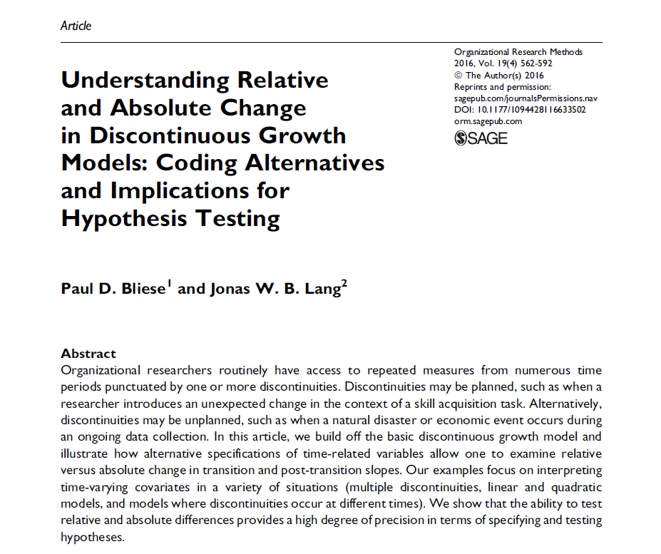
Summary Resources
Coding Discontinuous Growth Models

Slide 248
State-Level GDP Change
Notes:
library(lattice)
xyplot(gdp1k~I(TIME+1997)|as.factor(Area),
data=gdp.univ[1:240,],
layout = c(4,4),
type=c("p","g"),cex=1.2,pch=20,
col="black",
xlab=list("YEAR",cex=1.5),
ylab=list("GDP / 100K",cex=1.5))

Slide 249
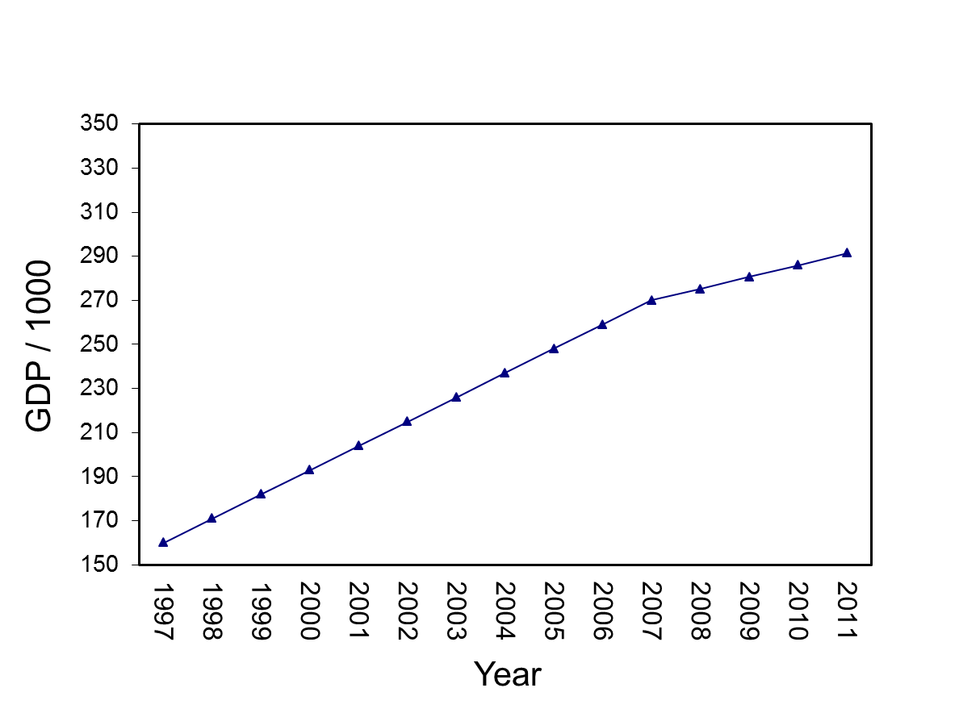
State-Level GDP Change
Notes:
TDAT<-gdp.univ[1:15,c("TIME","Trans","Recov")]
quantile(pinc[,2],c(.33,.66))/1000
median(pinc[,2])/1000
TDAT$Pinc20081k=149324.7
write.table(t(predict(mod4,TDAT,level=0)),file="clipboard", sep="\t",col.names=F,row.names=F)

Slide 250
State-Level GDP Change
Notes:
TDAT<-gdp.univ[1:15,c("TIME","Trans","Recov")]
quantile(pinc[,2],c(.33,.66))/1000
median(pinc[,2])/1000
TDAT$Pinc20081k=149324.7
write.table(t(predict(mod4,TDAT,level=0)),file="clipboard", sep="\t",col.names=F,row.names=F)

Slide 251
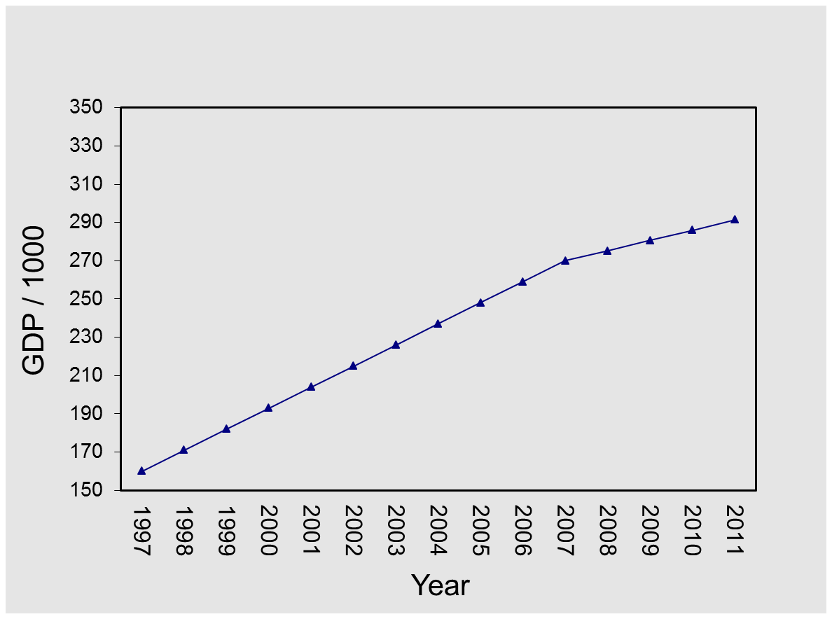
State-Level GDP Change
Questions we can ask
1. What is the overall pattern (pre-transition slope, transition change, post-transition slope) over time?
2. Are there differences in overall levels of GDP (intercept)?
3. Do States differ on pre-transition slopes, transition change, post-transition slopes?
4. What State-level variables predict pre-transition slope, transition change, post-transition slope?
Notes:
TDAT<-gdp.univ[1:15,c("TIME","Trans","Recov")]
quantile(pinc[,2],c(.33,.66))/1000
median(pinc[,2])/1000
TDAT$Pinc20081k=149324.7
write.table(t(predict(mod4,TDAT,level=0)),file="clipboard", sep="\t",col.names=F,row.names=F)

Slide 252
Sleep Example
Bliese, McGurk, Thomas, Balkin & Wesensten (2007)

Slide 253
Adaptability & Task-Change Paradigm
Lang & Bliese (2009)
Notes:
######### using 5,5,5,5,5,5 instead of zeros for PERIOD1XC
soardata[1:12,c("PERIOD1C","TRANSC","PERIOD2C","PERIOD1XC")]
tmod3<-lme(score~PERIOD1C+TRANSC+PERIOD2C+I(PERIOD1XC^2)+I(PERIOD2C^2)+GMF+
PERIOD1C:GMF+TRANSC:GMF+PERIOD2C:GMF+I(PERIOD1XC^2):GMF+
I(PERIOD2C^2):GMF,random=~1|ID,data=soardata)
summary(tmod3)$tTable
#Low
TDAT<-data.frame(GMF=-1,soardata[1:12,c("PERIOD1C","TRANSC","PERIOD2C","PERIOD1XC")])
VALS<-predict(tmod3,TDAT,level=0)
write.table(t(VALS),file="clipboard",sep="\t",row.names=F,col.names=F)
#Average
TDAT<-data.frame(GMF=0,soardata[1:12,c("PERIOD1C","TRANSC","PERIOD2C","PERIOD1XC")])
VALS<-predict(tmod3,TDAT,level=0)
write.table(t(VALS),file="clipboard",sep="\t",row.names=F,col.names=F)
#High
TDAT<-data.frame(GMF=1,soardata[1:12,c("PERIOD1C","TRANSC","PERIOD2C","PERIOD1XC")])
VALS<-predict(tmod3,TDAT,level=0)
write.table(t(VALS),file="clipboard",sep="\t",row.names=F,col.names=F)

Slide 254
Banking Sleep
Rupp, Wesensten, Bliese & Balkin (2009)

Slide 255

Firm Productivity: Great Recession

Slide 256
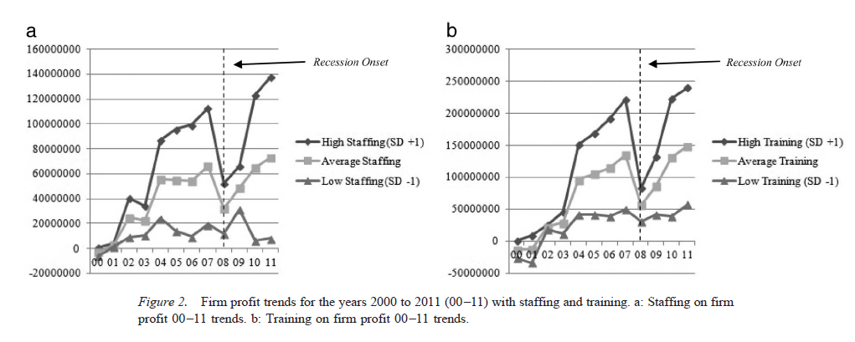
Firm Productivity: Great Recession

Slide 257
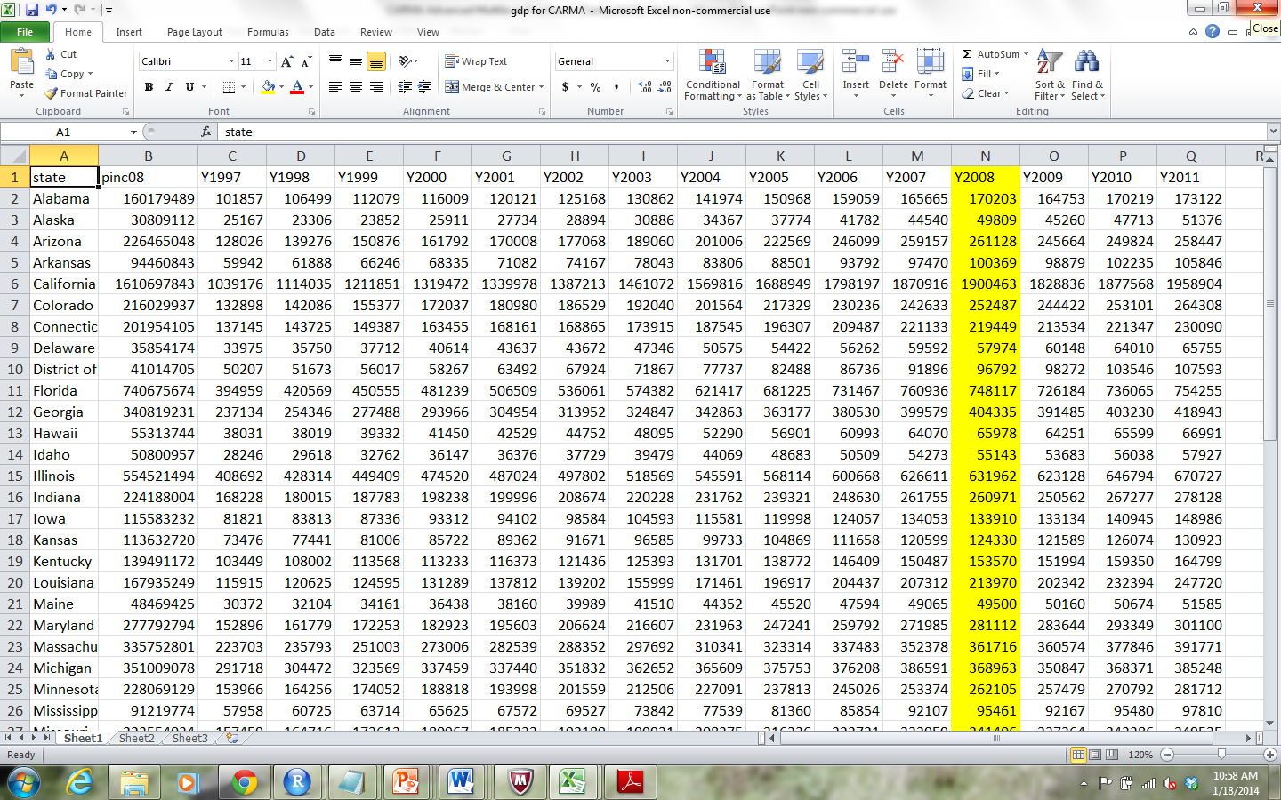
GDP Example
State-level GDP for 15 years (1997-2011)
In 1998, “Great Recession”

Slide 258
Growth Modeling Setup
Read data into R:
Copy data in EXCEL (Ctrl-C) “Discontinuous Growth State GDP 1997 to 2011.xlsx”
Paste into R with commands below
> gdpdata<-read.table(file="clipboard",sep="\t",header=T)
> names(gdpdata)
[1] "state" "pinc08" "Y1997" "Y1998" "Y1999" "Y2000"
[7] "Y2001" "Y2002" "Y2003" "Y2004" "Y2005" "Y2006"
[13] "Y2007" "Y2008" "Y2009" "Y2010" "Y2011"
> #For MAC users
> gdpdata<-read.table(pipe("pbpaste"),sep="\t",header=T)

Slide 259
Convert Data to Univariate Form
> names(gdpdata)
[1] "state" "pinc08" "Y1997" "Y1998" "Y1999" "Y2000"
[7] "Y2001" "Y2002" "Y2003" "Y2004" "Y2005" "Y2006"
[13] "Y2007" "Y2008" "Y2009" "Y2010" "Y2011"
> library(multilevel)
> gdpdata.univ<-make.univ(gdpdata,gdpdata[,3:17],
outname="gdp")

Slide 260
gdp 1997-2011: Alabama
> gdpdata.univ[1:15,c(1:5,18:19)]
state pinc08 Y1997 Y1998 Y1999 TIME gdp
1 Alabama 160179489 101857 106499 112079 0 101857
1.1 Alabama 160179489 101857 106499 112079 1 106499
1.2 Alabama 160179489 101857 106499 112079 2 112079
1.3 Alabama 160179489 101857 106499 112079 3 116009
1.4 Alabama 160179489 101857 106499 112079 4 120121
1.5 Alabama 160179489 101857 106499 112079 5 125168
1.6 Alabama 160179489 101857 106499 112079 6 130862
1.7 Alabama 160179489 101857 106499 112079 7 141974
1.8 Alabama 160179489 101857 106499 112079 8 150968
1.9 Alabama 160179489 101857 106499 112079 9 159059
1.10 Alabama 160179489 101857 106499 112079 10 165665
1.11 Alabama 160179489 101857 106499 112079 11 170203
1.12 Alabama 160179489 101857 106499 112079 12 164753
1.13 Alabama 160179489 101857 106499 112079 13 170219
1.14 Alabama 160179489 101857 106499 112079 14 173122

Slide 261
Growth Modeling Setup
“Discontinuous Growth Exercises”
Exercise 1: Growth Modeling Data Setup. Transform sleep data from “flat” to “stacked” format (Sleep actigraph 26 day.xls).

Slide 262
Coding for discontinuity
Discontinuous Growth Models

Slide 263
Coding for Discontinuity
Purpose
Detail how to add additional TIME variables to code for discontinuity
Use the State GDP data to illustrate setting up the specific variables

Slide 264
Make GDP more Manageable by Dividing by 1000
> gdpdata.univ[1:16,
c("state","TIME","gdp")]
state TIME gdp
1 Alabama 0 101857
1.1 Alabama 1 106499
1.2 Alabama 2 112079
1.3 Alabama 3 116009
1.4 Alabama 4 120121
1.5 Alabama 5 125168
1.6 Alabama 6 130862
1.7 Alabama 7 141974
1.8 Alabama 8 150968
1.9 Alabama 9 159059
1.10 Alabama 10 165665
1.11 Alabama 11 170203
1.12 Alabama 12 164753
1.13 Alabama 13 170219
1.14 Alabama 14 173122
2 Alaska 0 25167
> gdpdata.univ$gdp1k<-
gdpdata.univ$gdp/1000
> gdpdata.univ[1:10,
c("state","TIME","gdp","gdp1k")]
state TIME gdp gdp1k
1 Alabama 0 101857 101.857
1.1 Alabama 1 106499 106.499
1.2 Alabama 2 112079 112.079
1.3 Alabama 3 116009 116.009
1.4 Alabama 4 120121 120.121
1.5 Alabama 5 125168 125.168
1.6 Alabama 6 130862 130.862
1.7 Alabama 7 141974 141.974
1.8 Alabama 8 150968 150.968
1.9 Alabama 9 159059 159.059

Slide 265
State-Level GDP Change
Notes:
library(lattice)
xyplot(gdp1k~I(TIME+1997)|as.factor(Area),
data=gdp.univ[1:240,],
layout = c(4,4),
type=c("p","g"),cex=1.2,pch=20,
col="black",
xlab=list("YEAR",cex=1.5),
ylab=list("GDP / 100K",cex=1.5))

Slide 266
Create Time-Related Covariates
The basic linear growth model includes TIME
Additional TIME-based covariates describe other forms of continuous change (e.g., quadratic)
> tmod<-lme(gdp1k~TIME,random=~1|state,gdpdata.univ, control=list(opt="optim"))
> round(summary(tmod)$tTable,dig=3)
Value Std.Error DF t-value p-value
(Intercept) 163.152 39.078 713 4.175 0
TIME 9.744 0.477 713 20.436 0
> tmod<-lme(gdp1k~TIME+I(TIME^2),random=~1|state,gdpdata.univ, control=list(opt="optim"))
> round(summary(tmod)$tTable,dig=3)
Value Std.Error DF t-value p-value
(Intercept) 158.593 39.259 712 4.040 0.000
TIME 11.848 1.803 712 6.573 0.000
I(TIME^2) -0.150 0.124 712 -1.210 0.227

Slide 267
16 States: Linear

Slide 268
Create Time-Related Covariates
Discontinuity is captured by adding additional TIME-based covariates
Break time into segments
The discontinuous growth model we consider uses three TIME-based covariates to capture
Pre-discontinuity slope (TIME)
Change at the transition (TRANS)
Post-discontinuity transition slope (RECOV)

Slide 269
Create Time-Related Covariates
TRANS
RECOV
TIME
Notes:
TDAT<-gdp.univ[1:15,c("TIME","Trans","Recov")]
quantile(pinc[,2],c(.33,.66))/1000
median(pinc[,2])/1000
TDAT$Pinc20081k=149324.7
write.table(t(predict(mod4,TDAT,level=0)),file="clipboard", sep="\t",col.names=F,row.names=F)

Slide 270
Create Time-Related Covariates
The TIME-based covariate for the Transition (TRANS) is a dummy-coded variable
Pre-transition coded as 0
Post-transition coded as 1
In our example, 2008 is the year of discontinuity
TIME 0 to 10 (1997 to 2007) is pre-recession
TIME 11 to 14 (2008 to 2011) is post-recession
The ifelse function in R can be used to efficiently create the TRANS variable
gdpdata.univ$TRANS<-ifelse(gdpdata.univ$TIME>10,1,0)

Slide 271
Create Time-Related Covariates
The TIME-based covariate for the recovery slope (RECOV) is a combination of dummy and continuous
Pre-transition coded as 0
Post-transition slope coded 0 to n-1 post transition observations
In our example
TIME 0 to 10 (1997 to 2007) coded as 0
TIME 11 to 14 (2008 to 2011) coded 0,1,2,3
R code subtracts 11 from TIME (step1) and then changes negative numbers to 0 (step 2)
> gdpdata.univ$RECOV<-gdpdata.univ$TIME-11
> gdpdata.univ$RECOV[gdpdata.univ$RECOV<0]<-0

Slide 272
Create Time-Related Covariates
> gdpdata.univ[1:15,c("state","TIME","TRANS","RECOV")]
state TIME TRANS RECOV
1 Alabama 0 0 0
1.1 Alabama 1 0 0
1.2 Alabama 2 0 0
1.3 Alabama 3 0 0
1.4 Alabama 4 0 0
1.5 Alabama 5 0 0
1.6 Alabama 6 0 0
1.7 Alabama 7 0 0
1.8 Alabama 8 0 0
1.9 Alabama 9 0 0
1.10 Alabama 10 0 0
1.11 Alabama 11 1 0
1.12 Alabama 12 1 1
1.13 Alabama 13 1 2
1.14 Alabama 14 1 3

Slide 273
Creating Time-Related Covariates
“Discontinuous Growth Exercises”
Exercise 2: Create Time-Related Covariates in the sleep data

Slide 274
Analyzing and interpreting models
Discontinuous Growth Models

Slide 275
Analyzing and Interpreting Models
Purpose
Identify Model Building Steps
Interpreting Model Parameters
Examining Alternative Specifications

Slide 276
Model Building Steps
Notes on optimization in lme function
Build Level-1 Model (Bliese & Ployhart, 2002)
Step 1: Estimate the ICC
Step 2: Examine Fixed Effects for:
TIME
TRANS
RECOV
Step 3: Examine Variability in Growth Parameters
Step 4: Model autocorrelation
Step 5: Contrast Alternative Models
Build Level-2 Model (step 6)
Add level-2 predictors (Level-2)

Slide 277
Optimization
The lme function uses two different routines in the stats package for optimization
The function optim
The function nlmimb
The default after versions 2.2 of R has been nlmimb
Very precise
Less robust than optim
Complex models sometimes fail to converge with the default nlmimb so we will use the optim function
> My.Model<-lme(DV~IV, random=~IV|GRP,
data=MYDATA, control=list(opt="optim"))

Slide 278
Step 1: ICC estimate
ICC values are important to estimate
In this example, the ICC value is extremely high (0.94) working against finding discontinuous effects
Large differences across States
Low within-State variability
> null.mod<-lme(gdp1k~1,random=~1|state,gdpdata.univ, control=list(opt="optim"))
> VarCorr(null.mod)
state = pdLogChol(1)
Variance StdDev
(Intercept) 76969.042 277.43295
Residual 5140.942 71.70036
> 76969.042/(76969.042+5140.942)
[1] 0.9373896

Slide 279
Step 2 in Modeling
In one block examine fixed effects associated with
TIME
TRANS
RECOV
Only TIME is significant (but we will continue to examine data)
> mod2<-lme(gdp1k~TIME+TRANS+RECOV,random=~1|state,
gdpdata.univ,control=list(opt="optim"))
> round(summary(mod2)$tTable,dig=4)
Value Std.Error DF t-value p-value
(Intercept) 158.7940 39.1391 711 4.0572 0.0001
TIME 10.8671 0.7594 711 14.3098 0.0000
TRANS -5.4987 8.4224 711 -0.6529 0.5141
RECOV -5.0914 3.6421 711 -1.3980 0.1626

Slide 280
Interpreting Step 2
In 1997 (TIME 0), the average level of GDP across the 51 States was 158794 (158.794*1000)
GDP increased by 10867.129 each year
GDP dropped by 5498.661 in 2008 (relative to expected increase)
Recovery slope of -5091.427 indicates the recovery slope is weaker than the slope associated with the period before 2008 (but still positive)
> mod2<-lme(gdp1k~TIME+TRANS+RECOV,random=~1|state,
gdpdata.univ,control=list(opt="optim"))
> round(summary(mod2)$tTable,dig=4)
Value Std.Error DF t-value p-value
(Intercept) 158.7940 39.1391 711 4.0572 0.0001
TIME 10.8671 0.7594 711 14.3098 0.0000
TRANS -5.4987 8.4224 711 -0.6529 0.5141
RECOV -5.0914 3.6421 711 -1.3980 0.1626

Slide 281
Create Time-Related Covariates
Recovery slope 5091.427
Less than original slope
TRANS
RECOV
Drop of 5498.661
TIME
10867.129 yearly increase
GDP at Time 0
equals 158794
Notes:
TDAT<-gdp.univ[1:15,c("TIME","Trans","Recov")]
quantile(pinc[,2],c(.33,.66))/1000
median(pinc[,2])/1000
TDAT$Pinc20081k=149324.7
write.table(t(predict(mod4,TDAT,level=0)),file="clipboard", sep="\t",col.names=F,row.names=F)

Slide 282
Step 3: Modeling State Variability
Examine potential variability in time-based parameters
Add random slopes one at a time and contrast models
Best fit for model with random slopes for TIME, TRANS and RECOV
Suggests significant variability in all Time related parameters across States
> mod3.a<-update(mod2,random=~TIME|state)
> mod3.b<-update(mod3.a,random=~TIME+TRANS|state)
> mod3.c<-update(mod3.b,random=~TIME+TRANS+RECOV|state)
> anova(mod2,mod3.a,mod3.b,mod3.c)
Model df AIC BIC logLik Test L.Ratio p-value
mod2 1 6 8641.864 8669.671 -4314.932
mod3.a 2 8 6683.111 6720.189 -3333.556 1 vs 2 1962.7521 <.0001
mod3.b 3 11 6540.190 6591.171 -3259.095 2 vs 3 148.9212 <.0001
mod3.c 4 15 6379.728 6449.247 -3174.864 3 vs 4 168.4627 <.0001

Slide 283
State-Level GDP Change
Notes:
library(lattice)
xyplot(gdp1k~I(TIME+1997)|as.factor(Area),
data=gdp.univ[1:240,],
layout = c(4,4),
type=c("p","g"),cex=1.2,pch=20,
col="black",
xlab=list("YEAR",cex=1.5),
ylab=list("GDP / 100K",cex=1.5))

Slide 284
Step 3: Modeling State Variability
Contrast models with fixed slopes vs random slopes
Both models convey that parameters are variable
one through large SE’s
one showing significant variability among States
> round(summary(mod2)$tTable,dig=4)
Value Std.Error DF t-value p-value
(Intercept) 158.7940 39.1391 711 4.0572 0.0001
TIME 10.8671 0.7594 711 14.3098 0.0000
TRANS -5.4987 8.4224 711 -0.6529 0.5141
RECOV -5.0914 3.6421 711 -1.3980 0.1626
> round(summary(mod3.c)$tTable,dig=4)
Value Std.Error DF t-value p-value
(Intercept) 158.7940 26.1591 711 6.0703 0.0000
TIME 10.8671 1.9922 711 5.4550 0.0000
TRANS -5.4987 2.2932 711 -2.3978 0.0168
RECOV -5.0914 1.4221 711 -3.5803 0.0004

Slide 285
Step 4: Testing for Autocorrelation
Up to now, models assume independent errors in the covariance structure of the data.
No pattern to level-1 model residuals
Assumption of independent errors is rarely supported when dealing with repeated measures over time.
As Littell, Milliken, Stroup, and Wolfinger (1996) note, “measurements taken at adjacent times are typically more highly correlated than two measurements taken several time points apart” (p. 88).

Slide 286
Step 4: Testing for Autocorrelation
The correlation option in lme specifies alternative within-group correlation structures.
A common structure is corAR1() or first-order autoregressive
Update mod3.c and contrasting the -2 log likelihood values between the two models
Notice 1 df difference for the estimate of phi in mod4
> mod4<-update(mod3.c,correlation=corAR1(form=~TIME|state))
> anova(mod3.c,mod4)
Model df AIC BIC logLik Test L.Ratio p-value
mod3.c 1 15 6379.728 6449.247 -3174.864
mod4 2 16 6095.525 6169.679 -3031.762 1 vs 2 286.2027 <.0001

Slide 287
Step 4: Testing for Autocorrelation
> summary(mod4)
Linear mixed-effects model fit by REML
Data: gdpdata.univ
AIC BIC logLik
6095.525 6169.679 -3031.762
Random effects:
Formula: ~TIME + TRANS + RECOV | state
Structure: General positive-definite, Log-Cholesky parametrization
StdDev Corr
(Intercept) 186.470614 (Intr) TIME TRANS
TIME 14.288536 0.986
TRANS 9.254378 -0.948 -0.898
RECOV 8.739618 -0.989 -0.988 0.931
Residual 19.332704
Correlation Structure: AR(1)
Formula: ~TIME | state
Parameter estimate(s):
Phi
0.8617861

Slide 288
Step 4: Testing for Autocorrelation
Contrast models with and without adjustment of lag-1 autocorrelation
Changes in both parameter estimates and SEs
> round(summary(mod3.c)$tTable,dig=4)
Value Std.Error DF t-value p-value
(Intercept) 158.7940 26.1591 711 6.0703 0.0000
TIME 10.8671 1.9922 711 5.4550 0.0000
TRANS -5.4987 2.2932 711 -2.3978 0.0168
RECOV -5.0914 1.4221 711 -3.5803 0.0004
> round(summary(mod4)$tTable,dig=4)
Value Std.Error DF t-value p-value
(Intercept) 159.9887 26.2454 711 6.0959 0.0000
TIME 11.0041 2.0288 711 5.4238 0.0000
TRANS -5.8089 1.9922 711 -2.9159 0.0037
RECOV -5.6020 1.5201 711 -3.6853 0.0002

Slide 289
Steps 1 to 4
“Discontinuous Growth Exercises”
Exercise 3:
Estimate ICC
Model TIME-related Fixed Effects
Model variability across level-2 units
Estimate lag-1 autocorrelation

Slide 290
Step 5: Contrasting Alternative Models
The parameters TIME, TRANS and RECOV represent a flexible discontinuous model
In some cases, however, discontinuity might be captured with two of the three parameters
TIME and TRANS
TIME and RECOV
The form of the discontinuity differs depending upon which parameters are included

Slide 291
Step 5: Contrasting Alternative Models
The model with TIME and TRANS has identical slopes pre and post-discontinuity:
> mod5.a<-lme(gdp1k~TIME+TRANS,
random=~TIME+TRANS|state, gdpdata.univ,
correlation=corAR1(form=~TIME|state),
control=list(opt="optim"))
> round(summary(mod5.a)$tTable,dig=4)
Value Std.Error DF t-value p-value
(Intercept) 162.9069 26.9315 712 6.0489 0.0000
TIME 9.8017 1.7721 712 5.5310 0.0000
TRANS -4.8805 1.9446 712 -2.5097 0.0123

Slide 292
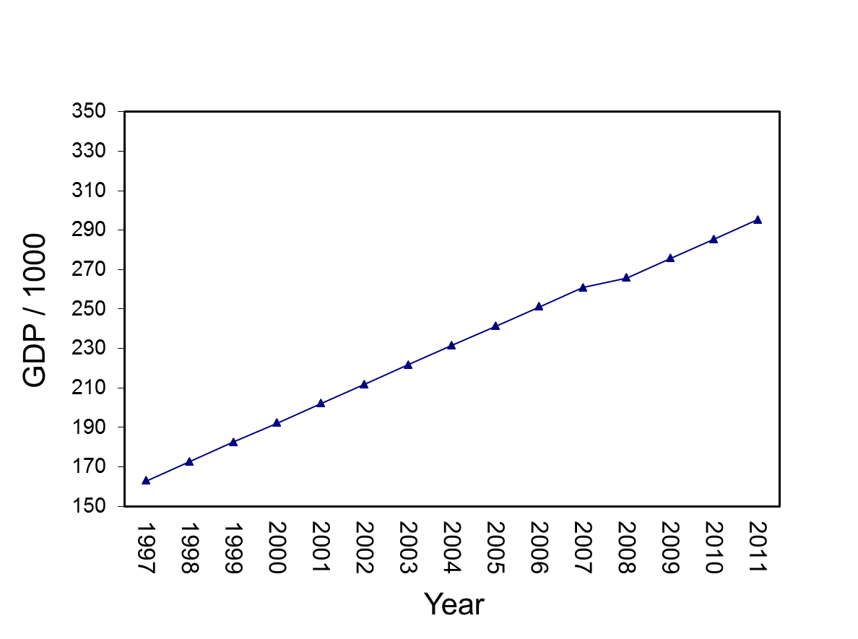
State-Level GDP Change
TRANS
Drop of 4880.5
Slopes are equal
Notes:
TDAT<-gdpdata.univ[1:15,c("TIME","TRANS","RECOV")]
write.table(t(predict(mod5.a,TDAT,level=0)),file="clipboard", sep="\t",col.names=F,row.names=F)

Slide 293
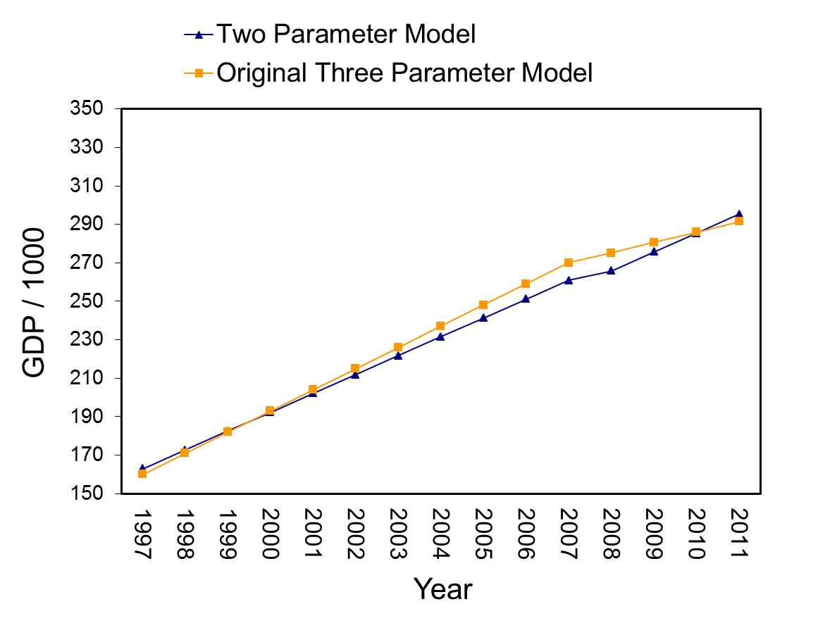
State-Level GDP Change
Notes:
TDAT<-gdpdata.univ[1:15,c("TIME","TRANS","RECOV")]
write.table(t(predict(mod5.a,TDAT,level=0)),file="clipboard", sep="\t",col.names=F,row.names=F)

Slide 294
Step 5: Contrasting Alternative Models
The model with TIME and RECOV has a change in slope pre and post-discontinuity
Excludes a parameter for a drop or increase at a specific time (2008):
> mod5.b<-lme(gdp1k~TIME+RECOV,
random=~TIME+RECOV|state, gdpdata.univ,
correlation=corAR1(form=~TIME|state),
control=list(opt="optim"))
> round(summary(mod5.b)$tTable,dig=4)
Value Std.Error DF t-value p-value
(Intercept) 161.1470 26.4624 712 6.0897 0e+00
TIME 10.5338 1.9364 712 5.4399 0e+00
RECOV -5.3337 1.5104 712 -3.5314 4e-04

Slide 295
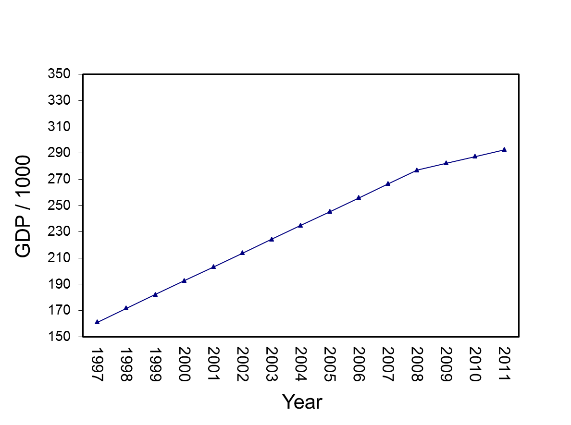
State-Level GDP Change
Change in Slope:
No drop/increase
Slopes are unequal
Notes:
TDAT<-gdpdata.univ[1:15,c("TIME","TRANS","RECOV")]
write.table(t(predict(mod5.b,TDAT,level=0)),file="clipboard", sep="\t",col.names=F,row.names=F)

Slide 296

State-Level GDP Change
Notes:
TDAT<-gdpdata.univ[1:15,c("TIME","TRANS","RECOV")]
write.table(t(predict(mod5.a,TDAT,level=0)),file="clipboard", sep="\t",col.names=F,row.names=F)

Slide 297
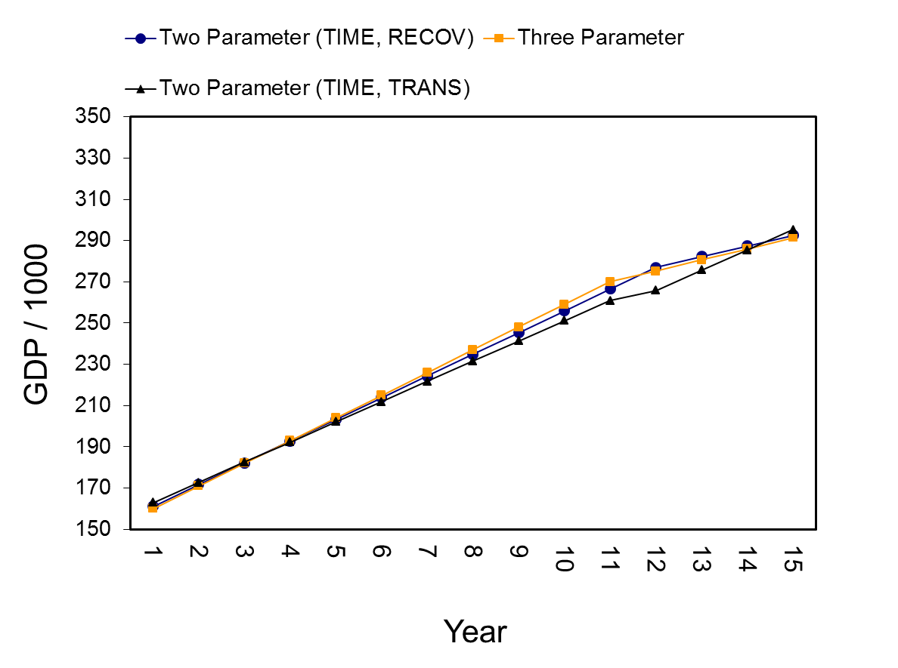
State-Level GDP Change
Notes:
TDAT<-gdpdata.univ[1:15,c("TIME","TRANS","RECOV")]
write.table(t(predict(mod5.a,TDAT,level=0)),file="clipboard", sep="\t",col.names=F,row.names=F)

Slide 298
Step 5: Picking Alternative Models
Alternative models have different predictors so comparisons of -2 log likelihood values is not appropriate
Default is Restricted-Maximum Likelihood (REML)
With REML, -2 log likelihood contrasts should be used only on random effects
May to useful to examine:
Akaike’s Information Criterion (AIC)
Bayesian Information Criterion (BIC)
Smaller is better
Can contrast values across non-nested models

Slide 299
Step 5: Picking Alternative Models
Akaike’s Information Criterion (AIC)
Formula: 2k – (2 * (logLik))
Bayesian Information Criterion (BIC)
Formula (large n approx): -2 * logLik + k * log(n)
> logLik(mod5.a)
'log Lik.' -3091.293 (df=11)
> AIC(mod5.a)
[1] 6204.586
> (2*11)-(2*(-3091.293))
[1] 6204.586
> BIC(mod5.a)
[1] 6255.581
> -2*-3091.293+11*log(765)
[1] 6255.625

Slide 300
Step 5: Picking Alternative Models
The BIC carries more of a penalty for additional parameters (k) than does the AIC
Practically speaking, this means that the BIC will favor simpler models

Slide 301
Step 5: Picking Alternative Models
Models:
Three parameter model (mod4)
TIME, TRANS (mod5.a)
TIME, RECOV (mod5.b)
Three parameter model (mod4) is best choice:
Lowest AIC
Lowest BIC
BIC for mod4 and mod5.b similar
> AIC(mod4)
[1] 6095.525
> BIC(mod4)
[1] 6169.679
>
> AIC(mod5.a)
[1] 6204.586
> BIC(mod5.a)
[1] 6255.581
>
> AIC(mod5.b)
[1] 6133.767
> BIC(mod5.b)
[1] 6184.763

Slide 302
Step 5 Exercise
“Discontinuous Growth Exercises”
Exercise 4:
Model Alternative Model 1 (TIME and TRANS)
Model Alternative Model 2 (TIME and RECOV)
Contrast
Three parameter models with two parameter models

Slide 303
Step 6: Adding Level-2 Predictors
The final step in discontinuous growth modeling is to add level-2 predictors of all the parameters found to randomly vary
In the GDP example, there are State-level differences in:
Intercepts (e.g., mean levels of GDP)
Pre-transition slope (TIME)
Change at the transition point (TRANS)
Post-transition slope (RECOV)

Slide 304
Step 6: Modeling State Variability
States vary on every parameter
> null.mod<-lme(gdp1k~1,random=~1|state,gdpdata.univ, control=list(opt="optim"))
> VarCorr(null.mod)
state = pdLogChol(1)
Variance StdDev
(Intercept) 76969.042 277.43295
Residual 5140.942 71.70036
> 76969.04/(76969.04+5140.942)
[1] 0.9373896
> mod3.a<-update(mod2,random=~TIME|state)
> mod3.b<-update(mod3.a,random=~TIME+TRANS|state)
> mod3.c<-update(mod3.b,random=~TIME+TRANS+RECOV|state)
> anova(mod2,mod3.a,mod3.b,mod3.c)
Model df AIC BIC logLik Test L.Ratio p-value
mod2 1 6 8641.864 8669.671 -4314.932
mod3.a 2 8 6683.111 6720.189 -3333.556 1 vs 2 1962.7521 <.0001
mod3.b 3 11 6540.190 6591.171 -3259.095 2 vs 3 148.9212 <.0001
mod3.c 4 15 6379.728 6449.247 -3174.864 3 vs 4 168.4627 <.0001

Slide 305
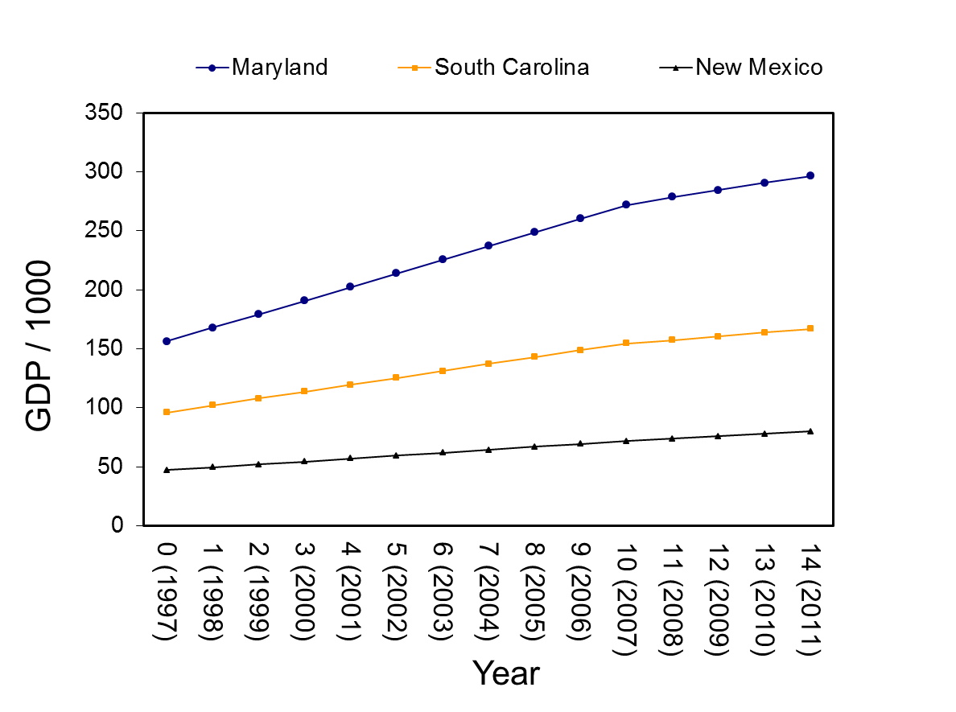
Visualizing State-Level Variability
Notes:
TDAT<-gdpdata.univ[1:15,c("TIME","TRANS","RECOV")]
TDAT$state="Maryland"
write.table(t(predict(mod4,TDAT,level=1)),file="clipboard", sep="\t",col.names=F,row.names=F)
####
TDAT<-gdpdata.univ[1:15,c("TIME","TRANS","RECOV")]
TDAT$state="South Carolina"
write.table(t(predict(mod4,TDAT,level=1)),file="clipboard", sep="\t",col.names=F,row.names=F)
####
TDAT<-gdpdata.univ[1:15,c("TIME","TRANS","RECOV")]
TDAT$state="New Mexico"
write.table(t(predict(mod4,TDAT,level=1)),file="clipboard", sep="\t",col.names=F,row.names=F)

Slide 306
Step 6: Modeling State Variability
Predicting Intercept Variability
State-Level Average Personal Income in 2008 (pinc08)
Average Personal Income related to State GDP
> mod6.a<-lme(gdp1k~TIME+TRANS+RECOV+pinc08,
random=~TIME+TRANS+RECOV|state, gdpdata.univ,
correlation=corAR1(form=~TIME|state),
control=list(opt="optim"))
> round(summary(mod6.a)$tTable,dig=4)
Value Std.Error DF t-value p-value
(Intercept) -59.1073 11.2495 711 -5.2542 0.0000
TIME 10.9638 2.0116 711 5.4503 0.0000
TRANS -5.7022 1.8716 711 -3.0468 0.0024
RECOV -5.4556 1.5095 711 -3.6142 0.0003
pinc08 0.0000 0.0000 49 99.1366 0.0000

Slide 307
Step 6: Modeling State Variability
Parameters and SE are all zero, so rescale pinc08 by dividing by 100,000 (pinc08.100k)
Average Personal Income in a State is a strong predictor of State GDP
> gdpdata.univ$pinc08.100k<-gdpdata.univ$pinc08/100000
> mod6.a<-lme(gdp1k~TIME+TRANS+RECOV+pinc08.100k,
random=~TIME+TRANS+RECOV|state, gdpdata.univ,
correlation=corAR1(form=~TIME|state),
control=list(opt="optim"))
> round(summary(mod6.a)$tTable,dig=4)
Value Std.Error DF t-value p-value
(Intercept) -59.1073 11.2495 711 -5.2542 0.0000
TIME 10.9638 2.0116 711 5.4503 0.0000
TRANS -5.7022 1.8716 711 -3.0468 0.0024
RECOV -5.4556 1.5095 711 -3.6142 0.0003
pinc08.100k 0.0897 0.0009 49 99.1366 0.0000

Slide 308
Step 6: Modeling State Variability
Notice huge change in Intercept Variance
> VarCorr(mod4)
state = pdLogChol(TIME + TRANS + RECOV)
Variance StdDev Corr
(Intercept) 34771.28998 186.470614 (Intr) TIME TRANS
TIME 204.16225 14.288536 0.986
TRANS 85.64351 9.254378 -0.948 -0.898
RECOV 76.38092 8.739618 -0.989 -0.988 0.931
Residual 373.75345 19.332704
> VarCorr(mod6.a)
state = pdLogChol(TIME + TRANS + RECOV)
Variance StdDev Corr
(Intercept) 5939.46580 77.067930 (Intr) TIME TRANS
TIME 201.47367 14.194142 -0.982
TRANS 61.91886 7.868854 0.989 -0.961
RECOV 76.91601 8.770177 0.997 -0.970 0.991
Residual 286.09112 16.914228

Slide 309
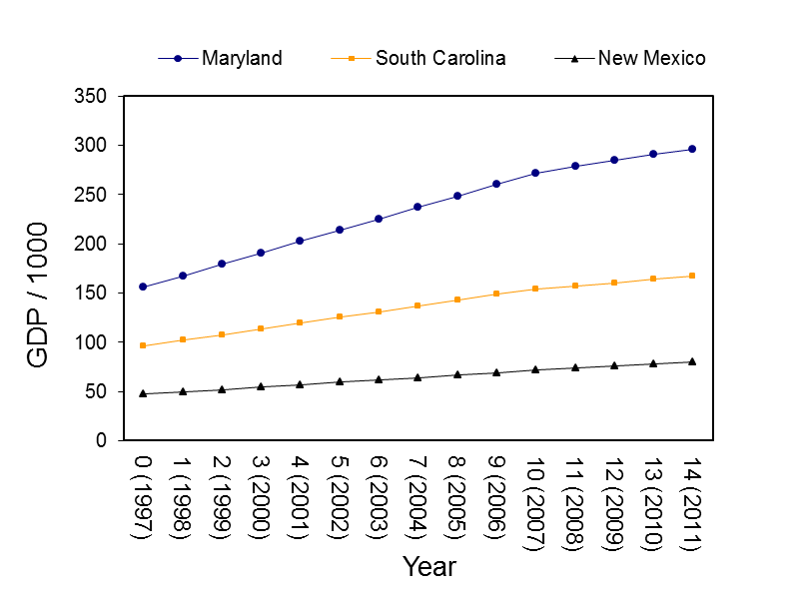
Step 6: Modeling Variability in Time-Based Parameters
Personal Income and State-Level variability in:
Pre-discontinuity slope (TIME)
Discontinuity (TRANS)
Post-discontinuity slope (RECOV)

Slide 310
Step 6: Modeling Variability in Time-Based Parameters
> mod6.b<-lme(gdp1k~TIME*pinc08.100k+
TRANS*pinc08.100k+RECOV*pinc08.100k,
random=~TIME+TRANS+RECOV|state, gdpdata.univ,
correlation=corAR1(form=~TIME|state),
control=list(opt="optim"))
> round(summary(mod6.b)$tTable,dig=4)
Value Std.Error DF t-value p-value
(Intercept) 4.0122 4.3978 708 0.9123 0.3619
TIME -0.8922 0.5077 708 -1.7574 0.0793
pinc08.100k 0.0638 0.0012 49 54.8118 0.0000
TRANS 1.5105 2.1745 708 0.6946 0.4875
RECOV 1.8000 1.1817 708 1.5232 0.1281
TIME:pinc08.100k 0.0048 0.0001 708 36.0762 0.0000
pinc08.100k:TRANS -0.0029 0.0006 708 -5.0823 0.0000
pinc08.100k:RECOV -0.0029 0.0003 708 -9.3703 0.0000

Slide 311
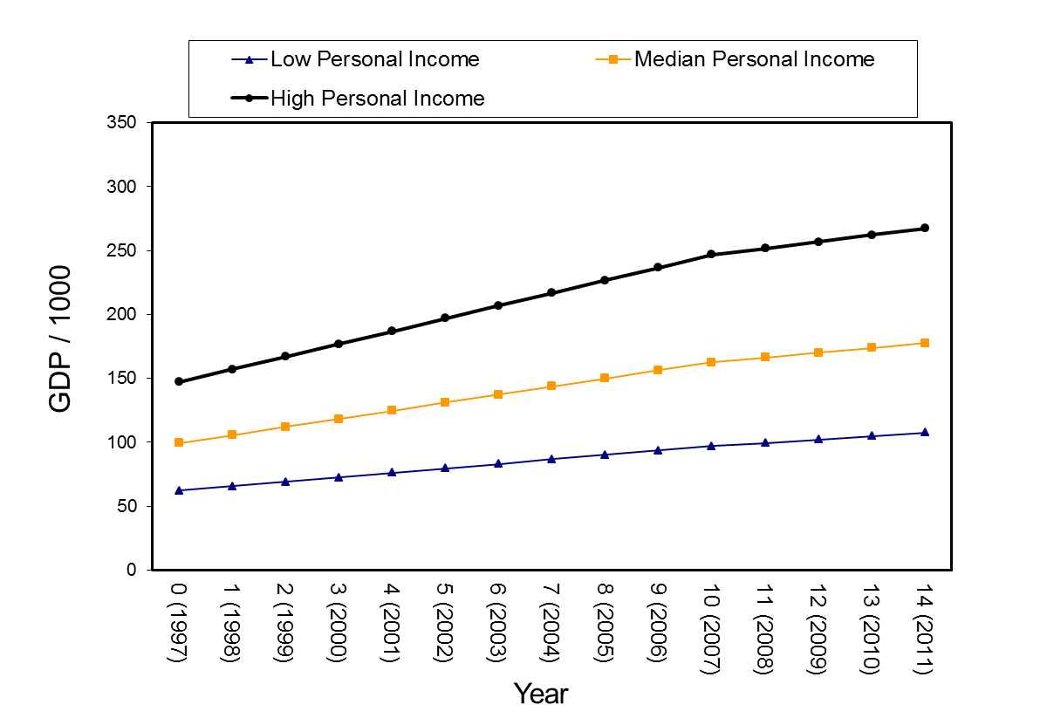
Step 6: Modeling Variability in Time-Based Parameters

Slide 312
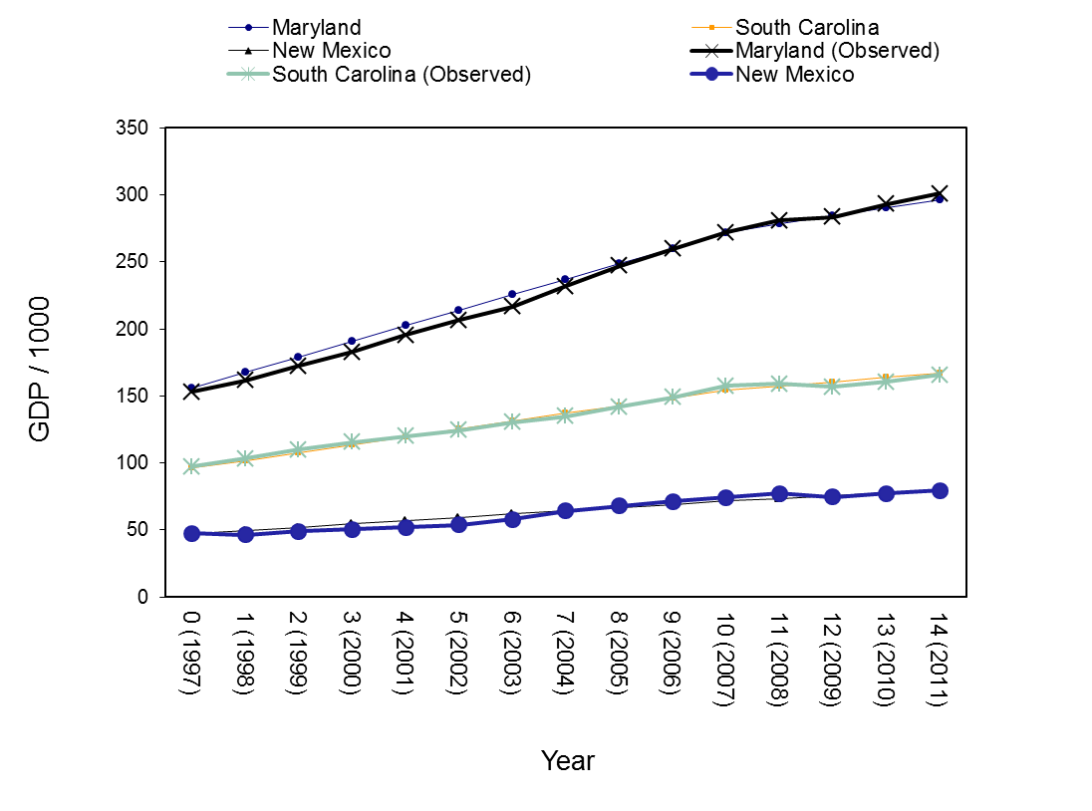
Step 6: Predicted Versus Observed

Slide 313
Step 6 Exercise
“Discontinuous Growth Exercises”
Exercise 5:
Model the Level-2 variable of AGE as a predictor of
Intercept variance
Time-varying parameter variances

Slide 314
Some Extensions
Material based on:
Bliese & Lang (in review). Modeling Relative and Absolute Change in Discontinuous Growth Models

Slide 315
Create Time-Related Covariates
> gdpdata.univ[1:15,c("state","TIME","TRANS","RECOV")]
state TIME TRANS RECOV
1 Alabama 0 0 0
1.1 Alabama 1 0 0
1.2 Alabama 2 0 0
1.3 Alabama 3 0 0
1.4 Alabama 4 0 0
1.5 Alabama 5 0 0
1.6 Alabama 6 0 0
1.7 Alabama 7 0 0
1.8 Alabama 8 0 0
1.9 Alabama 9 0 0
1.10 Alabama 10 0 0
1.11 Alabama 11 1 0
1.12 Alabama 12 1 1
1.13 Alabama 13 1 2
1.14 Alabama 14 1 3

Slide 316
Interpreting Step 2
In 1997 (TIME 0), the average level of GDP across the 51 States was 158794 (158.794*1000)
GDP increased by 10867.129 each year
GDP dropped by 5498.661 in 2008 (relative to expected increase)
Recovery slope of -5091.427 indicates the recovery slope is weaker than the slope associated with the period before 2008 (but still positive)
> mod.rel<-lme(gdp1k~TIME+TRANS+RECOV,
random=~TIME+TRANS+RECOV|state,
gdpdata.univ,control=list(opt="optim"))
> round(summary(mod.rel)$tTable,dig=3)
Value Std.Error DF t-value p-value
(Intercept) 158.794 26.159 711 6.070 0.000
TIME 10.867 1.992 711 5.455 0.000
TRANS -5.499 2.293 711 -2.398 0.017
RECOV -5.091 1.422 711 -3.580 0.000

Slide 317
Create Time-Related Covariates
Recovery slope 5091.427
Less than original slope
TRANS
RECOV
Drop of 5498.661
TIME
10867.129 yearly increase
GDP at Time 0
equals 158794
Notes:
TDAT<-gdp.univ[1:15,c("TIME","Trans","Recov")]
quantile(pinc[,2],c(.33,.66))/1000
median(pinc[,2])/1000
TDAT$Pinc20081k=149324.7
write.table(t(predict(mod4,TDAT,level=0)),file="clipboard", sep="\t",col.names=F,row.names=F)

Slide 318
Examining Absolute Change
The t-tests in the current models provide tests of relative change:
Is the drop at the transition point significant relative to what would be expected
Is the recovery slope different than the pre-change slope
What if our theory expected absolute change
The transition will lead to a significant absolute decline
The post-transition slope will be negative

Slide 319
Create Time-Related Covariates
> gdpdata.univ$TIME.A<-ifelse(gdpdata.univ$TIME>=10,10,gdpdata.univ$TIME)
> gdpdata.univ[1:15,c("state","TIME","TIME.A","TRANS","RECOV")]
state TIME TIME.A TRANS RECOV
1 Alabama 0 0 0 0
1.1 Alabama 1 1 0 0
1.2 Alabama 2 2 0 0
1.3 Alabama 3 3 0 0
1.4 Alabama 4 4 0 0
1.5 Alabama 5 5 0 0
1.6 Alabama 6 6 0 0
1.7 Alabama 7 7 0 0
1.8 Alabama 8 8 0 0
1.9 Alabama 9 9 0 0
1.10 Alabama 10 10 0 0
1.11 Alabama 11 10 1 0
1.12 Alabama 12 10 1 1
1.13 Alabama 13 10 1 2
1.14 Alabama 14 10 1 3

Slide 320
Interpreting Step 2
> mod.abs<-lme(gdp1k~TIME.A+TRANS+RECOV,random=~TIME+TRANS+RECOV|state,
gdpdata.univ,control=list(opt="optim"))
> round(summary(mod.abs)$tTable,dig=3)
Value Std.Error DF t-value p-value
(Intercept) 158.794 26.159 711 6.070 0.000
TIME.A 10.867 1.992 711 5.455 0.000
TRANS 5.368 2.130 711 2.520 0.012
RECOV 5.776 1.145 711 5.046 0.000
> mod.abs<-lme(gdp1k~TIME+TRANS+RECOV, random=~TIME+TRANS+RECOV|state,
gdpdata.univ,control=list(opt="optim"))
> round(summary(mod.rel)$tTable,dig=3)
Value Std.Error DF t-value p-value
(Intercept) 158.794 26.159 711 6.070 0.000
TIME 10.867 1.992 711 5.455 0.000
TRANS -5.499 2.293 711 -2.398 0.017
RECOV -5.091 1.422 711 -3.580 0.000

Slide 321
Some Extensions
Other models covered
Bliese & Lang (2016). Modeling Relative and Absolute Change in Discontinuous Growth Models

Slide 322
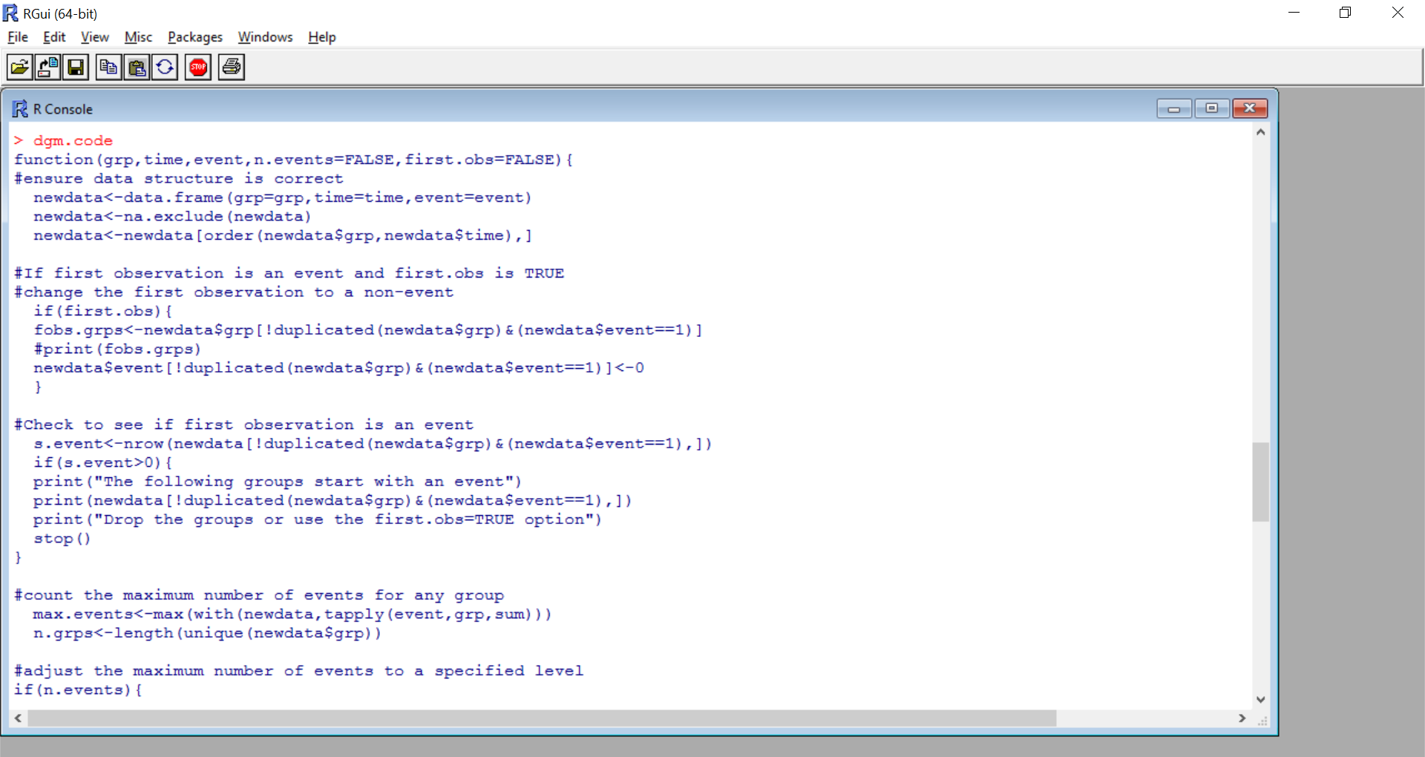
Some Extensions
Automating the process (dgm.code in multilevel library)

Slide 323
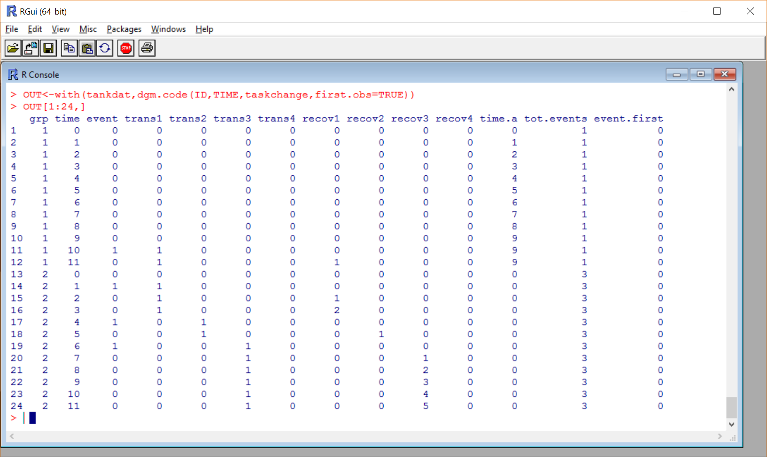
Some Extensions
Automating the process (dgm.code)

Slide 324
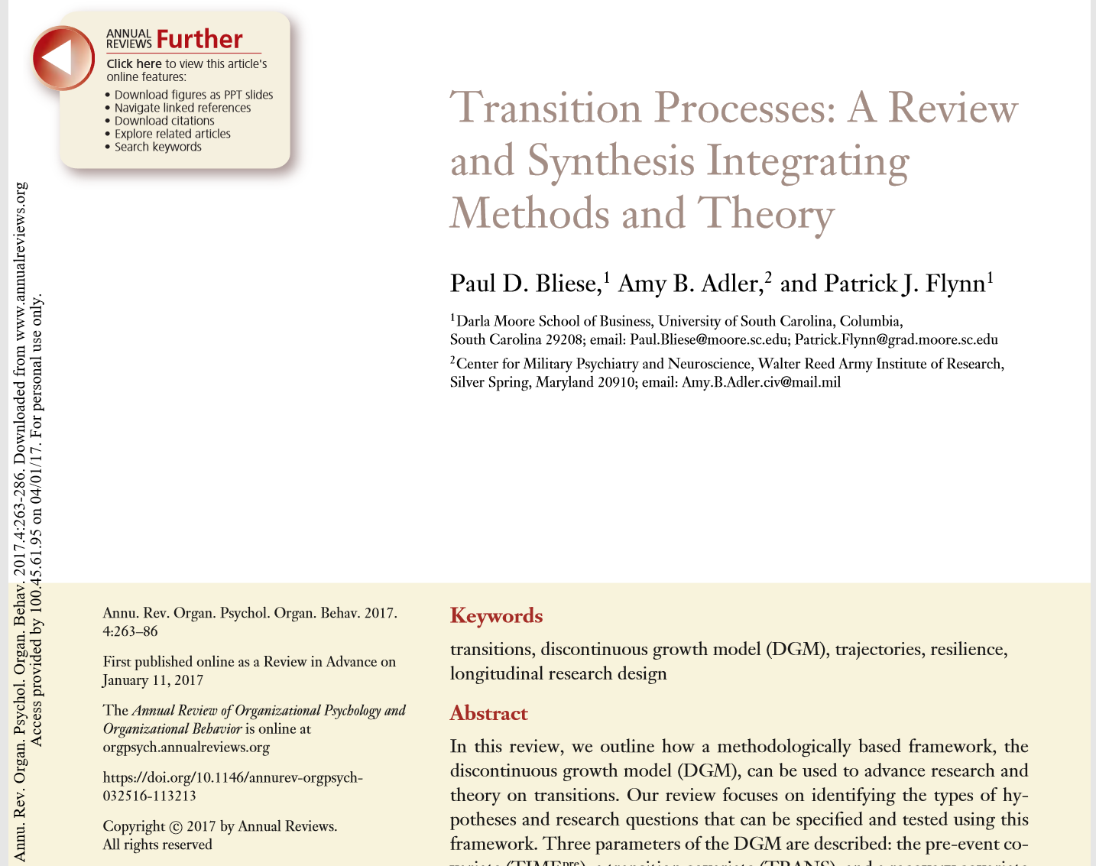
Some Extensions
Integrating methods and theory
Annual Review of Organizational Psychology and Organizational Behavior

Slide 325
Emergence Models
Basic Question
“Do group members’ feelings and perceptions become more similar or less similar over time?”
Proposed Method to:
Formally test and quantify whether consensus in groups emerges over a period in time
Understand how group member characteristics (e.g., being in a leadership role) relate to emergent tendencies within groups (Cronin & Weingart, 2011; Humphrey & Aime, 2014; Morgeson & Hofmann, 1999)
Study how unit-characteristics (e.g., baseline collective efficacy) predict consensus emergence over time.

Slide 326
Example 1
ICC(1) values of .03, .00, .25, .40, and .58 (Time 1-Time 5)
Time

Slide 327
Example 2
ICC(1) values of .01, .00, .19, .54, and .72 (Time 1-Time 5)

Slide 328
Sherif (1935)
Individuals made estimates of autokinetic light movement and there was a strong tendency for consensus over time.
Sherif attributed the change pattern in consensus to the group situation in which group members saw other group members’ estimates and then felt a need to move their own estimates into the direction of the others
Also tested the mechanism behind the effect by asking some groups/participants to first work on the task alone.

Slide 329
Growth Models and Variants
Lang & Bliese, (2018) analysis of Sherif (1935)
Data available in multilevel library version 2.6 for R

Slide 330
Growth Models and Variants
Lang & Bliese, (2018) analysis of Sherif (1935)
Data available in multilevel library version 2.6 for R
> threelevel<-lme(y ~ time,
random = list(group=pdLogChol(~time),person=pdIdent(~1)),
data=sherifdat,control=lmeControl(opt="optim",maxIter=3000,
msMaxIter=3000))
> threelevelCEM<-update(threelevel,weights=varExp( form = ~ time))
> anova(threelevel,threelevelCEM)
Model df AIC BIC logLik Test L.Ratio p-value
threelevel 1 7 182.3422 198.0817 -84.17112
threelevelCEM 2 8 155.8097 173.7977 -69.90485 1 vs 2 28.53253 <.0001

Slide 331
Growth Models and Variants
Lang & Bliese, (2018) analysis of Sherif (1935)
Data available in multilevel library version 2.6 for R
threelevelCEMwithcond<-lme(y ~ time*condition, random = list(group=pdLogChol(~time),
person=pdIdent(~1)),data=sherifdat,control=lmeControl(opt="optim",
optimMethod="L-BFGS-B",maxIter=3000,msMaxIter=3000),
weights=varExp( form = ~ time))
threelevelCEMwithPRED1<-lme(y ~ time*condition, random = list(group=pdLogChol(~time),
person=pdIdent(~1)),data=sherifdat,control=lmeControl(opt="optim",
optimMethod="L-BFGS-B",maxIter=3000,msMaxIter=3000),
weights=varComb(varExp( form = ~ time),varExp( form = ~ condition)))
threelevelCEMwithPRED2<-update(threelevelCEMwithPRED1,
weights=varComb(varExp( form = ~ time),varExp( form = ~ condition),
varExp( form = ~ time*condition)))
summary(threelevelCEMwithPRED2)
anova(threelevelCEMwithcond,threelevelCEMwithPRED1,threelevelCEMwithPRED2)
anova(threelevelCEMwithcond,threelevelCEMwithPRED2)

Slide 332
Growth Models and Variants
Lang & Bliese, (2018) analysis of Sherif (1935)
Data available in multilevel library version 2.6 for R
> summary(threelevelCEMwithPRED2)
Combination of variance functions:
Structure: Exponential of variance covariate
Formula: ~time
Parameter estimates:
expon
-1.210814
Structure: Exponential of variance covariate
Formula: ~condition
Parameter estimates:
expon
-0.7206653
Structure: Exponential of variance covariate
Formula: ~time * condition
Parameter estimates:
expon
0.5797531
Fixed effects: y ~ time * condition

Slide 333
Growth Models and Variants
Lang & Bliese, (2018) analysis of Sherif (1935)
Data available in multilevel library version 2.6 for R
> anova(threelevelCEMwithcond,threelevelCEMwithPRED1,threelevelCEMwithPRED2)
Model df AIC BIC logLik Test L.Ratio p-value
threelevelCEMwithcond 1 10 158.5739 180.7690 -69.28697
threelevelCEMwithPRED1 2 11 159.6696 184.0842 -68.83479 1 vs 2 0.904353 0.3416
threelevelCEMwithPRED2 3 12 157.7306 184.3647 -66.86531 2 vs 3 3.938967 0.0472
> anova(threelevelCEMwithcond,threelevelCEMwithPRED2)
Model df AIC BIC logLik Test L.Ratio p-value
threelevelCEMwithcond 1 10 158.5739 180.7690 -69.28697
threelevelCEMwithPRED2 2 12 157.7306 184.3647 -66.86531 1 vs 2 4.84332 0.0888

Slide 334
Growth Models and Variants
Lang, J. W. B., Bliese, P. D., & de Voogt, A. (2018)
T1 ICC(1) = .08
T2 ICC(1) = .02
T3 ICC(1) = .01
Notes:
> xyplot(JSAT~TIME|UNIT,univbct2[1:432,],
+ groups=SUBNUM,type=c("p","l"))
> tmod<-lme(JSAT~1,random=~1|UNIT,univbct2,subset=TIME==0,na.action=na.omit)
> VarCorr(tmod)
UNIT = pdLogChol(1)
Variance StdDev
(Intercept) 0.07743963 0.2782798
Residual 0.88796423 0.9423185
> 0.07743963/(0.07743963+0.88796423)
[1] 0.08021475
> tmod<-lme(JSAT~1,random=~1|UNIT,univbct2,subset=TIME==1,na.action=na.omit)
> VarCorr(tmod)
UNIT = pdLogChol(1)
Variance StdDev
(Intercept) 0.01812596 0.1346327
Residual 0.86234759 0.9286267
> 0.01812596/(0.01812596+0.86234759)
[1] 0.0205866
> tmod<-lme(JSAT~1,random=~1|UNIT,univbct2,subset=TIME==2,na.action=na.omit)
> VarCorr(tmod)
UNIT = pdLogChol(1)
Variance StdDev
(Intercept) 0.008336679 0.09130542
Residual 0.718433001 0.84760427
> 0.008336679/(0.008336679+0.718433001)
[1] 0.01147087
> M2a<-lme(JSAT ~ TIME, random = list(UNIT=pdSymm(~TIME),SUBNUM=pdIdent(~1)),
+ data = univbct2,na.action=na.omit,control=csettings)
> M2b<-update(M2a,weights=varExp( form = ~ TIME))
> anova(M2a,M2b)
Model df AIC BIC logLik Test L.Ratio p-value
M2a 1 7 3333.408 3369.858 -1659.704
M2b 2 8 3327.897 3369.554 -1655.949 1 vs 2 7.510725 0.0061

Slide 335

Growth Models and Variants
Lang, J. W. B., Bliese, P. D., & de Voogt, A. (2018)

Slide 336
Growth Models and Variants
Parameters | M2a | M2b
Army data, DV = Job satisfaction
Intercept, γ₀₀₀ | 3.26 | 3.26
TIME, γ₁₀₀ | 0.05 | 0.05
Group intercept variance, σ_{β00}² | 0.11 | 0.10
Group variance for TIME, σ_{β10}² | 0.01 | 0.01
Covariance, σ_{β00β10} | -0.03 | -0.02
Person intercept variance, σ_{π0}² | 0.38 | 0.38
Residual variance, σ_{e}² | 0.43 | 0.51
TIME, δ₁ |  | -0.10

Slide 337
Course Outline
Levels Introduction
Introduction to R
Estimating Multilevel Models in R
Aggregation: Agreement and Reliability
OLS Fixed Effect and Contextual Analyses
Mixed Effects Models (e.g., HLM)
Growth Modeling
Discontinuous Growth Modeling
Emergence Models

